Slide 1
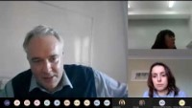
Webinar Recording - The value of VOT in helping to address inequalities

