Slide 1

Inclusive Wellbeing Economies
June 2023

Slide 2
Introduction
This presentation supports the Association of Directors of Public Health Yorkshire and Humber Inclusive Wellbeing Economies priority.
It summarises the developed narrative available here, further resources on this topic are available here .
Contact shane.mullen@eastriding.gov.uk
July-2023

Slide 3
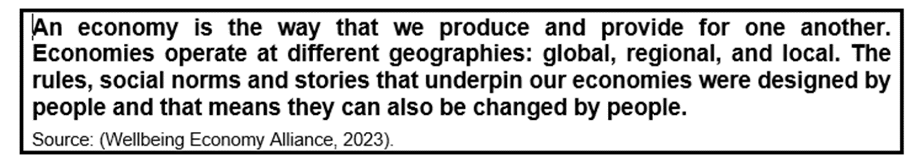
What is an Inclusive Wellbeing Economy
An Inclusive wellbeing economy is:
To thrive, local economies need lots of generative organisations, including worker-owned businesses, community organisations, charities, social enterprises, locally rooted SMEs and municipal enterprises. All these types of organisations allow the wealth they create to circulate around their local economies. Those with shared ownership structures – such as worker-owned co-operatives, mutuals and community businesses – have the added advantage of widening ownership of wealth even further, by passing profits directly on to workers, consumers or citizens.
Increased control over life, power over an individuals future and more wealth translates to improved wellbeing.

Slide 4
Why it matters to Public Health?
Inequalities in power and control over our lives are worsening health inequalities
Work increasingly treats employees as on demand, disposable inputs and a cost to be minimised.
This is leading to more people being unwell, and is reflected in the growing number of people of working age who are economically inactive due to long term illness
This is adding to many other excluded groups, who are already experiencing negative impacts on their physical and mental health.
Local economies are loosing their workforce to ill health at a time when there are labour shortages, resulting in less wealth at a time when more is needed.

Slide 5
Why is it a Priority?
Public Health is an advocate for the forgotten in society.
Prioritising inclusive wellbeing economies is an opportunity to address many of the fundamental causes of inequality;
  Affecting positively the conditions which all people live,
  Through increasing wealth in places
  Ensuring all people have fair access to wealth
  Social Justice is improved for all
  Wealth is not generated from harmful industries
  Economic growth must be sustainable
Inclusive Wellbeing Economies give areas a chance to escape the continual trap of spending money to fix what was broken, preventing ill health by tackling the causes of the causes.

Slide 6
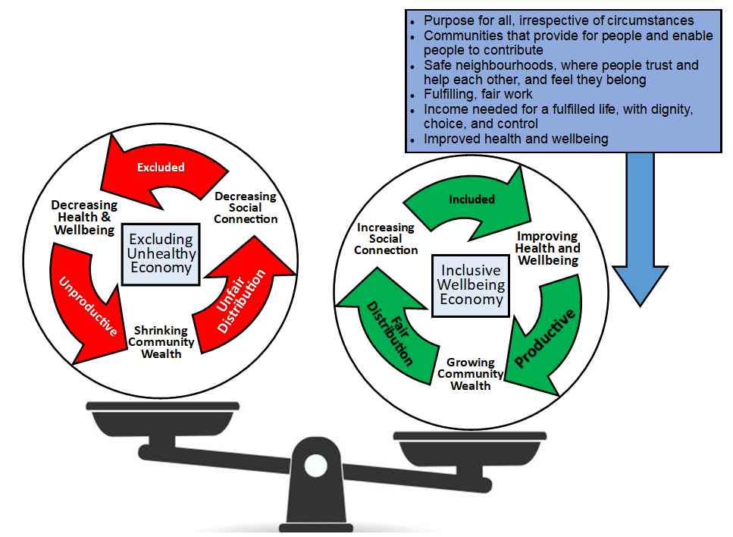
Why is it a Priority?
Designing in benefits of Inclusive wellbeing economies into services, organsations and business’ over time will shift the balance of the economy – Ultimately creating Improved Health and Wellbeing
There is more to do in the economy than just workplaces, all the below would need parallel action in a place;
Anchor Institutions
Community Wealth Building
Community Banking
Community Safety
Diversity of organisations
Fair Work schemes
Education and Skills
Volunteering
Workplace wellbeing

Slide 7
The breadth
The Narrative, Reading Resources and What Works are all structure around the five headings below to help group up the parallel activities;
Understand and use strategic levers
  What is in PH’s gift and where the power lies for change
Know the population and use community centred approaches
  What people what for their community
Make the most of local assets
  What assets such as Anchor Institutes that can move the communities economy to be more inclusive wellbeing focused.
Link the economy to the place
  How to hold more of the spent money in local communities
Understand the impact of economics on future generations
  Monitor the change on the economy and how the inclusive wellbeing approach improves wellbeing
This can be done at different geographies, the narrative guides the reader through each.

Slide 8
Getting Started
Set your vision.
Engage with communities.
Find the teams and build the relationships.
Finding the teams in the local authority, combined authority and/or local enterprise partnership is key.
Get community wealth building going.
More money must be anchored to the community as it is vital for places to thrive and people to be healthier.
Public sector insourcing, community banks and a diverse set of business types need creating
Curate the policy context.
Lever public services to grow social value.
Influence the ICS to do more community development and economic development
Lean on the anchor institutes as part of this pushing for inward investment
Monitor the goals
Pick a mix of economic and wellbeing indicators

Slide 9
Where to go for resources

Slide 10
Key Literature
ADPH Yorkshire and Humber Hub
https://www.yhphnetwork.co.uk/links-and-resources/adph-priorities/inclusive-wellbeing-economies/policy-resources/
Useful Reading Resources
Policy Guide - Wellbeing Economy Alliance (weall.org)
Unlocking the NHS’s social and economic potential: creating a productive system
Scottish Gov Wellbeing Economy Toolkit
Home | IPPR
Levelling-Up-Yorkshire-and-the-Humber_Report_13.07.20-compressed.pdf (yhealth4growth.info)
NHSA REPORT FINAL (thenhsa.co.uk)
Inclusive and sustainable economies: leaving no-one behind - GOV.UK (www.gov.uk)
Creating wealth and health - The Health Foundation
The Manifesto for Local Economies | CLES
Inclusive economies and healthy futures: Supporting place-based action to reduce health inequalities | Local Government Association
National Inclusive and Sustainable Economies Network | NHS Confederation
Together we can change the rules | New Economics Foundation
Knowing the goal: an inclusive economy that can address the public health challenges of our time | Journal of Epidemiology & Community Health (bmj.com)

Slide 11
Framed Sound bites
Community Wealth Building
Wealth is being extracted from our communities in Yorkshire and the Humber.
National and international companies are concentrating wealth into fewer and fewer people and contributing little to local, regional, or national economies.
Control of redistributing wealth is beyond regional hands and its does not follow where wellbeing need is.
Without this wealth, health and wellbeing is stalling in most of our communities across Yorkshire and the Humber.
Democratising the ownership of the economy via social enterprises, cooperatives, employee led mutuals promotes empowered communities and inclusive, healthy, and well communities.
Economic Inactivity
Absence from work due to sickness has grown since the beginning of the pandemic, particularly in those aged 50 and older.
Interruption to routine treatment and care has caused greater levels of ill health in our communities.
People are waiting longer in poorer circumstances, and their health and wellbeing is suffering.
It is our poorest communities who are feeling the brunt of this.
Investing in health and the recovery of the NHS, supporting people to get better, is therefore an investment in the economy, as people’s health improves, and they are supported back into work.
Economic Growth
Growth at all costs can be harmful to health and wellbeing.
Growth in industries such as those like pollutive industries which drive climate change and environmental damage, or promote harmful activities such as problem gambling, can cause further harm to the health and wellbeing of the population.
Some growth is needed like in much of the north of England- which has traditionally been left behind- to redress the economic and health and wellbeing imbalances seen between the north and south.
Good growth needs to be sustainable, regenerative, inclusive, and distributive, putting people and the planet at the heart.

Slide 12
Framed Sound bites
Anchor Institutions
International and national supply chains for anchor institutions fail to realise the benefits for local communities from public expenditure and the opportunities spending locally can create.
Locally anchored institutions are big local employers and have significant buying power through their supply chains.
Locally anchored institutions care about and are invested in their communities.
Investment by anchor institutions in communities creates local wealth and more opportunities for local people, which in turn helps to improve the health of our most disadvantaged communities.
Opportunities through Devolution
Limited investment in communities and low levels of local control over spend and policy is excluding people from the economy and causing harm to health and wellbeing.
The community’s voice is too often left out of the decisions that most affect our communities.
The voices of those excluded from the local economy are missed, misinterpreted, or offered up tokenistically diminishing opportunities for individuals and communities alike to have a say about what affects them.
Communities stagnate or deteriorate leading to disempowerment and disengagement.
More power and wealth in local places will help communities to be heard about what affects them and draw in investment to affect change in the place they live, improving health and wellbeing for all.

