Slide 1

Inclusive Wellbeing Economies
Master Slide Deck

Slide 2
Contents
What are inclusive wellbeing economies?
What do inclusive wellbeing economies look like in practice?
Why do inclusive wellbeing economies matter?
How can you get started with inclusive wellbeing economies?
Resources on inclusive wellbeing economies

Slide 3
How to use these slides
These slides collate a range of useful information and resources on inclusive wellbeing economies and are designed to support, supplement and guide the conversations and work that you are involved in around this topic.
They are designed with public health professionals in mind, although much of the content will still be relevant and useful regardless of your background.
It is not expected that you use these slides in their entirety, although you can if you wish. They are designed in such a way that you will be able to extract the parts of this presentation that fit your aims and the audience you are speaking to.
We welcome any questions, feedback or thoughts on these slides, which can be sent to tom.mapplethorpeapf@kirklees.gov.uk.

Slide 4
What are inclusive wellbeing economies?

Slide 5
Some definitions for starters
“An economy is the way that we produce and provide for one another. Economies operate at different geographies: global, regional and local. The rules, social norms and stories that underpin our economies were designed by people and that means that they can also be changed by people”
Wellbeing Economy Alliance, 2023
“[An inclusive wellbeing economy is] a more deliberate and socially purposeful economy – measured not just by how fast or aggressive it grows; but also, by how well wealth is created and shared across the whole population and place, and by the social and environmental outcomes it realises for people”
Y&H Public Health Network, 2024
Notes:
Economies are how we relate to each other and how we exchange goods and services. Not inevitable – what we have currently is not the only way of doing this. The economic systems we currently have were developed and iterated over many years and centuries by people. What that means is that we can collectively make the decision to do things differently, if the current way of doing things doesn’t work for us anymore.
People are not subject to economies; economies are subject to people.
Growth is not the end; growth is one potential means to an end. Need to consider whether we need growth to meet our goals and, if so, what kind of growth and where.
https://www.yhphnetwork.co.uk/links-and-resources/adph-priorities/inclusive-wellbeing-economies/

Slide 6
Some definitions for starters
“In a wellbeing economy, economic growth is no longer only seen as an end in itself, but a means to achieving wellbeing… As such, the growth of an economy is only positive as long as it increases what matters to people – that includes basic needs such as housing, nutrition, safety, and health, as well as mental health, psychological wellbeing, and freedom - and is regenerative/or even restores nature… [it] aims to achieve conditions that allow everyone to equally live healthy and happy lives within planetary boundaries, where everyone includes future generations.”
Institute for Public Health & Euro Health Net, 2024
Notes:
https://www.publichealth.ie/sites/default/files/resources/Sustainable%20Wellbeing%20Economy%20report%20final.pdf

Slide 7
And some quotes
“Anyone who believes exponential growth can go on forever in a finite world is either a madman or an economist”
Kenneth Boulding
“The gross national product does not allow for the health of our children, the quality of their education or the joy of their play. It does not include the beauty of our poetry or the strength of our marriages, the intelligence of our public debate or the integrity of our public officials. It measures neither our wit nor our courage, neither our wisdom nor our learning, neither our compassion nor our devotion to our country, it measures everything in short, except that which makes life worthwhile.”
Robert F. Kennedy
“The welfare of a nation can scarcely be inferred from a measure of national income.”
Simon Kuznets
Notes:
GDP (formerly GNP) doesn’t even measure economic output that well (not taking into account more informal parts of the economy, such as caregiving, volunteering, etc) and it was never intended to be used in the way it’s being used now, i.e., as a benchmark figure for a country’s prosperity and success. It doesn’t account for the quality of economic activity or how the benefits of that activity are distributed amongst a population. It also doesn’t account for the wider impacts of that activity, e.g., on health, wellbeing or the natural world.
https://www.weforum.org/stories/2021/12/stakeholder-capitalism-episode-1-a-brief-history-of-gdp/

Slide 8

https://www.youtube.com/watch?v=R8no2wZLKHc&t=174s
Notes:
Brief video from Wellbeing Economies Alliance (WEAll) – ‘A Wellbeing Economy is Possible’

Slide 9
How does IWE differ from BAU?
Business as usual Inclusive wellbeing economies
Focus on economic growth, e.g., GDP Focus on wellbeing and thriving populations
Growth is the end goal / measure of success Growth is a means to an end
Grows regardless of whether people thrive People thrive regardless of whether it grows
Extracts wealth and resources Circulates wealth and resources
Wealth and resources distributed inequitably Wealth and resources shared equitably
Not working within planetary boundaries Working within planetary boundaries
Complicated but linear Complex system
Primacy of the market Embedded economy
Markets are self-regulating Markets should be regulated
People serve the economy Economy serves the people
Notes:
IWE = inclusive wellbeing economies. BAU = business as usual.
Embedded economy – recognises the importance of the state, commons and household and places it within the living world. Recognises the value of ‘non-economic’ activities to the economy. Much of this comes from Kate Raworth’s Doughnut Economic - https://doughnuteconomics.org/about-doughnut-economics.

Slide 10
Economic growth – a more nuanced view
As you will have gathered from the previous slides, inclusive wellbeing economies contest the ‘economic growth at all costs’ narrative that is often dominant.
However, this does not mean that economic growth is bad in all circumstances. Rather it is the type of growth that matters in inclusive wellbeing economies.
For example, what kind of growth is it, where is it happening and who stands to benefit from it? Is it growth at all costs or growth for a purpose?
Economic growth focused in those places and for those communities where there are significant inequalities could help narrow the gap and ‘level up’.
BUT this depends on how this growth is achieved, what characteristics it has and who benefits from it. This is where IWE principles come in.
E.g., use of local suppliers and supply chains, employment opportunities for local people, development of local assets.

Slide 11
What do inclusive wellbeing economies look like in practice?

Slide 12
More circular local economies
To truly thrive and support local people to thrive, local economies needs lots of generative organisations, including: -
worker-owned businesses
community organisations
charities
social enterprises
locally rooted SMEs
municipal enterprises
All these types of organisations allow the wealth they create to circulate around their local economies.
Notes:
SME = small to medium sized enterprise

Slide 13
More circular local economies
In addition to this, organisations with shared ownership structures have the added advantage of widening ownership of wealth even further, by passing profits directly on to workers, consumers or citizens.
Examples of this include: -
worker-owned co-operatives
mutuals
community businesses
By baking all of these elements and the following ones into our economies as early on as possible, we can mitigate the need for ‘failure demand’, e.g., spending a lot of money to fix problems created by inequality.

Slide 14
Components of an inclusive wellbeing economy
There are many different ingredients that can help to support inclusive wellbeing economies. Which ones you focus on will depend on your local context.
Strong anchor institutions and networks
Community wealth building
Community banking
Community safety
Diverse range of local institutions, organisations and businesses
Fair work schemes to support ‘good work’
Offers to support good workplace wellbeing
Focus on education and skills
Valuing and supporting volunteering
Notes:
Anchor institutions and networks - https://www.kingsfund.org.uk/insight-and-analysis/long-reads/anchor-institutions-and-peoples-health
Community wealth building - https://cles.org.uk/community-wealth-building/what-is-community-wealth-building/
Community banking - https://cles.org.uk/what-is-community-wealth-building/the-principles-of-community-wealth-building/making-financial-power-work-for-local-places/mutuals-and-community-banks/
Good work - https://www.local.gov.uk/topics/employment-and-skills/good-work-project

Slide 15
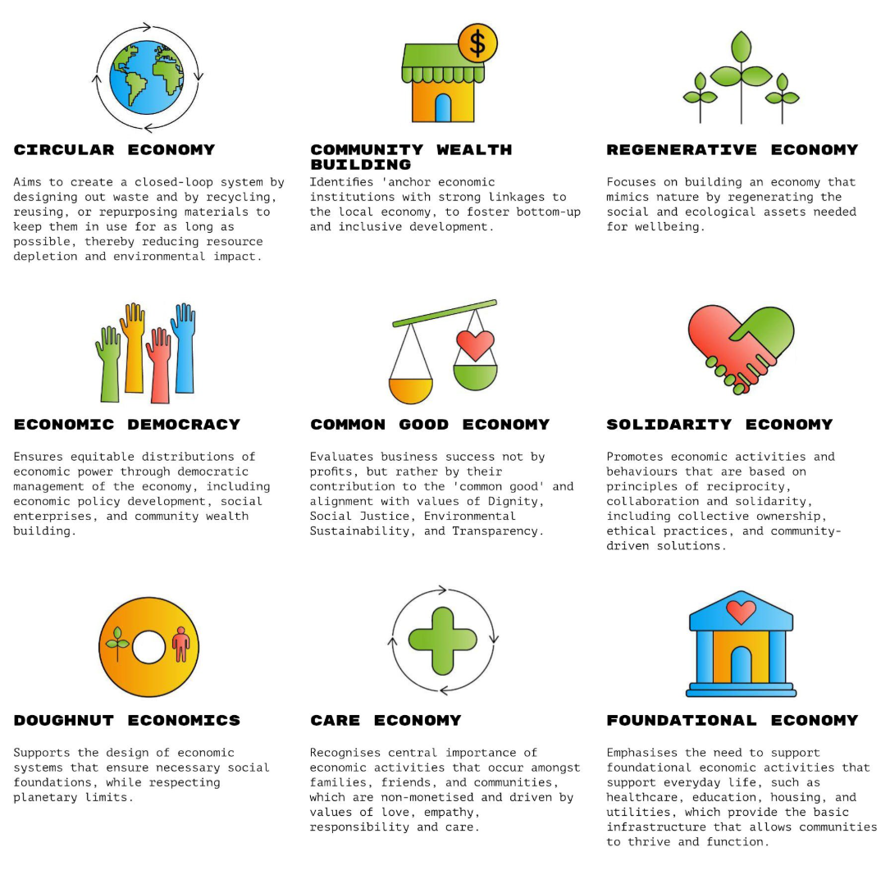
Different models, same principles
There are a multitude of different concepts and models that align with or are utilised by inclusive wellbeing economies.
This may seem confusing at first, but all of these models are largely complementary in terms of their values and there is significant overlap between them.
They are essentially slightly different ways of thinking about the same kinds of things.
Notes:
Despite this, there are some important distinctions between models too (in terms of emphasis, scope, etc) and places should consider which model(s) are right for them and their local places, based on which ones most resonate and align with their values and priorities and those of local communities, as well as which ones are more likely to generate traction and shared purpose amongst a range of key partners and stakeholders..
Where more than one model is adopted (a ‘pick and mix’ approach), places will need to be mindful of to what extent these models are compatible and how any tensions or necessary trade-offs will be resolved.

Slide 16
Why do inclusive wellbeing economies matter?

Slide 17
Why does it matter? So what?
Our current economic systems distribute wealth and resources unequally, and this leads to significant inequalities in wealth.
They are also placing unsustainable strain on the natural world, which is exacerbating climate change.
All of this then has considerable impacts on the health and wellbeing of our local populations and leads to substantial health inequalities.
Whichever way you look at it (e.g., from a climate, health or social justice perspective), the current system is not working well for us as a collective.
Working towards inclusive wellbeing economies allow us to rebalance how our economies work, to prevent these negative impacts and to escape the trap of spending money to fix them after they occur.

Slide 18
Why does it matter? So what?
We are increasingly seeing the impacts of this in all of our daily lives and work, for example: -
Work increasingly treats employees as on demand, disposable inputs and a cost to be minimised (rather than assets to be supported and nurtured).
This is leading to more people being unwell, reflected in the growing number of people of working age who are economically inactive due to long term illness.
Local economies are losing their workforce to ill health at a time when there are labour shortages, resulting in less wealth when more is needed.
All of this exacerbates existing inequalities, stifles local economies and disempowers local communities.

Slide 19
Why does it matter to public health?
Wealth and health are inextricably linked. How our economies run and distribute wealth and resources impacts on health.
The current economic system is leading to massive inequalities in the distribution of wealth and resources, which is in turn leading to inequalities in health.
Prioritising inclusive wellbeing economies is an opportunity to address many of the fundamental causes of these inequalities by: -
- Positively impacting the conditions people live in
- Increasing wealth in places and ensuring people have fair access to it
- Improving social justice for all
- Ensuring that wealth is not generated from harmful industries
- Ensuring that economic growth is environmentally sustainable
Notes:
Wealth and health two sides of the same coin.

Slide 20
Why does it matter to public health?
If we get this right, it will lead to: -
Purpose for all irrespective of their circumstance.
Communities that provide for people and allow them to contribute.
Safer neighbourhoods where people trust and help each other and feel that they belong.
Fulfilling and fair work.
People having the income they need for a fulfilled life, with dignity, choice and control.
Improved health and wellbeing.

Slide 21
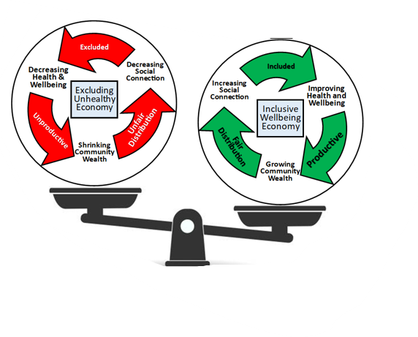
A vicious cycle or a virtuous cycle?

Slide 22
Why does it matter to others?
“I’m working in economic regen or economic policy, why should I care?”
Shifting towards an IWE will allow you to ‘level up’ across your local place and help boost prosperity in left behind places and communities.
“I’m an elected member, why should I care?”
Shifting towards an IWE will lead to more inclusive and prosperous local economies, where all local people have the best opportunity to thrive.
“I’m a local business, why should I care?”
Shifting towards an IWE will allow more wealth and resources to be retained and spent within local places, benefitting local businesses.
“I’m a local resident, why should I care?”
Shifting towards an IWE will allow for wealth and resources to be shared more equally and give you the best opportunity to participate in your local economy and thrive.
Notes:
More work to do around comms and framing – this is just a starter.

Slide 23
‘Failure demand’ and the importance of acting early
A narrow focus on economic growth at all costs is causing harm to people and the planet, requiring governments to spend money (re-distribution) to respond to these harms.
For example, huge amounts of money are spent annually to tend to the impacts of poverty and precariousness, housing insecurity and homelessness, and of the environmental destruction generated by our current economic systems.
By transforming our economies to be more inclusive and to enable population health and wellbeing as early on as possible (pre-distribution), we can mitigate the potential for ‘failure demand’, i.e., being caught up in a cycle of paying to fix what our current economic systems continue to break.
Notes:
https://weall.org/failure-demand-counting-the-true-costs-of-an-unjust-and-unsustainable-economic-system

Slide 24
How can you get started with inclusive wellbeing economies?

Slide 25
Getting started
Moving to a more inclusive wellbeing economy involves changing from one way of thinking about and doing things to another. We can approach this in a couple of different ways.
Looking at the wider systems and ways of doing things that underpin our local economies can bring change at a more systemic level. BUT it’s sometimes harder at a local level to influence the kind of things that will bring about this wider change.
Looking at smaller, locally-oriented actions allows us to focus down on those things that are practical and achievable at a local level. BUT scope and impact may sometimes be limited by wider factors that are out of our control.
In practice, you probably need some of both and where you start from will depend on your local context and where the interest and energy among your partners takes you.
You could start by looking at wider systems and then use that to focus down on particular actions that are needed OR start with what’s doable at a small scale and use the energy and momentum generated by that to make the case for wider change.

Slide 26
Starting big - thinking about systems change
There are multiple different models that can be used to think about systems change. These next few slides will briefly describe a couple that have already been applied to the shift to more inclusive wellbeing economies and that you can use to help explore what this might look like for you at a local level.
These are: -
Two Loops Model (originally described by Wheatley and Frieze)
Four P’s Model (described by Trebeck and used by WeAll)
Notes:
https://www.sfu.ca/complex-systems-frameworks/frameworks/strategies/two-loop-model.html
https://weall.org/what-is-wellbeing-economy#b3

Slide 27
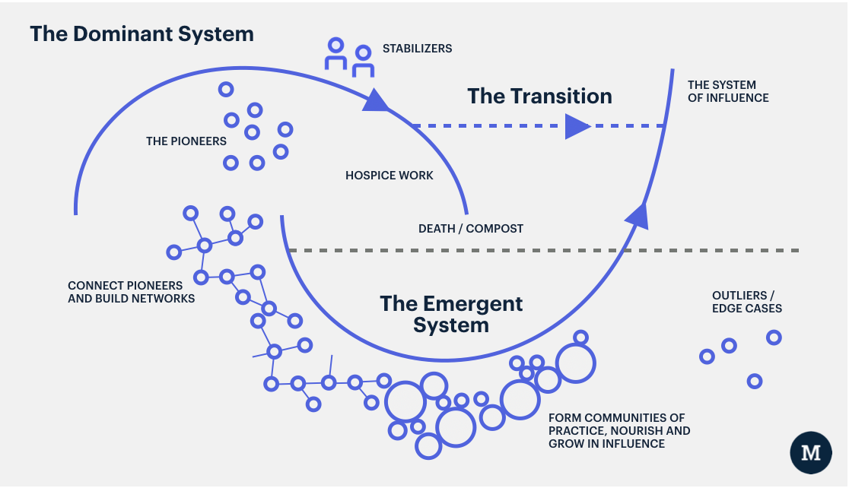
Two Loops Model
Notes:
This framework can be used to talk about both ‘what we need less’ (the hospicing of a dominant system that no longer works for us) as well as ‘what we need more of’ (supporting a new inclusive wellbeing economy system).
Potential questions for exploration might be: -
The dominant system:
What challenges are we facing that our existing economic system struggles to address?
What are the practices, structures, or policies in our organisation that keep the current economic system in place?
How can these practices, structures, or policies be replaced with ones that are better aligned with our goals of becoming an inclusive wellbeing economy.
Who will this transition be hard for? How can they be acknowledged and supported?
The emerging system:
What new ideas or practices are starting to emerge within our organisation or sector that symbolise an emerging wellbeing economy system?
What examples of such activities and processes already exist in the local context and embody the desired ways of working and outcomes?
How can these (emerging) initiatives be nurtured, supported and scaled up?
Credit to Margreet Freeling, Wellbeing Economies Alliance, for this content.

Slide 28
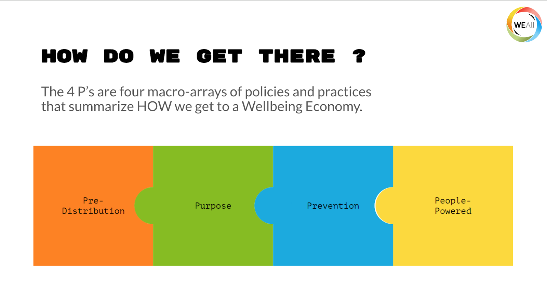
Four P’s Model
Notes:
Pre-distribution: We don’t leave it to people to fend for themselves or rely on limited redistributive mechanisms, but predistribute power, wealth, time, and income so that the heavy lifting is done by the economy itself. Example: social enterprises and businesses owned by their workers, community wealth building and living wages.
Purpose: The purpose of the economy becomes exclusively to deliver human and ecological wellbeing. Example: adopting a wider suite of success measures Beyond GDP, and visionary national development plans.
Prevention: Rather than being content just fixing the harm we do to nature and people, we adopt preventive measures that stop harm from happening in the first place. Example: Outcome budgeting and circular production and consumption.
People-powered: Economic decisions are powered by the people, who become directly involved in decision making and agenda setting. Example: Citizen assemblies and participatory budgeting.
Credit to Margreet Freeling, Wellbeing Economies Alliance, for this content.

Slide 29
Starting small – opportunities for action
There are a wide range of potential opportunities for action at a local level that will help you build and work towards a more inclusive wellbeing economy.
We can’t cover the full range of these here but they can largely be divided into four main categories, although these are not necessarily exhaustive.
Work and health
Circular economies
Community wealth building
Anchor organisations
There is much more on each of these categories, including specific actions that can be considered in Narrative to Action – Moving towards inclusive wellbeing economies in Yorkshire and the Humber.
There is also more on community wealth building and anchor organisations later in this presentation.
Notes:
Work and health – building a fairer and more inclusive labour market that supports good work and better population health and wellbeing
Circular economies – reducing the environmental impact of the way in which our economies use and dispose of resources
Community wealth building – increasing the amount of wealth and resources that are retained in and that benefit local people and communities
Anchor organisations – increasing the capacity of large organisations embedded in our local places to use their assets and resources for social good

Slide 30
Laying the groundwork – preparation is key
Whether you’re starting with wider systems or smaller actions, the inclusive and wellbeing economies narrative developed as part of this fellowship describes some factors that will help make it easier to take action: -
Understand what strategic levers you have at your disposal and use them.
Know your local population(s) and use community-centred approaches.
Understand and be prepared to make the best use of local assets at your disposal.
As far as possible, link your local economy to your local place.
Understand the impacts of what you do on future generations.
There is further guidance on this for people working at a local, sub-regional and regional level in the narrative.

Slide 31
Getting started - some potential first steps
Engage with stakeholders and local communities to understand local needs and aspirations, and to inform your vision.
Build and invest in relationships and ways of working that will help you to collaboratively work towards your vision.
Think about the assets and levers that you have and that can be built upon in your local place, e.g., anchors, voluntary sector.
Think about getting community wealth building started, to anchor more money to local places and communities.
Pick a series of indicators that will allow you to measure what good looks like for your local area.
Look into some of the resources listed at the end of these slides.

Slide 32
Defining stakeholders and agreeing shared goals
The first step is to understand the stakeholders that need to be part of the conversation in your local place. Maybe start by mapping them out or building up a ‘rich picture’ that explores how they interrelate.
Bring stakeholders together as part of a discussion(s) around inclusive wellbeing economies in your local place. Explore what this means to different stakeholders and allow open and honest discussion around any perceived barriers or concerns.
Use this discussion(s) as a means of building consensus between stakeholders and agreeing a vision and shared purpose for your local place, i.e., what do inclusive wellbeing economies mean for your place, what would you like to achieve and where does the focus need to be (at least initially).
Local communities should be part of this process and ideally be engaged as equal partners. Community insight will be vital in terms of understanding the needs, hopes and aspirations of local people. Use community-centred approaches.
Notes:
Rich pictures - https://www.open.edu/openlearn/science-maths-technology/engineering-technology/rich-pictures
Community-centred approaches - https://www.gov.uk/government/publications/health-and-wellbeing-a-guide-to-community-centred-approaches

Slide 33
Investing in relationships and working collaboratively
Once you have your group of local stakeholders and a vision and shared purpose, think about how you continue to invest in this moving forward.
Explore ways of working that allow you to build on what you have and continue to collaborate, using your vision and shared purpose as an anchor.
Think about how the governance for this group might work and who it is accountable to. This could be formal, informal or a mixture of both.
Continue to be curious both within your stakeholder group and without. Bring in other people where there is a perceived gap and be prepared to adjust if needed.
Where you can, use the group as a way of innovating and testing ideas through collaboration in a ‘safe to fail’ environment. Actively seek and share learning from this process and use to it inform your future work.
Notes:
‘To develop an effective partnership, the following elements are key: strong, championing, connected leadership; committed partner engagement; appropriate long-term resourcing (including funding); a strong partner co-produced vision and strategy; flexible fit for purpose governance and structures; trust between partners; and a focus on pre-existing assets within place, to drive inclusive and sustainable local economic development.’
https://blog.bham.ac.uk/lpip/2024/11/06/inclusive-and-sustainable-local-economic-performance/
https://lpiphub.bham.ac.uk/inclusive-and-sustainable-local-economic-performance-evidence-review/

Slide 34
Mapping out local assets and levers
Your work should be informed by an understanding of local assets and how they can be drawn upon and utilised to support your vision and shared purpose.
Assets can be both tangible and relational. They can include organisations, people, resources, relationships and structures.
Draw on existing asset mapping where this has been undertaken. If it hasn’t, consider undertaking some asset mapping of your own.
Once you have your asset map, consider how it can be used to add value to your work. What opportunities and levers do you have to draw upon?
Local knowledge and insight from your stakeholder group and local communities will be an important part of this process.
Notes:
Asset mapping - https://qi.elft.nhs.uk/wp-content/uploads/2018/11/Community-Mapping-Toolkit-3.pdf

Slide 35
Getting community wealth building started
Community wealth building is a ‘people-centred approach to local economic development, which redirects wealth back into the local economy, and places control and benefits into the hands of local people’.
As defined by the Centre for Local Economic Strategies (CLES), it involves five key principles: -
Plural ownership of the economy
Making financial power work for local places
Fair employment and just labour markets
Progressive procurement of goods and services
Socially productive use of land and property
Notes:
https://cles.org.uk/community-wealth-building/what-is-community-wealth-building/
Plural ownership of the economy
Rebuilding the connection between the people and the places that create wealth and those who benefit from it is at the heart of community wealth building. We know that locally owned or socially minded enterprises are more likely to employ, buy and invest locally. This means that rather than extracting wealth they contribute to local economic development. For this reason, community wealth building seeks to promote locally owned and socially minded enterprises.
To further strengthen the link, community wealth building promotes various models of enterprise ownership. These include public sector insourcing, municipal enterprises, worker ownership, co-operatives, community ownership and local private ownership. These models enable wealth created by users, workers and local communities to be held by them, rather than flowing out as profits to shareholders.
Making financial power work for local places
Community wealth building seeks to increase flows of investment within local economies. It does this by harnessing the wealth that exists locally, rather than by seeking to attract national or international capital. For example, local authority pension funds are encouraged to redirect investment from global markets to local schemes. Mutually owned banks are supported to grow, and regional banking charged with enabling local economic development are established.
All of these are ideally placed to channel investment to local communities while still delivering a steady financial return for investors.
Fair employment and just labour markets
Community wealth building not only aims to improve employment opportunities but also worker rights by, for example, promoting recruitment from lower income areas, inclusive employment practices, committing employers to paying living wage and building progression routes for employees.
Often the biggest employers in a place, the approach anchor institutions take to employment can have a defining effect on the employment prospects and incomes of local people. Working with human resource departments within anchor institutions to stimulate the local economy through progressive employment and local labour market activities has proved a powerful tool.
Progressive procurement of goods and services
Community wealth building promotes the progressive procurement of goods and services, as this spending power can be a means through which greater economic, social and environmental benefits can be achieved.
By adapting their procurement processes and decision making, anchor institutions can create dense local supply chains and ecosystems of local enterprises, SMEs, employee owned businesses, social enterprises, cooperatives and other forms of community ownership. This is important because these types of businesses are more likely to support local employment and have a greater tendency to recirculate wealth and surplus locally.
Socially productive use of land and property
Local land and property assets represent a base from which local wealth can be accrued through equitable forms of ownership, management, and development. Through a community wealth building approach , these assets are owned and managed in ways which ensure that they generate wealth for local citizens, rather than enclosed by private interests.
The goal here is not simply for a local authority or anchor institution to ‘own more land’, but instead to ensure that they land they do own is run by and for the people. This can be understood through the concept of ‘the commons’- the idea that the land held by public institutions is owned by all of us, together. To achieve this, public land owners should develop governance and management structures where communities can take direct control of common assets, for example through transferring under-utilised assets to Community Land Trusts, or working through Public-Commons Partnerships. The local state should engage citizen groups to get involved in the governance and management of municipal assets at every level.
By advancing a ‘commons’ approach to public land and assets, anchors can ensure that our shared buildings, parks, and other land holdings helps to create good local economies, ensure sensible environmental stewardship, and advance social justice.

Slide 36
Getting community wealth building started
To get started on community wealth building, you will need to understand the current lay of the land in your local place.
Draw upon the relationships you’ve built with key stakeholders and communities and the asset mapping that you’ve undertaken.
Use your vision and shared purpose to guide you. What are the needs, hopes and aspirations in your local place and how does community wealth building speak to your vision and shared purpose or help you to achieve them?
Start small. Pick one aspect of community wealth building and focus on that initially. Are there any easy wins? If so, maybe start there.
Whatever you choose to focus on, bring people with you, especially those in local communities that will be most impacted. Communicate about what you’re doing, why it is needed and what the benefits will be.

Slide 37
The role of anchor organisations
Anchor organisations are those ‘which have an important presence in a place, usually through a combination of:-
being largescale employers,
being the largest purchasers of goods and services in the locality
controlling large areas of land and having relatively ﬁxed assets
They are ‘often tied to a particular place by their mission, histories, physical assets and local relationships. Examples include local authorities, NHS trusts, universities, trade unions, large local businesses, the combined activities of the community and voluntary sector and housing associations.
Anchor organisations and networks have a key role to play in community wealth building and in inclusive wellbeing economies more widely.

Slide 38
Measuring what good looks like for you
Success in terms of implementing inclusive wellbeing economies will look different for different places, depending on their vision and shared purpose.
Using your vision and shared purpose as a starting point and working with key stakeholders and communities, define what success would look like for your area.
Once you understand this, think about what indicators would allow you to measure whether that success is being achieved (or not).
Seek out routinely collected data that matches the indicators you have identified. In some cases, this may not be available, and you may need to start collecting this data yourself.
Whatever data you use, make sure that it is made publicly available and accessible so that you are accountable against the outcomes you are aiming for. It may be helpful to host regular events where this is shared.
Examples of relevant datasets and indicators are included in the resource section at the end of these slides.

Slide 39
Talking about inclusive wellbeing economies?

Slide 40
Framing and making the case
As you implement and embed inclusive wellbeing economies in your local place, you will need to talk to and work with other stakeholders with varying degrees of knowledge, familiarity and support. To do this, you will need to articulate and make the case for inclusive wellbeing economies in a way that will depend on the context you’re working in and the audience you’re talking to. In short, you’ll need to think about framing.
“Framing refers to the choices we make about what we say and how we say it: how we explain an issue, what we emphasise and the things we leave unsaid. Using a particular frame is essentially choosing to tell a different story – one that will improve understanding and build support for the changes we want to see. And that matters, because it can lead to radical changes in how people think, feel and act.”
https://www.health.org.uk/features-and-opinion/features/lets-talk-differently-about-health-why-framing-matters

Slide 41
Framing and making the case
The following slides will look at how you could consider framing conversations you’re having about inclusive wellbeing economies. It draws heavily from the Wellbeing Economies Alliance’s Wellbeing Economy Policy Design Course, which covers this topic in more depth.
It is not intended to be an exhaustive resource but instead to start you thinking about how you communicate and articulate with key audiences around inclusive wellbeing economies.
There are other resources that cover framing in greater depth and may be of use if you want to explore this topic in further depth. You could start with the policy design course referenced above or with the work of the Frameworks Institute.

Slide 42
1) Opening doors through empathy
Research shows that approaching conversations with empathy increases the chances of broadening the perspectives of those who hold different views.
Empathy requires open, honest and respectful communication and efforts to understand the perspectives and concerns of others, even when you disagree.
Approaching conversations with empathy allows us to find shared interests and goals that can help bring us together and create shared visions for moving forward.
KEY TAKE-HOME: Try to understand the perspectives and concerns of those that you’re talking to. Be open minded, curious, respectful and non-judgmental. Use this approach to find common ground and explore shared goals.
Notes:
Santos, L. A., Voelkel, J. G., Willer, R., & Zaki, J. (2022). Belief in the utility of cross-partisan empathy reduces partisan animosity and facilitates political persuasion. Psychological Science, 33(9), 1557-1573. https://doi.org/10.1177/09567976221098594

Slide 43
2i) Finding language that works
The case for an inclusive wellbeing economy can be made from a variety of angles, as different arguments will be persuasive to different audiences.
Given its broad appeal, different characteristics of a wellbeing economy can speak to different political stakeholders.
Drawing on your experience and based on the context you’re working in, try to find a language that can garner interest from a broad range of stakeholders.
Both rational and emotional language and reasoning have a role to play here. Use of storytelling techniques can tap into both of these approaches.
KEY TAKE-HOME: Craft your narrative and the language you use to fit the audiences you’re aiming to reach and influence. This could be focused on either narrow or broad appeal, depending on your context. Consider and plan carefully and communicate with intention.

Slide 44
2ii) Different cases for a wellbeing economy
A moral case emphasises how an inclusive wellbeing economy approach is the right thing to do from a perspective of existing values such as human rights, being good ancestors, and principles of solidarity.
An existential case highlights the urgency of environmental breakdown and the need to act now.
A democratic case speaks to the groundswell of public opinion in favour of an economy that works for people and the planet, highlighting the outcomes of public opinion polls, deliberative dialogues, citizen assemblies, and so on.
A fiscal case stresses the high costs of 'failure demand' and the inefficiency of a ‘growth-first-then-clean-up-and-redistribute-later’ approach.
An early investment or economic resilience case highlights how investing in the health of people, societies, and the environment now, will strengthen the resilience of societies and economies going forward.
A visionary case emphasises the opportunities for creating thriving economies that prioritise social and ecological wellbeing and showcases the initiatives that are working towards this aim to provide inspiration for what the future can look like.
Notes:
Failure demand – fixing things retrospectively rather than getting things right in the first place

Slide 45
2iii) Public narrative: an approach to storytelling
Public narrative draws on the work of Marshall Ganz. It is a structured way of using storytelling techniques to motivate people to take action to achieve a shared goal.
There are three components to forming a public narrative: -
Story of self shows we are invested in a particular cause and how it links to our values – it presents a challenge we have faced, how we have overcome that challenge and what the outcome was – it invites others to connect with us.
Story of us invites others to join with you in the cause and illustrates your shared purpose, goals and values in doing so – it aims to show others why they should be invested in this cause and invites them to join you in collectively taking action.
Story of now outlines why this particular cause is of relevance and requires action at this specific point in time – it shows urgency, is rooted in the values in the other two stories and illustrates a contradiction to those values that requires action.
Notes:
https://narrativearts.org/article/public-narrative/

Slide 46
3) Showing the momentum
There is a lot of momentum towards inclusive wellbeing economies across the world, and showcasing this can help demonstrate the broad appeal of and support for these principles, as well as how they have been translated into practice.
Wellbeing economy ideas: -
are widely supported by the public, as evidenced in international surveys and public polls.
are being explored and used by governments, organisations and civil society across the world.
are rooted in the beliefs and traditions of a range of diverse cultures and have been embraced and practised by communities around the world.
KEY TAKE-HOME: Talking about the widespread momentum and support for inclusive wellbeing economies will ground theoretical understanding of the underlying principles in the real world and help people to understand that this is something that is achievable.

Slide 47
4i) Common concerns and how to engage
When making a case for a wellbeing economy, anticipating common concerns and being ready to counter them can help to relieve doubts and bring people on-side.
Some common concerns include: -
Isn’t our wellbeing dependent on economic growth?
Don’t we need economic growth to fund essential public services?
Will a wellbeing economy jeopardise a healthy business environment?

Slide 48
4ii) Isn’t our wellbeing dependent on economic growth?
Many people still assume that there’s a link between economic growth and population wellbeing. Implicit in our political and public discourse is a belief that economic growth will increase wellbeing for all.
However: -
GDP is not a good measure of societal wellbeing.
A rising tide does not lift all boats equally.
More is not always better.
The current growth model is detrimental to wellbeing.
Notes:
GDP is not a good measure of societal wellbeing
GDP is a useful indicator to measure the extent of economic activities in a country, but it is not a good measure of human wellbeing or societal progress. This is a fact that was already understood by Simon Kuznets, one of the intellectual fathers of the metric.
GDP fails to accurately capture wellbeing, as it disregards important aspects of wellbeing such as social inequalities, environmental sustainability, as well as non-monetary exchanges and unpaid work, such as care work.
GDP measures the quantity, not the quality, of economic activity. Expenditures that increase GDP, such as the cost of cleaning up environmental damage or increased health expenditures due to accidents and disease, do not necessarily reflect positive economic development.
The disconnect between wellbeing and economic growth is further supported by research on alternative metrics of societal wellbeing and progress. While global GDP per capita has been rising since the 1980s, the Genuine Progress Indicator has decreased in the same time period.
A rising tide does not lift all boats equally
The socioeconomic benefits related to a growing economy are often very unequally distributed in society as well as between societies. In 2021, the richest 10% of the global population received 52% of total income and owned 76% of all wealth, respectively. At the same time, the poorer half of the global population only earned 8,5% of total income and owned 2% of global wealth.
Since the 1980s, the share of GDP going to labour in the form of wages has been declining in comparison with the share of GDP that goes to owners of capital.
These trends point towards the fact that workers benefit less from economic growth when compared to owners of capital, an issue that raises concerns of social justice and fairness.
High levels of inequalities are problematic for wellbeing, even in a growing economy. Evidence suggests that countries with higher inequalities perform worse in a wide range of domains crucial for wellbeing, including physical and mental health, education, trust, as well as violence and crime. Similarly, global inequalities exacerbate environmental challenges and hamper collective efforts to address these.
More is not always better
Empirically, economic growth and associated increases in income are not linked to happiness in the long-term, especially in high-income countries. This has become known as the Easterlin paradox.
Consumerism as a central pillar of current economic growth has negative effects on wellbeing due to its close association with materialist values. Psychological research shows that people whose values centre around materialism experience lower wellbeing, reflected in lower life satisfaction, worse physical health, poorer quality social relations, as well as higher susceptibility to depression and anxiety.
Instead, findings from the world’s longest scientific study of happiness, the Harvard Study of Adult Development, show that rather than money or material things, it is the quality of our relationships with others that is the most important in influencing people’s happiness.

Slide 49
4ii) Isn’t our wellbeing dependent on economic growth?
A starting point: -
People who have this concern already care about wellbeing.
Therefore, the conversation can focus on the means to achieve your shared goal of improving wellbeing.
Some people may be concerned about specific aspects of wellbeing, such as employment, health, education, or access to nature. In these cases, it may be useful to engage in conversations on how different aspects of wellbeing are interlinked and invite them to consider a more holistic understanding of wellbeing first.
Potential ideas and actions to explore: -
Use holistic measures of societal progress.
Value economic activities and behaviours by their contribution to social and ecological wellbeing.
Implement more progressive systems of taxation, that tax economic activities according to their impact on societal and environmental wellbeing.
Reorient government policies to foster human wellbeing and basic needs satisfaction in line with justice principles and environmental limits.
Notes:
Using holistic measures of societal progress.
For example, many governments have developed dashboards of wellbeing indicators to assess progress in society that capture a wide array of economic, social, and environmental wellbeing measures.
Valuing economic activities and behaviours by their contribution to social and ecological wellbeing.
Distinguishing between economic activities that highly contribute to wellbeing with limited environmental resources (e.g,. care work) and other activities that add little to wellbeing while consuming unsustainable amounts of resources (e.g., luxury goods and activities). A starting point for this is the development of green taxonomies for environmentally sustainable activities in places like Brazil, Indonesia, China (the Green Industry Guidance Catalogue), Colombia and the European Union.
Implementing more progressive systems of taxation that tax economic activities according to their impact on societal and environmental wellbeing.
So that economic activities that reduce social and environmental wellbeing are taxed more, and eventually phased out, while those that contribute to wellbeing are provided with incentives and are taxed less.
Reorienting government policies to foster human wellbeing and basic needs satisfaction in line with justice principles and environmental limits.
For example, by:
- introducing universal basic services or universal basic incomes to ensure everyone’s basic needs are satisfied
- decreasing inequalities in income and wealth through a focus on predistribution, caps on excessive income and wealth, and redistributive measures
- reducing overconsumption through sustainable pricing of goods and services and regulations on advertising in public spaces
- enabling regenerative and redistributive businesses to thrive
- working towards a caring society in which care for human and non-human life is valued and given status as the foundation for wellbeing, care is shared fairly, and care activities are supported with time and resources
- establishing deliberative forums that engage diverse communities to discuss and determine what is necessary for a good life, what a life in balance would look like, and what is needed to achieve this

Slide 50
4iii) Don’t we need economic growth to fund essential public services?
Often, economic growth is presented as a pre-requisite to financing the delivery and improvement of essential public services (including the transition towards inclusive wellbeing economies). More immediate demands on government budgets are sometimes used to argue that ‘we can’t afford to focus on wellbeing’.
However, this argument only holds true if we take the government’s current fiscal architectures as a given. There are, in fact, several reasons why economic growth is not an inherently necessary condition for financing essential state functions: -
The composition of government revenues matters
Strategic public investment is key
A wellbeing economy will save the government money in the long-term
Notes:
The composition of government revenues matters
Many governments generate a substantial part of their revenues via taxes on labour or consumption. For example, in the United States as well as in the European Union, more than half of all tax revenues come from employment. Employment-related taxes also make up a substantial portion of the total tax revenue in many Latin-American and Asian nations. African countries tend to rely more on consumption taxes, including Value-Added Tax (VAT). In the Middle East and North Africa (MENA region) Value-Added Tax are also an important source of government revenue, as is revenue from natural sources like oil and gas.
Since employment, consumption, and oil and gas production are so closely linked to – and indeed often driven by – economic growth, an expansion of economic activities is often seen as essential to maintain stable government revenues. The composition of government revenues is, however, not set in stone. Decreasing the reliance on labour taxes, consumption, and oil and gas production and diversifying government revenues can enable societies to effectively fund the transition towards a wellbeing economy, even in the absence of economic growth.
Strategic public investment is key
Currently, governments are spending a lot of money and resources on fixing the harm done by our profit-driven economic systems. The associated costs - often called ‘failure demand’ - are very large.
For example, governments still heavily subsidise fossil fuel industries, despite their exceedingly harmful impacts on the natural environment and human health. In 2022, worldwide fossil fuel subsidies reached $7 trillion, approximately 7.1 percent of global GDP.
At the same time, governments are spending hundreds of billions a year dealing with the impacts of extreme weather events that are caused by greenhouse gas emissions, with the drain on public expenditure likely to increase as those weather events get more extreme and frequent.
There exists great potential in redirecting government expenditures towards environmentally and socially meaningful purposes, such as climate investments and social policies.
A wellbeing economy will save government money in the long-term
In the current economic system, the welfare state largely focuses on relieving socio-economic harms such as poverty and unemployment.
In a wellbeing economy, the need for the welfare state to repair socio-economic harms can be significantly reduced, as the focus shifts to preventing these harms from occurring in the first place.

Slide 51
4iii) Don’t we need economic growth to fund essential public services?
A starting point
People who have this concern are not dismissing that wellbeing is important.
Starting from this common ground, the conversation can focus on exploring more efficient and responsible ways for governments to invest in and improve public services.
Potential ideas and actions to explore: -
Use preventative approaches to reduce the demand for welfare expenditure
Reorganise the funding of social expenditure
Redistribute resources towards needs satisfaction and wellbeing in the economy
Notes:
We currently waste a lot of resources on harmful activities, which could be repurposed to more productive and beneficial ends. As a result, we spend a LOT of money fixing the problems (e.g., increased welfare demand) caused by our current economic systems, which is an incredibly inefficient use of our resources in the long run. Better use of resources would eliminate this ‘failure demand’ and so the need for economic growth to fund responses to it.
Use preventative approaches to reduce the demand for welfare expenditure.
Invest in reducing poverty, unemployment, ill health, homelessness, etc.
Reorganise economies so that they fulfil people’s needs and support health and wellbeing better than they currently do. E.g., make necessities (housing, energy, food) more accessible and affordable, reduce working times and redistribute work to reduce unemployment.
Better equity in all of these things leads to less need for expenditure – more equitable societies are healthier and happier societies.
Reorganise the funding of social expenditure.
Implement more progressive systems of taxation that tax economic activities according to their impact on societal and environmental wellbeing, so that economic activities that reduce social and environmental wellbeing are taxed more, and eventually phased out, while those that contribute to wellbeing are provided with incentives and are taxed less.
Production of money should be democratised and brought into the public sphere so that it can better fulfil social and ecological objectives.
Redistribute resources towards needs satisfaction and wellbeing in the economy
Redistribute resources and investment away from socially and environmentally harmful activities to those that support the wellbeing of people and planet.

Slide 52
4iv) Will a wellbeing economy jeopardise a healthy business environment?
A third common concern is that moving to an inclusive wellbeing economy may ‘hurt’ healthy business environments, which could in turn lead to unemployment, putting other wellbeing outcomes at risk.
However: -
Businesses are fundamental for a wellbeing economy, especially foundational business sectors (e.g., food, housing, health & care, transport, energy, etc).
It is how businesses operate, what their overarching goals are, and how they are designed to pursue those goals that will require fundamental shifts.
Inclusive wellbeing economies are around changing government rules and incentives for businesses, not adding bureaucracy.
Many businesses are already taking steps to become more ecologically and socially responsible and are calling for government actions to enable broader action.
Notes:
Businesses play a crucial role in a wellbeing economy
A wellbeing economy is about recognising that there is more to the economy than ‘markets’ and rebalancing and revaluing the roles that the market, the state, the commons and households play in how we care and provide for one another.
That does not mean that a wellbeing economy is anti-business. Businesses play a crucial role in building a wellbeing economy, by extending their goals beyond the pursuit of short-term profit to include care for their workers, wider stakeholders and the environment.
Governments, in turn, can help shape markets so that they enable regenerative and redistributive businesses to thrive, as well as shaping the deep design of businesses so they are better able to pursue social and ecological goals.
It is about changing government rules and incentives for businesses, not adding bureaucracy
Governments already guide business priorities in many ways, based on existing (dis)incentives and rules. A wellbeing economy approach would reorient existing rules and (dis)incentives, so that business success is redefined from being 'the best in the world' to being 'the best for the world’.
At present, businesses with a social or environmental purpose are often given a harder route to success than destructive, selfish businesses. That needs to change. This does not mean more bureaucracy that hinders innovation. There is good evidence that companies with a purpose outperform their peers, especially when sustainability principles are embedded in the deep design of businesses.
Many businesses are calling for government actions to enable a broader transformation
An increasing number of companies are taking actions to become more ecologically and socially responsible. Many businesses recognise that they can’t do this alone and need government support in order to level the playing field for their businesses to prosper in the long-term. For example, in 2023, more than 1,400 companies spanning 70 countries with a total revenue of US$ 7 trillion called on their governments to adopt policies now to reverse nature loss in this decade.

Slide 53
4iv) Will a wellbeing economy jeopardise a healthy business environment?
A starting point: -
Start by emphasising and reassuring that businesses are a crucial component of inclusive wellbeing economies.
Focus is more on the types of business, what they do, how they do it, how they are designed and the impacts that they have.
Inclusive wellbeing economies seek to enable and support businesses that have a positive impact on the wellbeing of people and the environment.
Potential ideas and actions to explore: -
Thinking about how we shape start-ups and new businesses
Transforming existing businesses
Recognising the role of businesses
Looking at tax and procurement policy
Notes:
Thinking about how we shape start-ups
How can we influence their purpose, the design of their ownership models and their governance structures, the networks that they find themselves within and their relationships with finance and other stakeholders?
How can they be incentivised and supported to have a more positive impact on people and the environment?
E.g., allowing the use of publicly owned premises, setting up development funds, targeted assistance to emerging industries,
Transforming existing businesses
Supporting businesses to transition into employee ownership, steward ownership or other purpose-led models and designing public policy to help accelerate this transition.
Regulate markets to ensure that businesses engaged in this transition are not at a disadvantage or are even incentivised to behave in this way.
E.g., tax exemptions for employee-owned businesses.
Recognising the role of businesses
In particular, those businesses which are more regenerative or distributive in nature.
Constitutional recognition of cooperatives and other social and purpose-led businesses.
Legislative and logistical support for these kinds of business.
Looking at tax and procurement policy
Public procurement that specifically supports purpose-led businesses.
Tax systems that support these kinds of businesses.
Encouragement of investment into these kinds of businesses.
All of this underpinned by the central role of business design, e.g., support for more collective & democratic ownership models and for businesses that have governance models that put nature, communities & workers first. Innovation is key!

Slide 54
Resources on inclusive wellbeing economies

Slide 55
To get you started
Yorkshire & Humber Public Health Network – Inclusive Wellbeing Economies
This website is run by the Yorkshire & Humber Association of Directors of Public Health and includes resource hubs for all three of their priority ambitions, including inclusive wellbeing economies.
Future NHS NEY Anchor Organisations Network – Inclusive Wellbeing Economies
This webpage is run by the NEY Anchor Organisations Network and has a resource hub for inclusive wellbeing economies. Membership of Future NHS is required to access this, but it’s free to sign up.

Slide 56
Exploring a bit deeper
UK national and English regional policy and advocacy
Yorkshire & Humber Academic Health Sciences Network - Levelling Up Yorkshire and Humber: health as the new wealth post-COVID
Health Innovation Yorkshire & Humber - Empowering local places for health and prosperity: new perspectives from Yorkshire and the Humber
Northern Health Science Alliance - Health for Wealth: Building a Healthier Northern Powerhouse for UK Productivity
Health Foundation – Using economic development to improve health and reduce health inequalities
Centre for Local Economic Strategy - The Manifesto for Local Economies

Slide 57
Exploring a bit deeper
Policy and advocacy from devolved nations and other countries
Ireland – Creating an impactful and sustainable Wellbeing Economy for better public health
Scotland – Wellbeing Economies
Wales – Wellbeing of Future Generations Act
World Health Organisation – Health for All: Transforming economies to deliver what matters

Slide 58
Exploring a bit deeper
Designing and influencing policy
Wellbeing Economy Alliance – Designing Public Policy
Wellbeing Economy Alliance – Wellbeing Economy Policy Design Course
Scottish Government - Wellbeing economy toolkit: supporting place based economic strategy and policy development
SIPHER Consortium – Inclusive Economies: Supporting Policy Development
Support with implementation
Public Health England – Inclusive and sustainable economies: leaving no-one behind
Local Government Association - Inclusive economies and healthy futures: Supporting place-based action to reduce health inequalities

Slide 59
Exploring a bit deeper
Community wealth building
Centre for Local Economic Strategies – What is community wealth building?
Power to Change – Getting it right: Introducing a community right to buy
Centre for Local Economic Strategies – How we built community wealth in Preston: Achievements and lession
Anchor institutions and networks
Centre for Local Economic Strategies – How to build and anchor network: Learning from the West Midlands
NHS Confederation - Unlocking the NHS’s social and economic potential: Supporting integrated care systems to develop more productive systems
NHS Confederation – Unleashing health and prosperity throughout Britain: Supporting health systems to unlock social and economic development

Slide 60
Exploring a bit deeper
Work and health
Local Government Association – Good Work Project
Health Innovation Yorkshire and Humber – Health and work
Health Foundation – Towards a healthier workforce: Interim report of the Commission for Healthier Working Lives
NHS Confederation – Improving Our Nation’s Health: a whole of government approach to tackling the causes of long-term sickness and economic inactivity
Royal Society for Public Health – A better way of doing business: Securing the right to a healthy workforce

Slide 61
Exploring a bit deeper
Community centred approaches
Public Health England - A guide to community-centred approaches for health and wellbeing
Young Foundation – Rewriting the rulebook: A plan for greener, fairer, community-powered growth across the UK

Slide 62
Exploring a bit deeper
Research and academic literature
Brand-Correa L, Brook A, et al. Economics for people and planet—moving beyond the neoclassical paradigm. The Lancet Planetary Health, Volume 6, Issue 4, e371 - e379
Crisp R, Waite D, Pike A. ‘Beyond GDP’ in cities: Assessing alternative approaches to urban economic development. Urban Political Ecology 2023; 61: 7.
Erickson E, Atfield G, et al. Building a business case for good jobs: The links between Good Work and innovation, productivity and employee health/wellbeing (ReWAGE Evidence Paper). 2024
Jansen A, Wang R, et al. Beyond GDP: a review and conceptual framework for measuring sustainable and inclusive wellbeing. Lancet Planetary Health 2024; 8: 9: 695-705.

Slide 63
Exploring a bit deeper
Research and academic literature
Mazzucato M, Ghebreyesus TA. Advancing the economics of health for all. Lancet 2024; 404: 10457: 998-1000.
Pugh, A 2024, Inclusive and Sustainable Local Economic Performance Evidence Review. The Local Policy Innovation Partnership Hub
Shipton D, Sarica S, Craig N, et al. Knowing the goal: an inclusive economy that can address the public health challenges of our time. J Epidemiol Community Health 2021;75:1129-1132

Slide 64
Exploring a bit deeper
Blogs and short reads
The Health Foundation (Y Naik) - Creating wealth and health
Public Healthy (A Turner) – Addressing the causes of the causes through a wellbeing economy
Some datasets and indicators that may be of interest
Wellbeing Economy Alliance – Measuring the wellbeing economy: How to go beyond GDP
Australian Government – Measuring What Matters
Leeds – Leeds Social Progress Index

Slide 65
Exploring a bit deeper
Some local examples of good practice
Barnsley – Pathways to Work Commission
Clackmannanshire – Community wealth building in Clackmannanshire
Greater Manchester – Good Employment Charter
Leeds – Leeds Inclusive Growth and The Leeds Doughnut
Preston – The Preston Model

Slide 66
Some organisations to keep an eye on
Centre for Local Economic Studies (CLES)
Doughnut Economics Action Lab (DEAL)
Ellen MacArthur Foundation
Finance Watch
Green Economy Coalition
Health Anchors Learning Network (HALN)
Institute for Progressive Policy Research (IPPR)
Local Futures
New Economics Foundation (NEF)
Population Health Improvement UK (PHI UK)
Post Growth Institute
Rethinking Economics
Systems Science in Public Health & Health Economic Research (SIPHER)
Wellbeing Economy Alliance (WEAll)

Slide 67
Thanks
There are a number of people whom I want to acknowledge for their role in helping to develop these slides: -
Toni Williams, Office for Health Improvement & Disparities
Deborah Harkins, Calderdale Council
Shane Mullen, East Riding of Yorkshire Council
Margreet Frieling & Lisa Hough-Stewart, Wellbeing Economy Alliance
Members of the Y&H IWE Working Group

