Slide 1


Yorkshire and Humber Citizens’ Juries on Health and Harmful Products
Initial findings:
Juror quotes by theme

Slide 2
Contents
Industry influence on policymaking
Advertising
Availability
Price (reducing the price of healthy food)
Labelling
Food
Why do jurors want these changes?

Slide 3
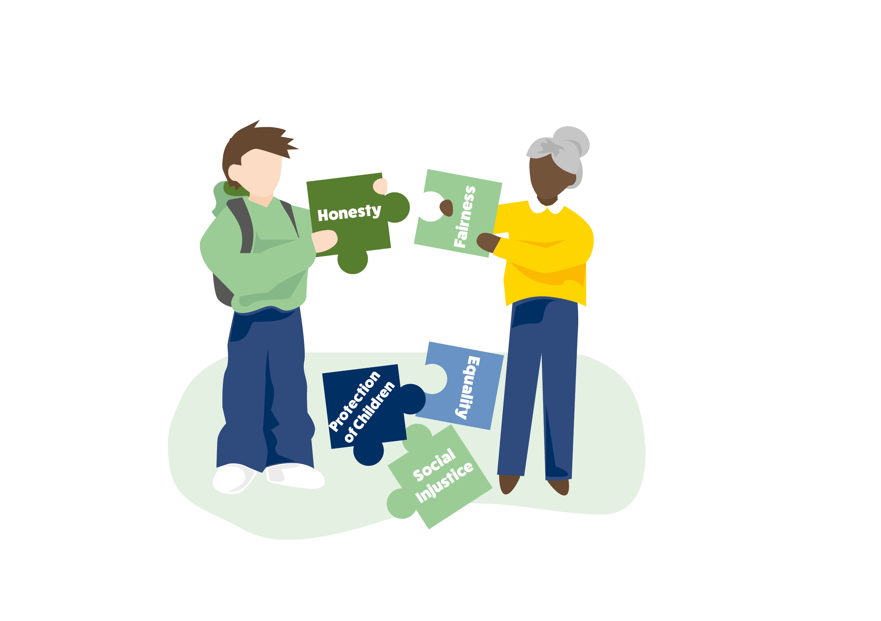
Industry influence on policymaking
“This is our well-being and health that's involved here. It's not all about money.”
“We think the government should restrict industry from being involved in policy-making the way it is with tobacco. It should be the same with alcohol and unhealthy foods.”
“When policy is being made, industry should not be involved in the policy, because they're too influential.”
“It needs to be health bodies with research who are involved in setting policy, not industries that are driven by profit.”
“Big companies have the power to just make things disappear and that's not fair”

Slide 4


Advertising
“Advertising is everywhere, we just get bombarded”
“We're inundated now… every platform you're on, it's advertising, advertising. So it's hard to get away from.”
“The more you see it, the more you want it”
“Advertising targets young people to try and hook them for life”
“You never see any healthy things advertised, ever. It’s all the unhealthy things.”
“All the offers and promotions we get these days are on the food that's not good for us. When do you see buy one, get one free for anything good?”
“There should be more control and regulation on how advertising is used to market these products.”

Slide 5

Availability
“The ease at which you can buy alcohol. Just go to the bottom of the road in most cases.”
“Everything's so easy to get, and everything's so available. You don't have to look far, you don't have to walk far.”
“If people know it's there, like, five minutes away from home, they're more inclined to buy that”
“There's so much unhealthy fast food and that's what we need to be tackling. And not enough healthy fast food. It's convenience that's driving people's behaviours.”
“Healthy food should be more easily accessible”

Slide 6
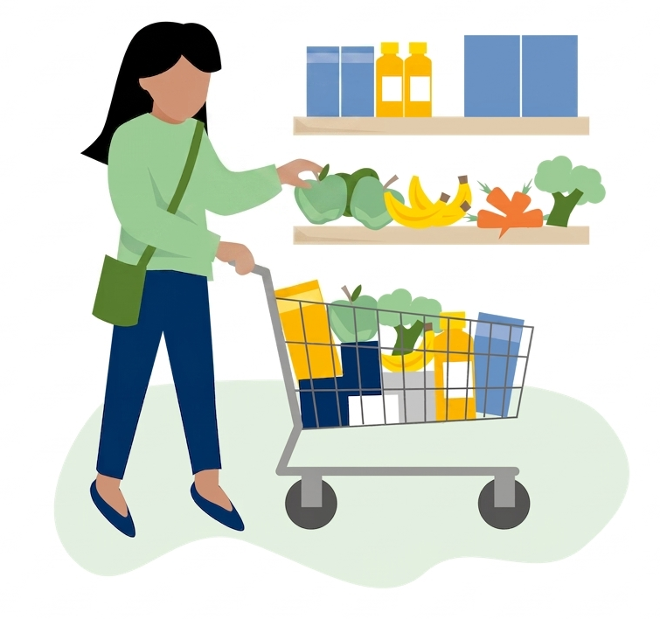
Price (reduce the price of healthy food)
“We'd like to rebalance prices so that it's more affordable to buy healthy food, rather than unhealthy.”
“We need cheaper, more convenient, healthy foods”
“It's not always about making a bad thing more expensive, like unhealthy food, but making the healthy option easier, more affordable.”

Slide 7
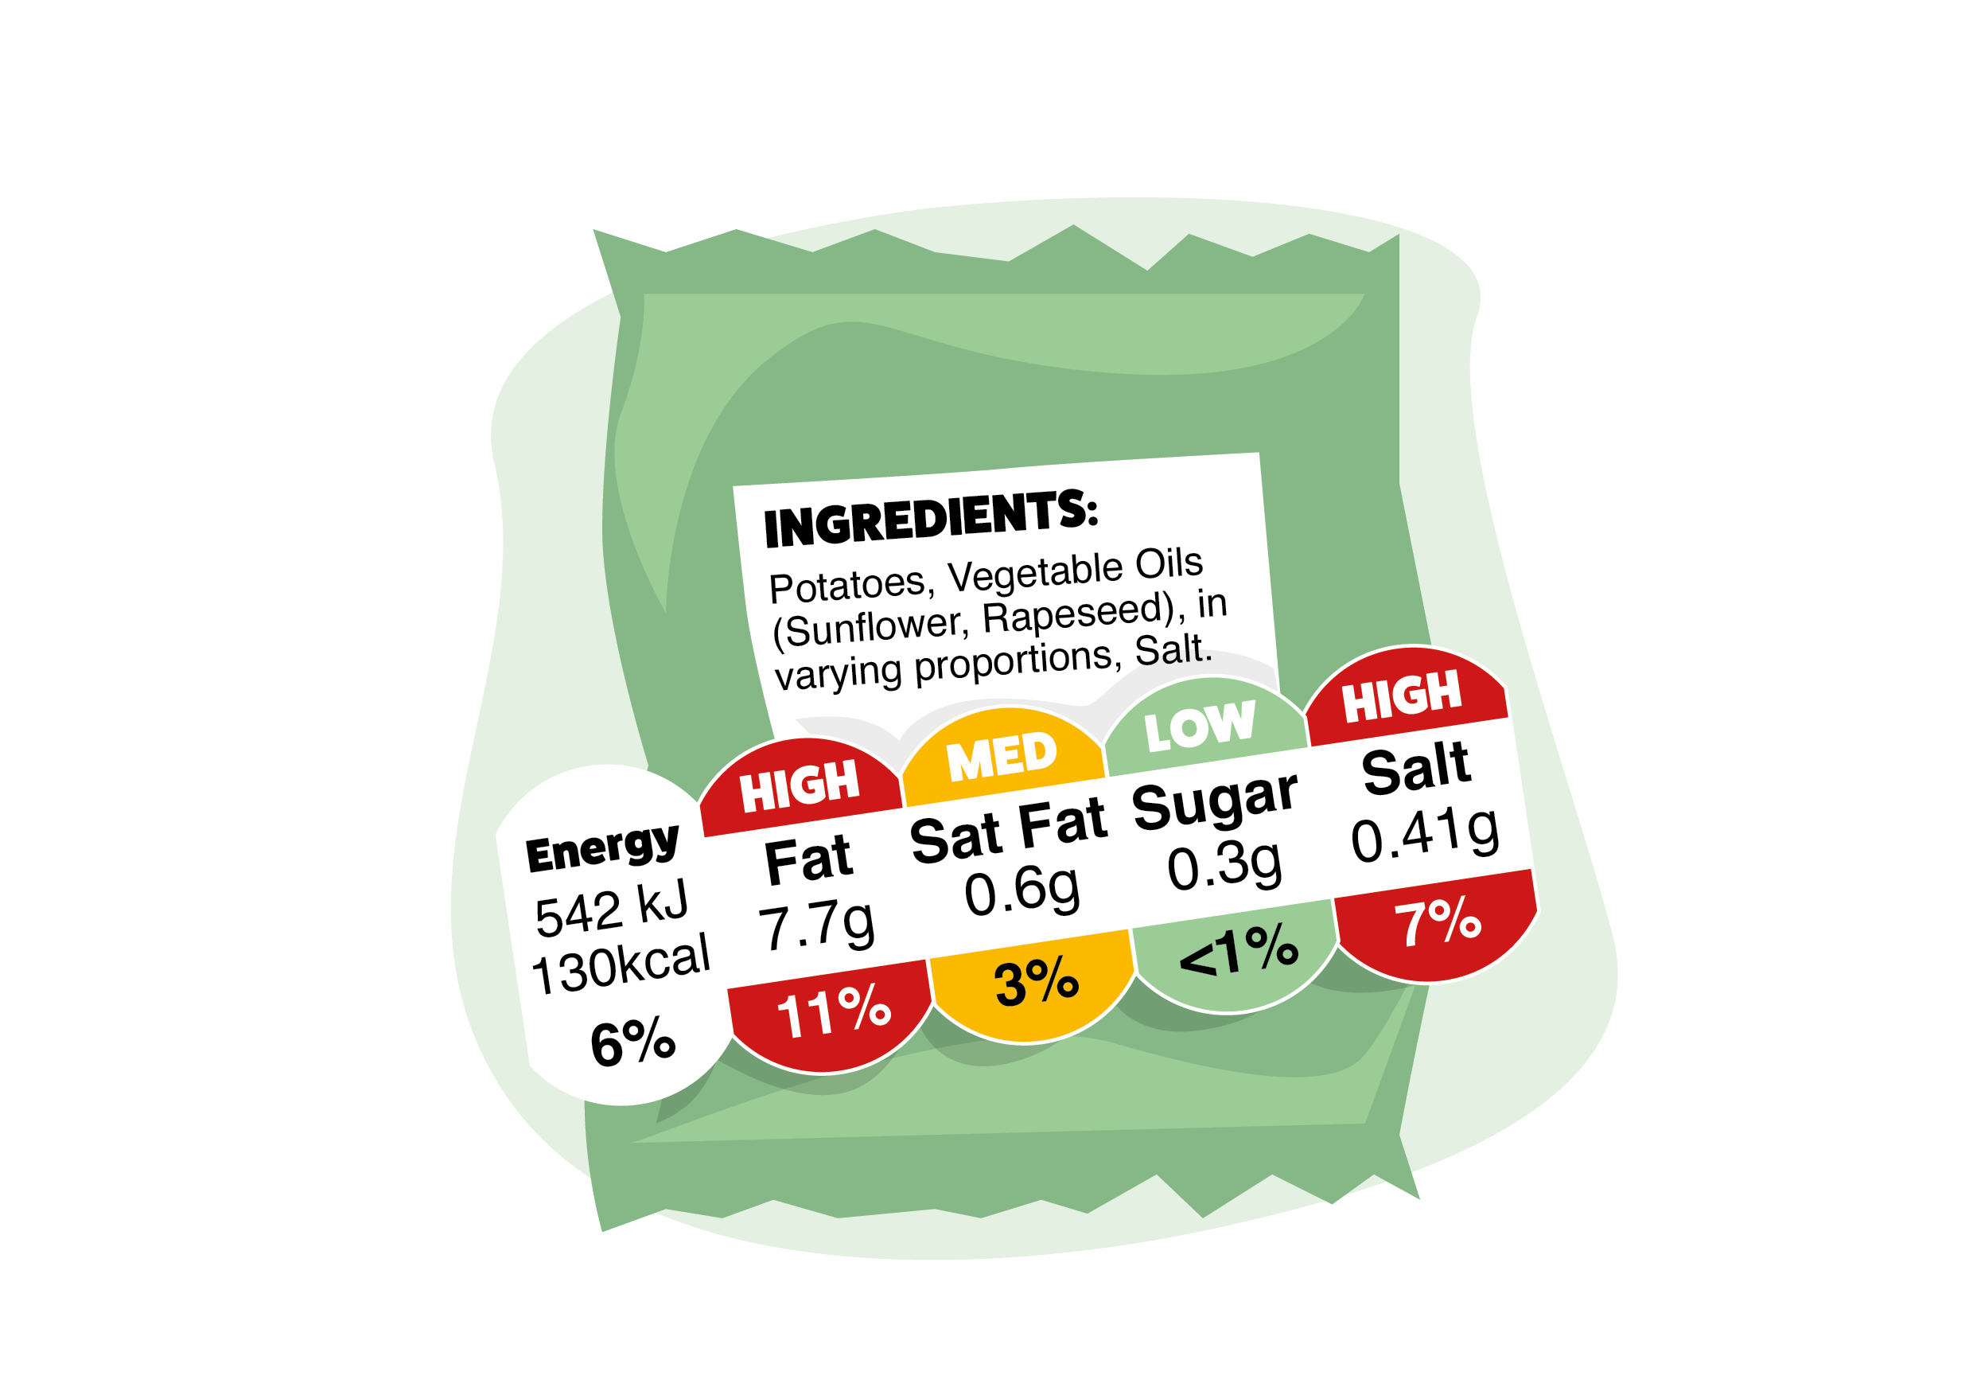
Labelling
“the labelling of things, you know, occasionally you might look at the back of the label and then you see the ingredient list and you just don't understand it, it's just like a different language. You know, and you think, what does that do? What's an emulsifier? “
“We should improve labelling on alcohol to reduce the appeal and remind of the dangers”
“There definitely needs to be something done about when they label something as healthy when it clearly isn’t.”

Slide 8


Food
“Get children excited about healthy food!”
On the importance of addressing unhealthy food:
“We all need to eat. So it's not whether these companies sell us food or they don't sell us food. It's about the health of the food that they're selling us.”
“we all consume food every day. You have to eat.”
“the most important thing out of all of it is food. Without it we can't live”

Slide 9


Why do jurors want these changes?
“It will empower local communities to take control of their health”
“Empower the people rather than the industry”
“People will have the opportunity to ‘start from the same place’, access healthy food regardless of where they are”
“It will make our local communities healthier, now and in the future”
“Prevent (future) strain and burden on the NHS”
“Keep financial interests out of policy – health above profit”
Notes:
These reasons can be group under the following areas:
Create choices and give people control
Improve health locally and nationally
Reduce pressure on the NHS
Prioritise health over profit
Education and reinforcement of messages to influence change

Slide 10
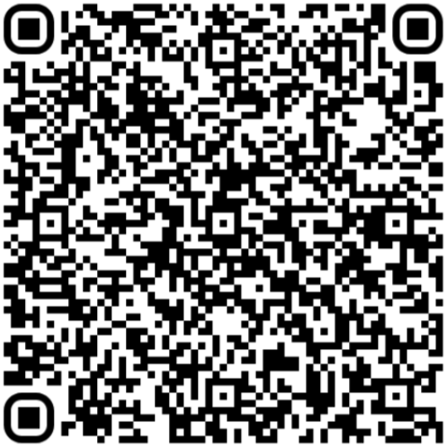
Find out more…
https://yhadph.short.gy/CJ
Juror stories and video clips
Findings from the juries
Communicating for impact toolkit
The Citizens’ Jury process
Executive summary and full report

Slide 11














Commissioned and funded by: Yorkshire and Humber Association of Directors of Public Health (Y&H ADPH)
Acknowledgements
Juror recruitment and support:
With support from:

