Slide 1

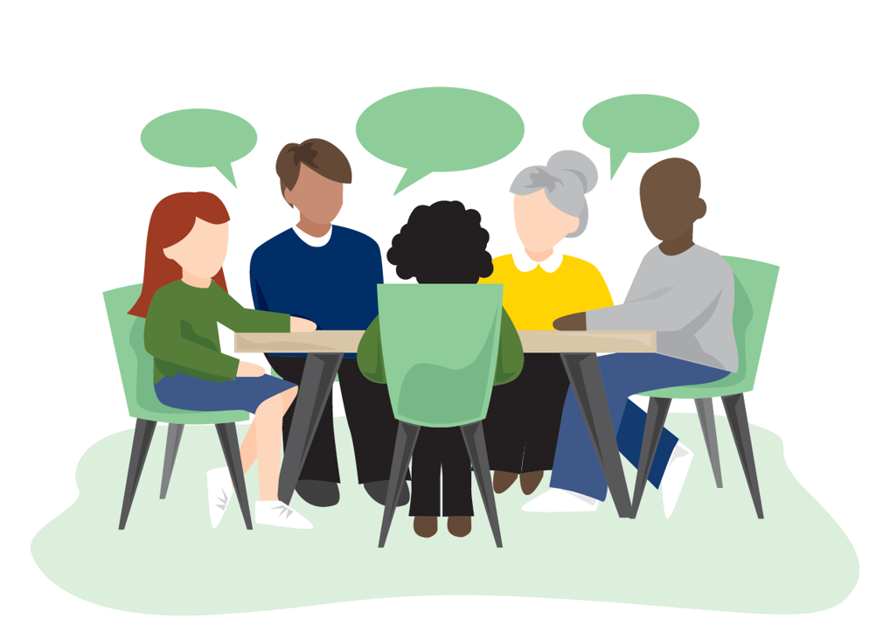
Yorkshire and Humber Citizens’ Juries on Health and Harmful Products
Juror stories

Slide 2
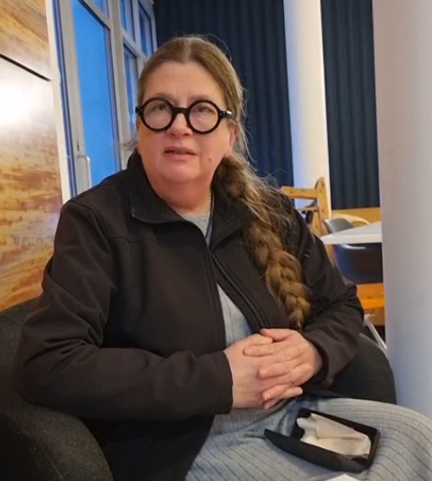
Ruth
“I joined the Citizens Jury because I thought it was very an interesting area subject and I wanted to find out more about my community and the issues affecting it.”
“I think one of the main things I learned was about the inequalities of health, particularly for areas that I live in in Doncaster, and how that affects life expectancy.”
“People do care about these issues and it really should be focused on a lot more. Whether it is legislation at a national level, or at a local level, things have to change for peoples’ health and wellbeing”

Slide 3
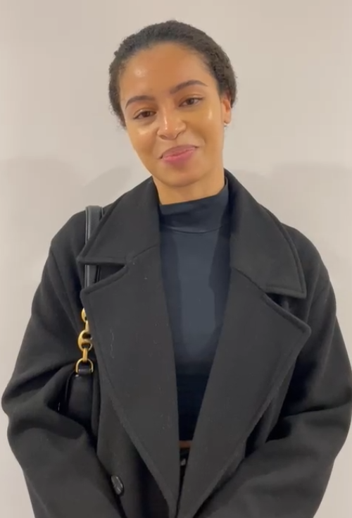
Olivia
“I joined the Citizens’ Jury because I’m passionate about seeing change in local community and nationally as well”
“I've learned about different people's perspectives and experiences in Wakefield, as well as what goes into policy making and all of the hard work that it actually takes to make policies a reality.”
“I would like decision makers to hear about how interconnected all of these issues are, and I think also, for me, it's mainly about the unhealthy foods and the ingredients that go into them and making uncommon knowledge more common.”

Slide 4
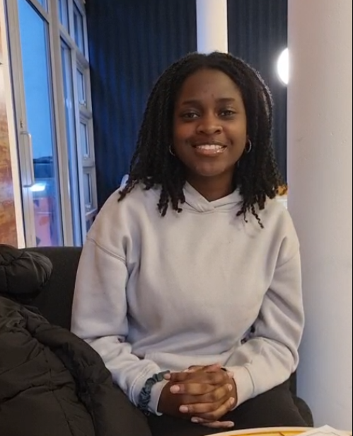
Nicole
“I joined the Citizens Jury because I wanted to get out of my comfort zone and participate in helping the community in whatever way I can, especially since I am part of the youth of the society, so I do want to contribute.”
“What I've learned is that alcohol, tobacco and unhealthy foods do have a major impact on our society's health issues and we need to tackle that.”
“What I would like for decision makers to hear is that things like advertising of products on social media of products like alcohol, unhealthy food and vaping, particularly for the young people of our society, I think that needs to be reduced.
Also, the accessibility of alcohol and vapes all around. There are so many local corner shops that you can easily go to that just have these products available and I feel that this is contributing to a decline in society’s health and I feel like we should be able to implement policies to reduce that.”

Slide 5
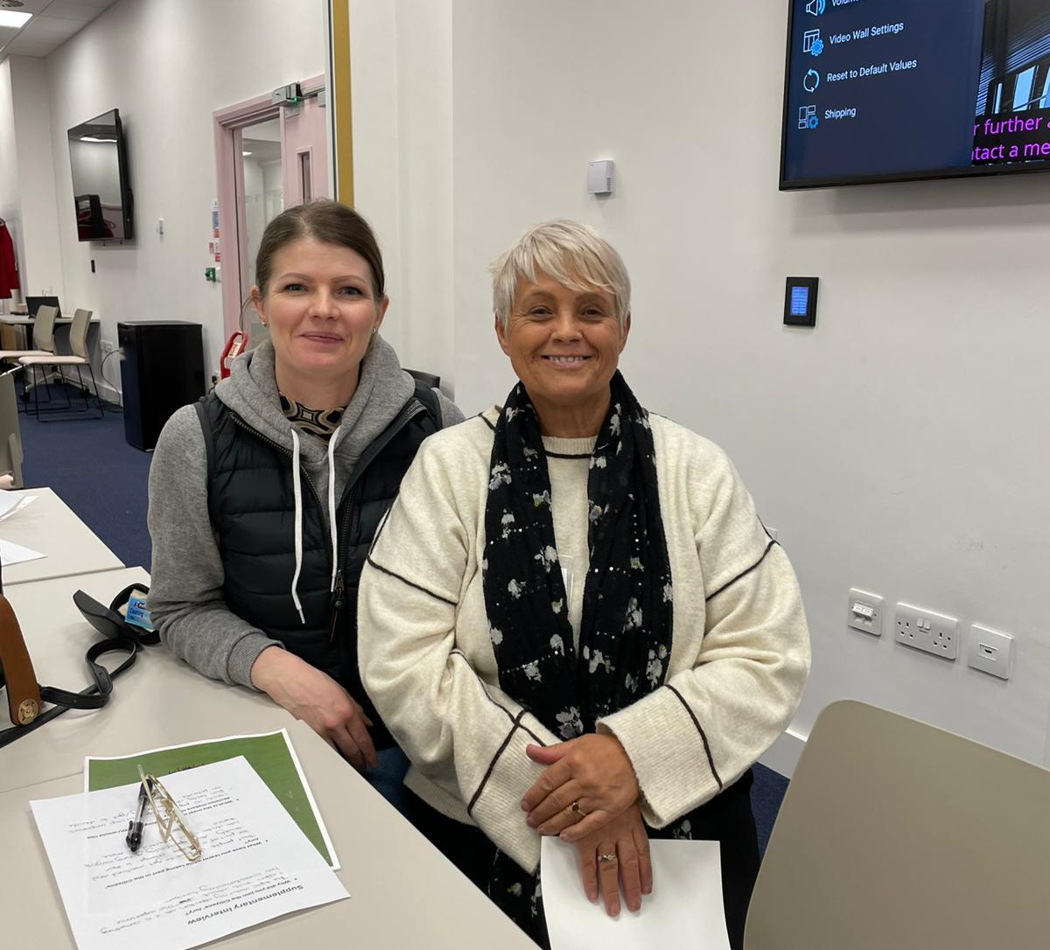
Jodie & Angela
“The experience has broadened my horizon.”
“I have learnt that people do like to get involved and be part of a positive change in their society.”
“I think it’s popular opinion [among jurors] that we should stop companies from being able to lobby and to decide on policies”
Jodie
“Taking part means I hopefully get to help change things in the future and give people a view from the people that these changes culturally affect.”
“I have learnt that industries have too much input into policy decisions.”
Angela

Slide 6
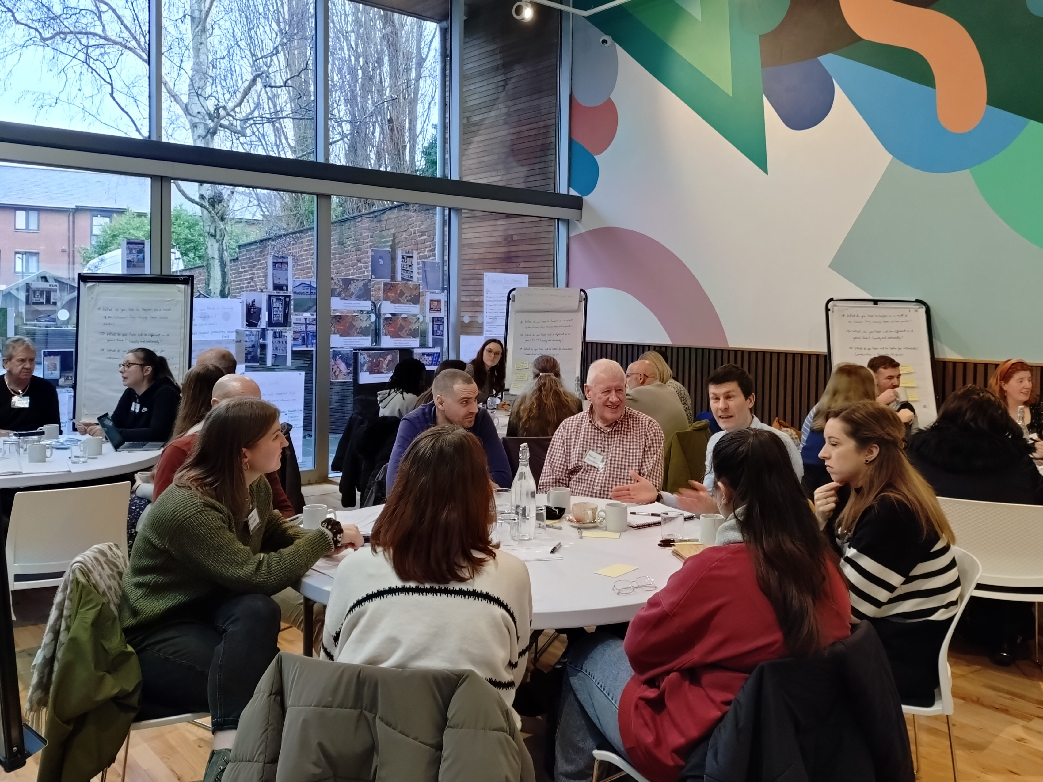
Aneeka
“I wanted to take a more active role as a citizen and do something out of my comfort zone and do something to help my local area.”
“I've learnt more about what my community values and how we collectively want and hope for a healthier future and better health for ourselves and future generations.”
“I'd like decision makers to know that we intrinsically want deeper change, especially with the rise of alcohol, smoking to vaping and obesity related to unhealthy foods.”

Slide 7
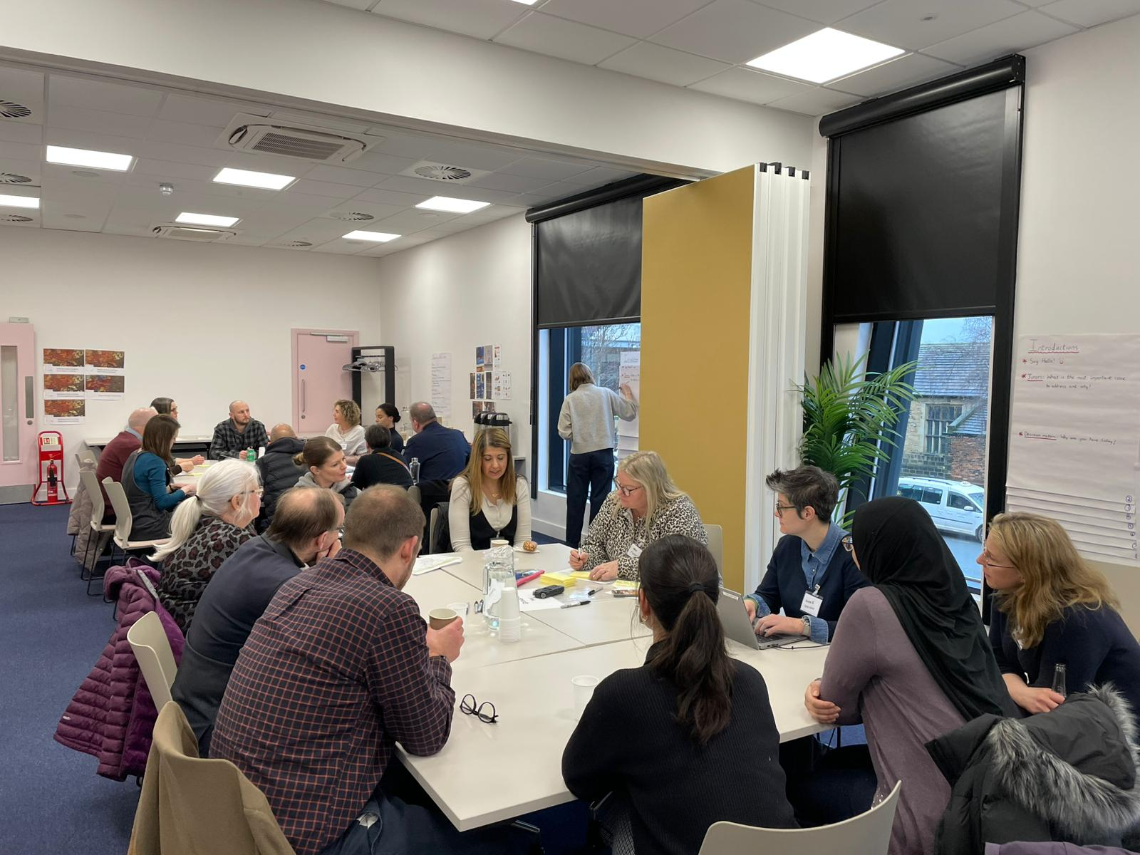
Mariam
“I found the experience really interesting and enriching. It was really positive to see how invested the powers that be are in the perspectives and ideas of the public. We were well looked after and I felt that everyone was listened to and encouraged to contribute. I would recommend this experience to anyone who is offered it as it has certainly given me a more nuanced understanding of the different factors at play.”

Slide 8
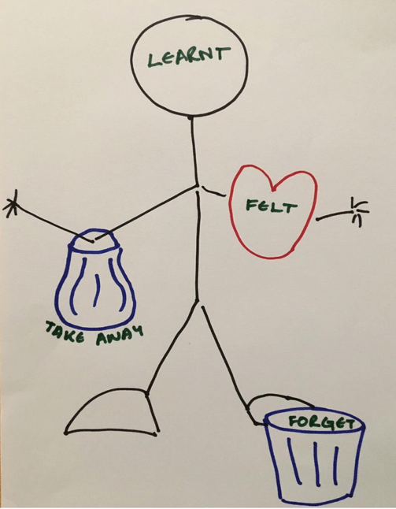
Juror’s collective reflections on the process
After each workshop, jurors were invited to reflect on the process:
Jurors described how participation in the Citizens’ Jury made them feel:
They valued meeting new people, working as a group and taking part in something important
The opportunity to hear other people’s views
Coming away feeling enthusiastic and encouraged
Jurors felt they learnt:
A lot of helpful information, including health statistics and about public health policies and policy making
That unhealthy eating is a major issue
About the importance and power of advertising to influence people and that there is too much advertising
That change is slow but change is possible
That people think differently
About the limitations of education as a policy intervention
“Others do care and change can happen”.

Slide 9
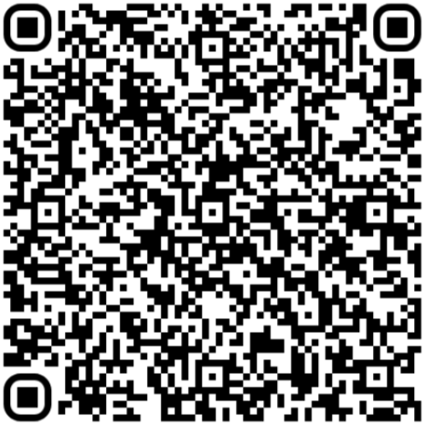
Find out more…
https://yhadph.short.gy/CJ
Findings from the juries
Filmed juror stories
Resource pack
Communicating for impact toolkit
The Citizens’ Jury process

Slide 10














Commissioned and funded by: Yorkshire and Humber Association of Directors of Public Health (Y&H ADPH)
Acknowledgements
Juror recruitment and support:
With support from:

