Slide 1


Yorkshire and Humber Citizens’ Juries on Health and Harmful Products
Initial findings

Slide 2














Commissioned and funded by: Yorkshire and Humber Association of Directors of Public Health (Y&H ADPH)
Acknowledgements
Juror recruitment and support:
With support from:

Slide 3
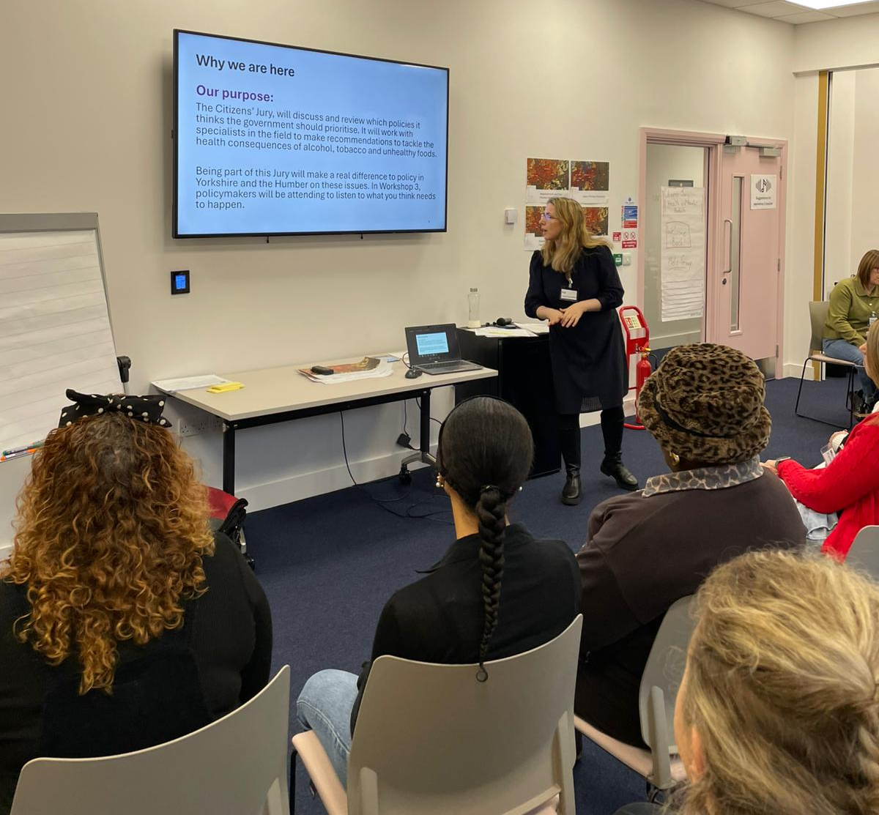
Project aim
To explore public views about the health and social impacts of commercial activities relating to tobacco, alcohol, and unhealthy food and to consider how governments should respond.
Notes:
To consider how governments (local, regional and national) should respond

Slide 4
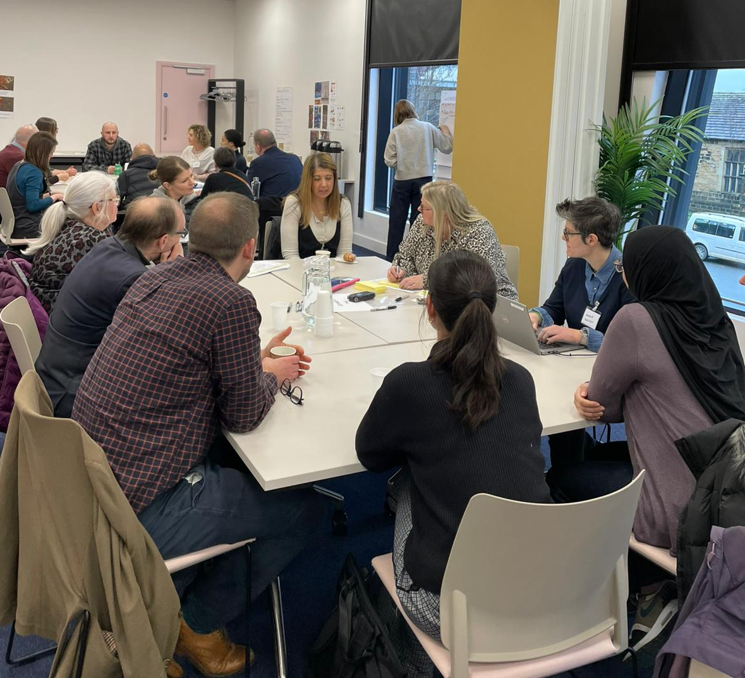
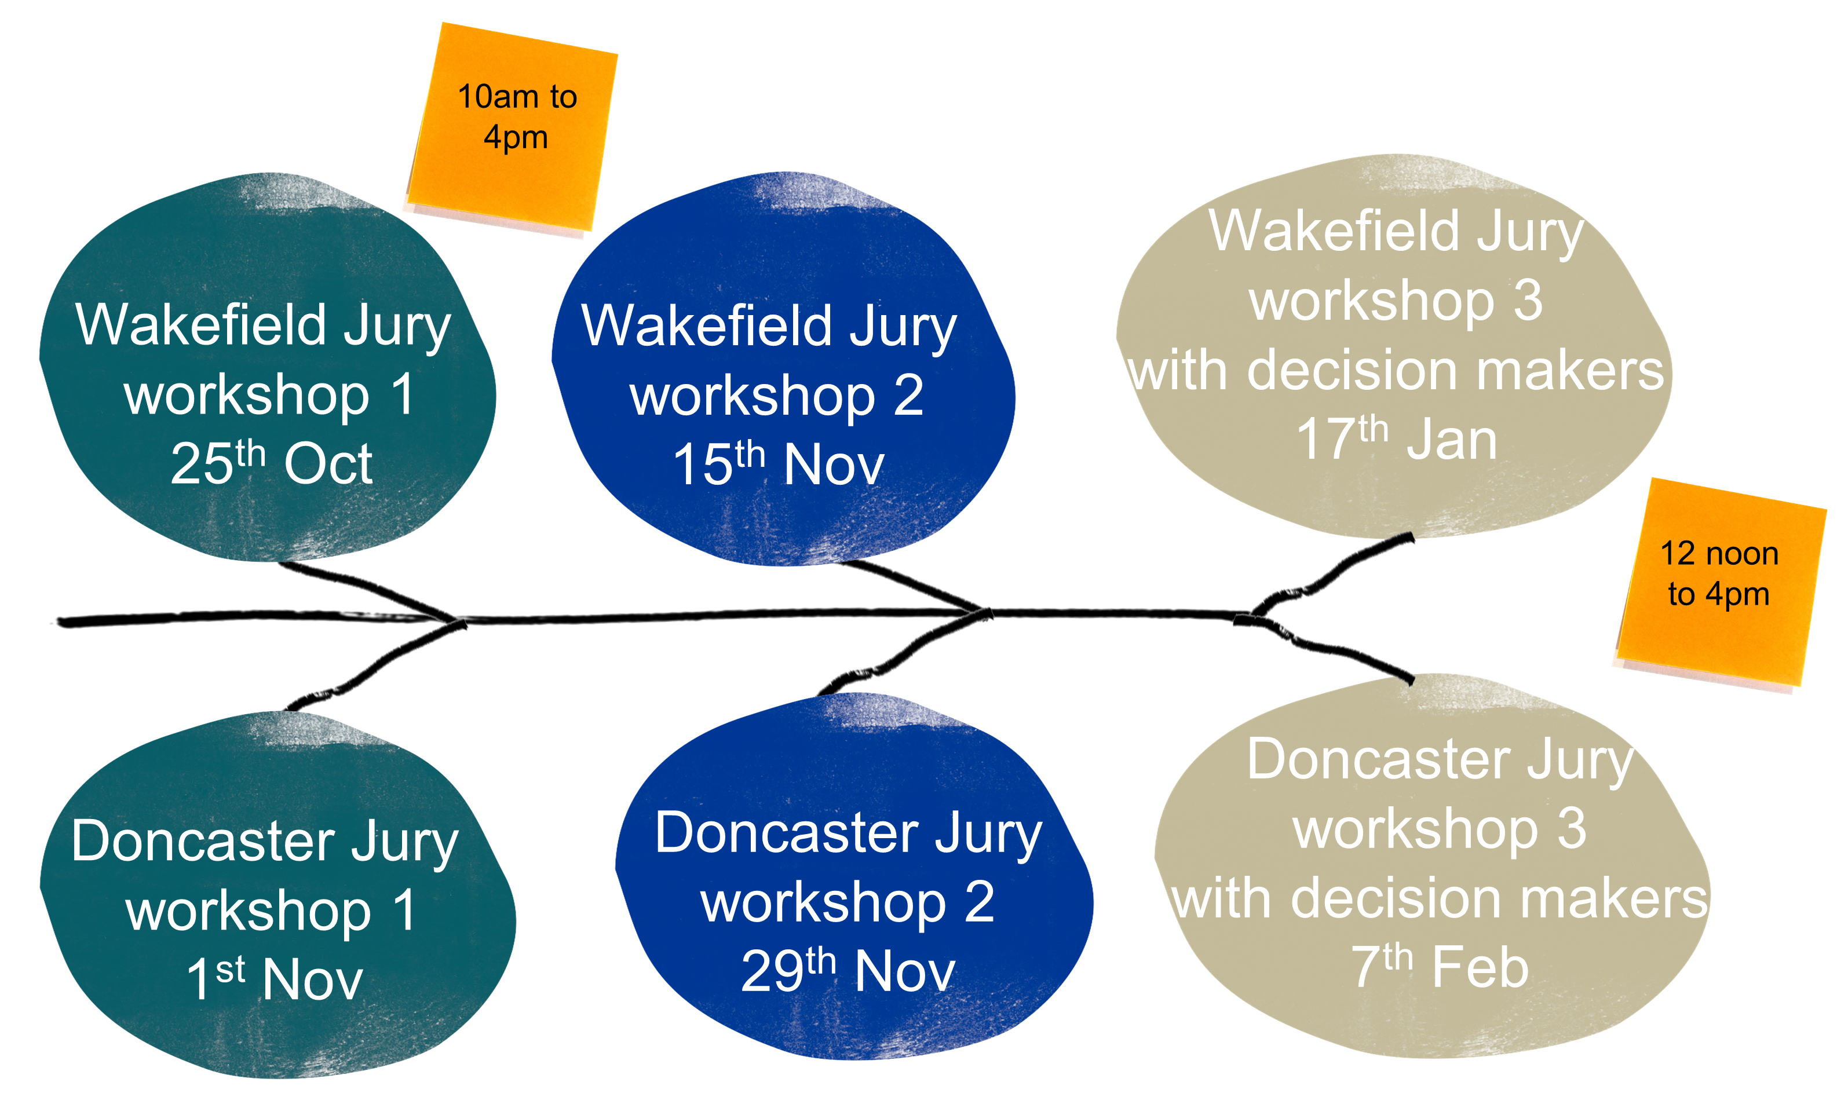
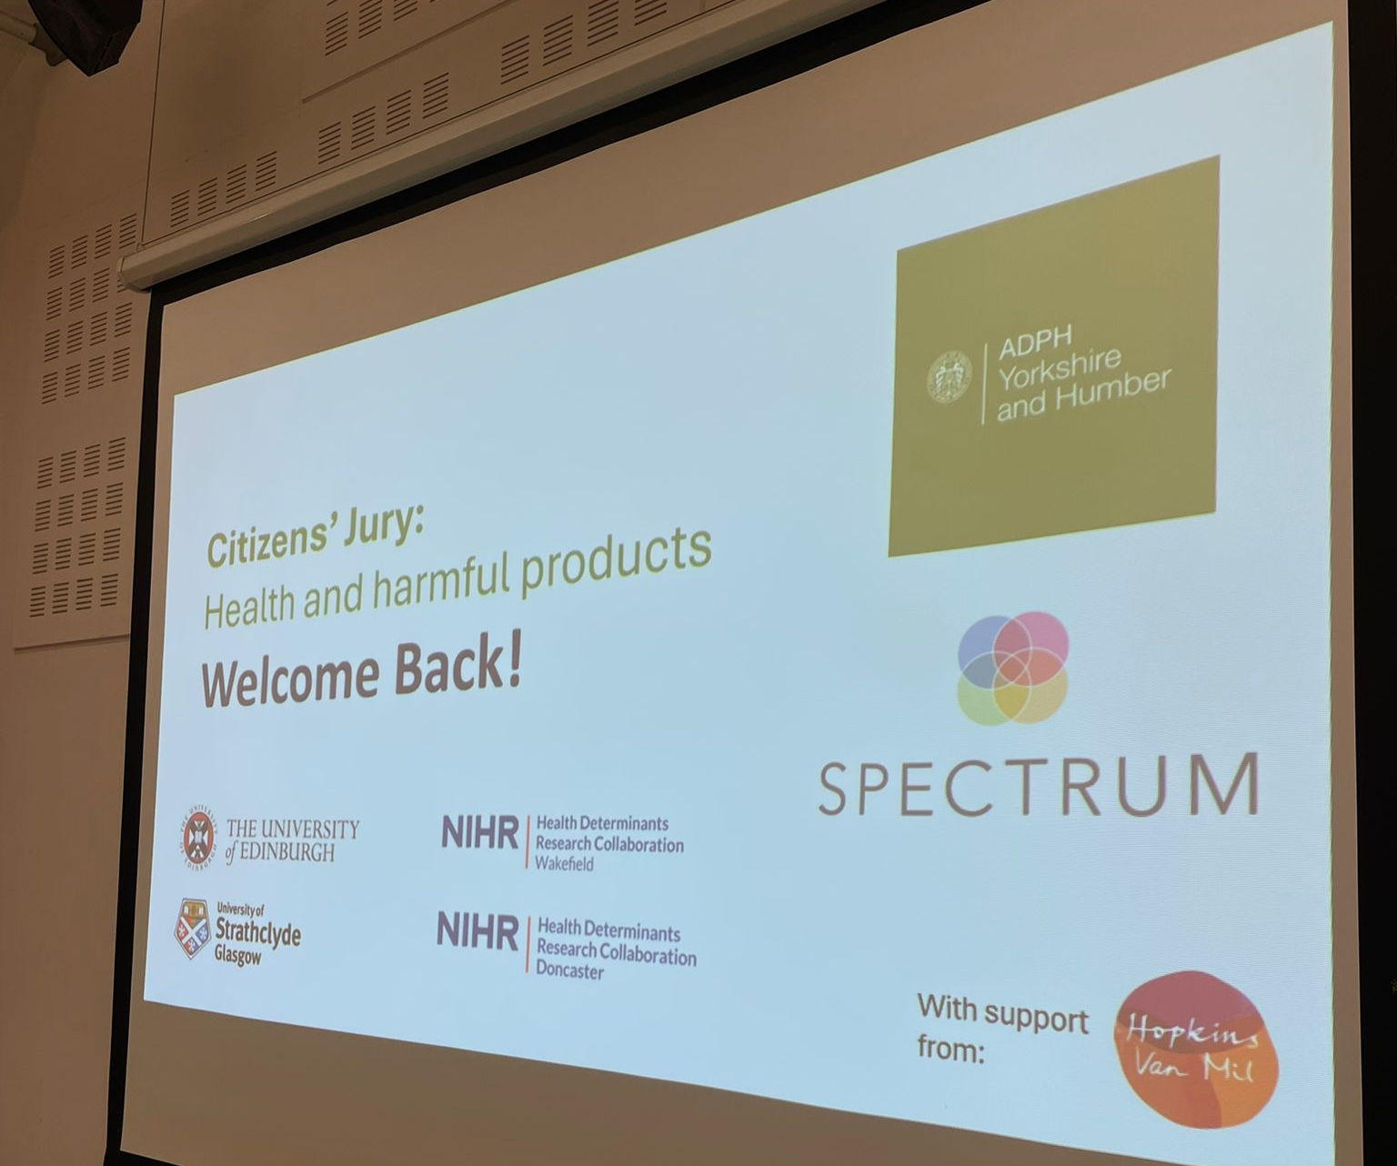
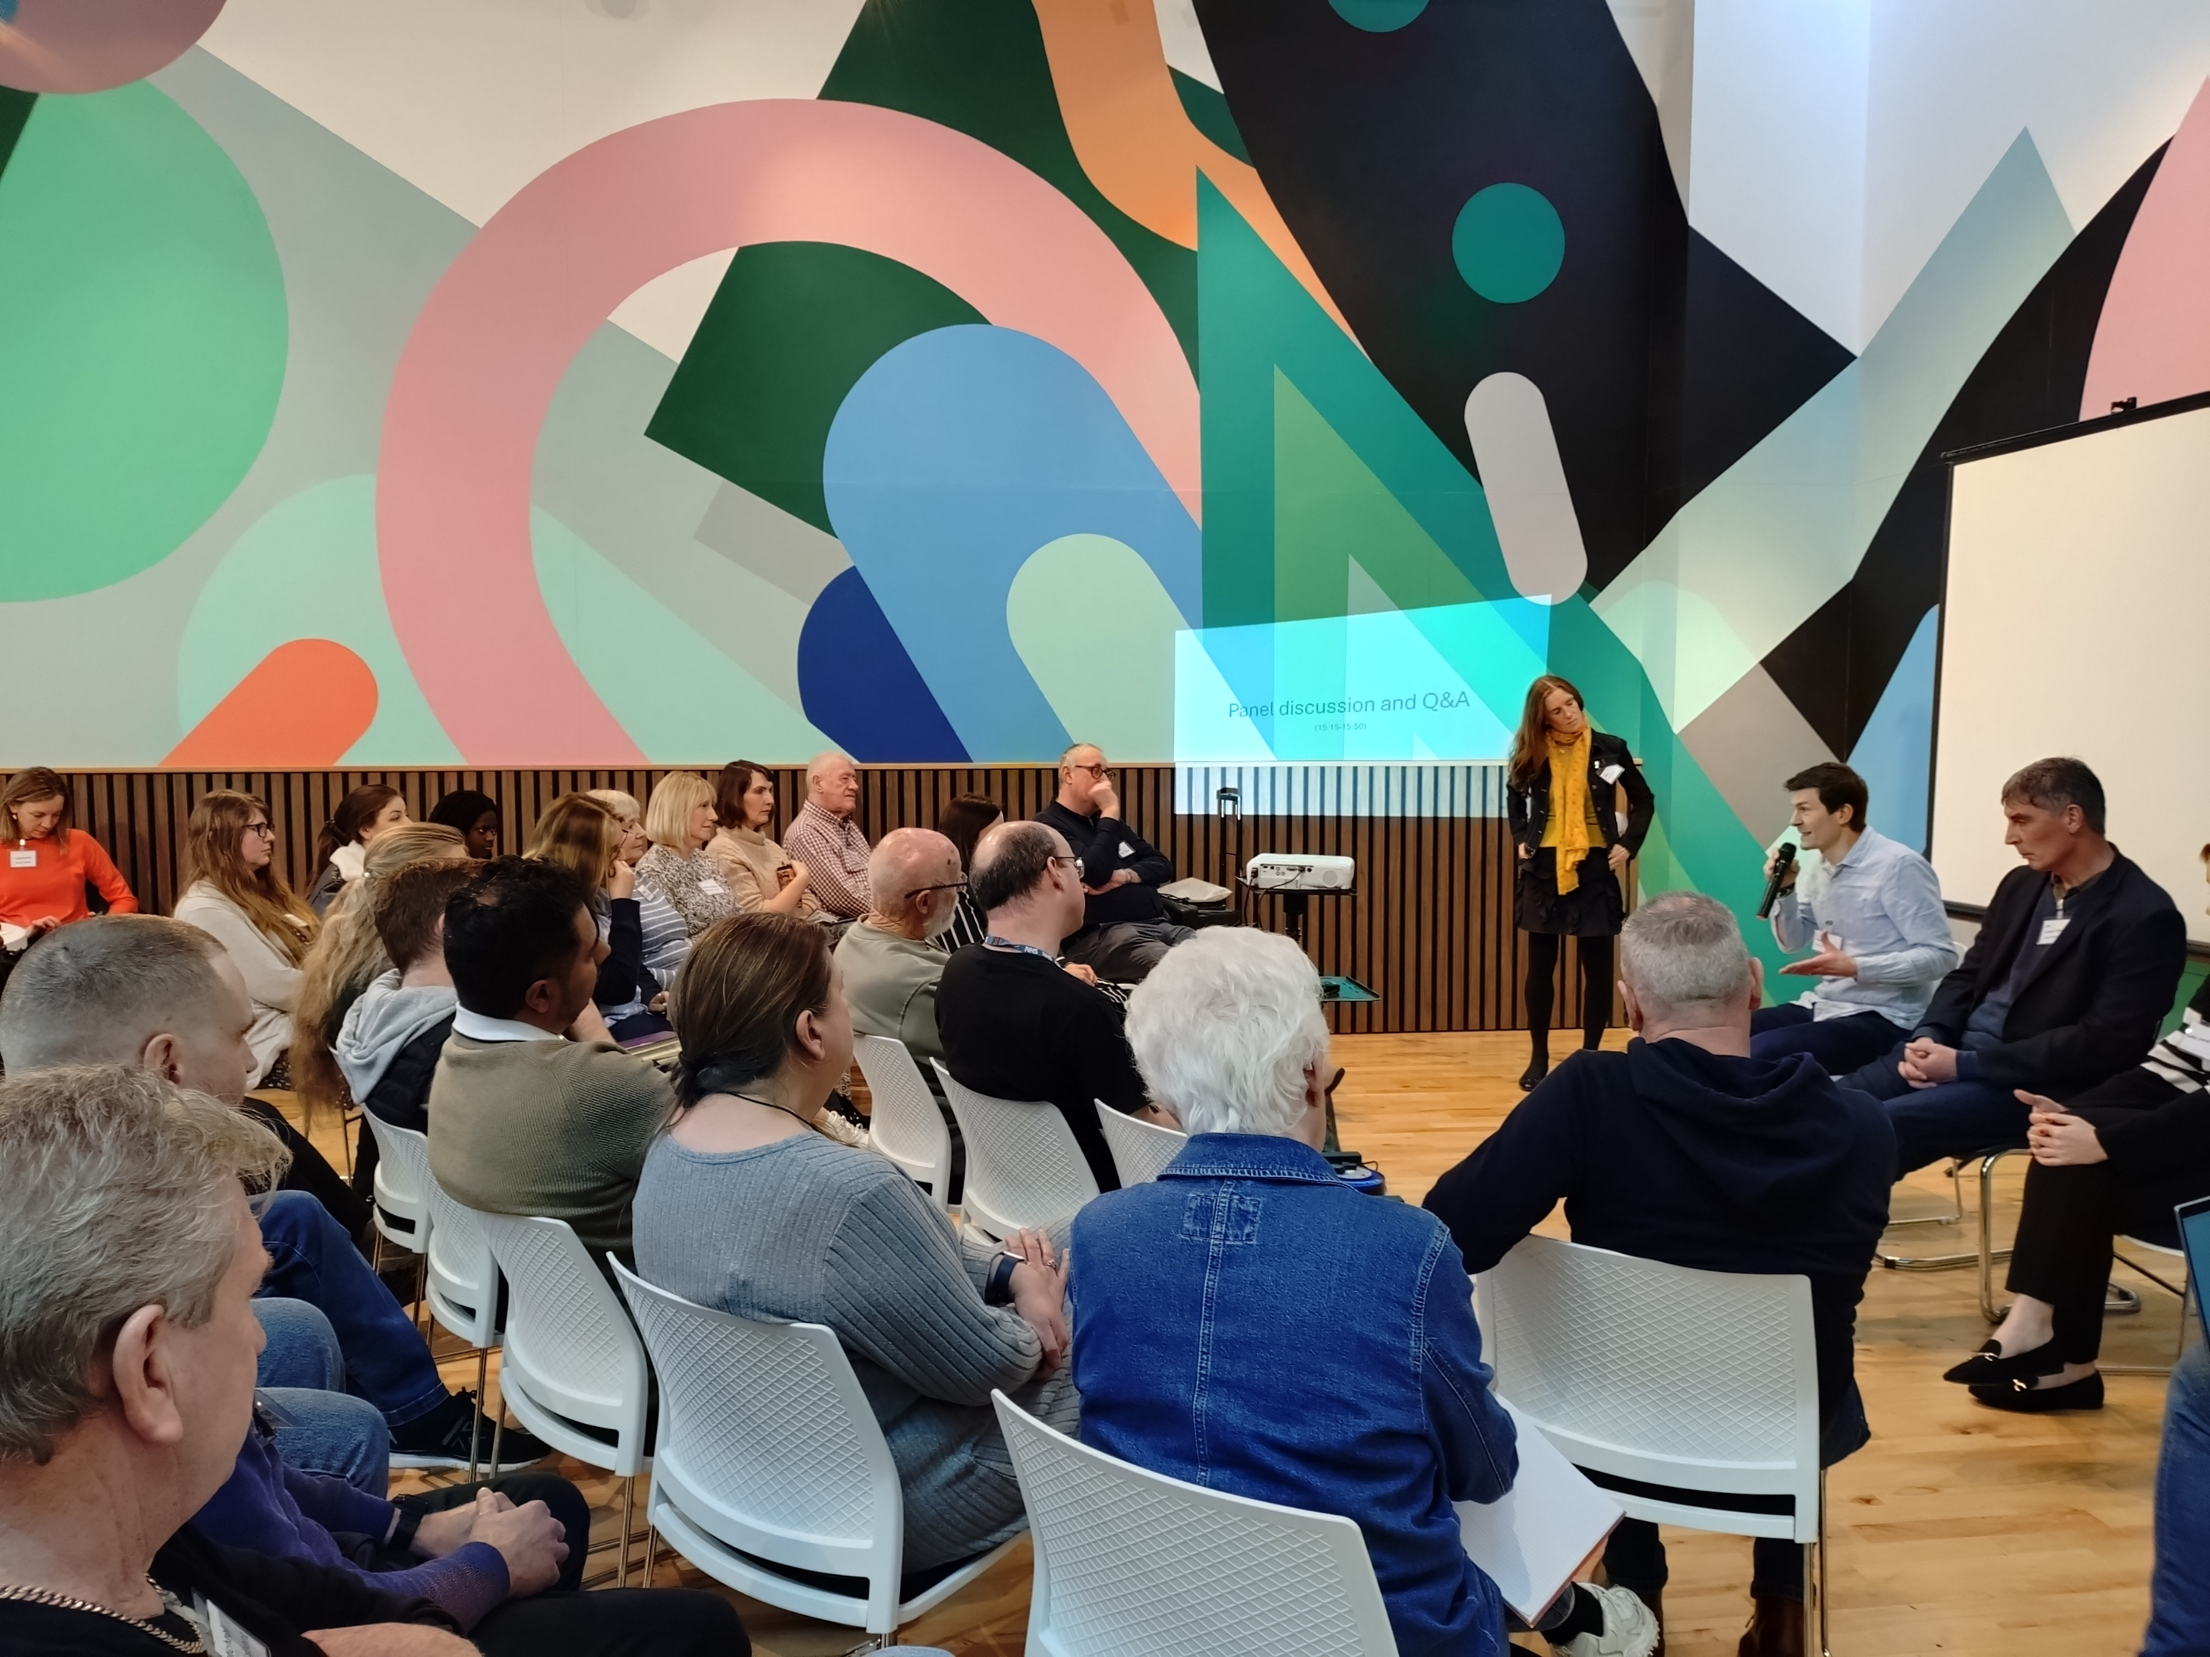
Workshops

Slide 5
Disclaimer
The findings shared here are preliminary. Full findings will be shared once academic analysis of the workshop discussions has been completed. Any results should be understood alongside the full mix of data generated in the workshops.
Data generated from the workshops
Images shared by Jury members
Questionnaire (start of W1 and repeated at the end of W2)
Polling using Wooclap.com during workshops
Jury voting of key issues and different policy actions
‘Manifestos for change’ developed by Jury members
Transcripts of discussions
Ethnographic notes
Initial, high-level findings
Researchers undertaking qualitative analysis; published academic outputs and updated summary of findings to follow.

Slide 6
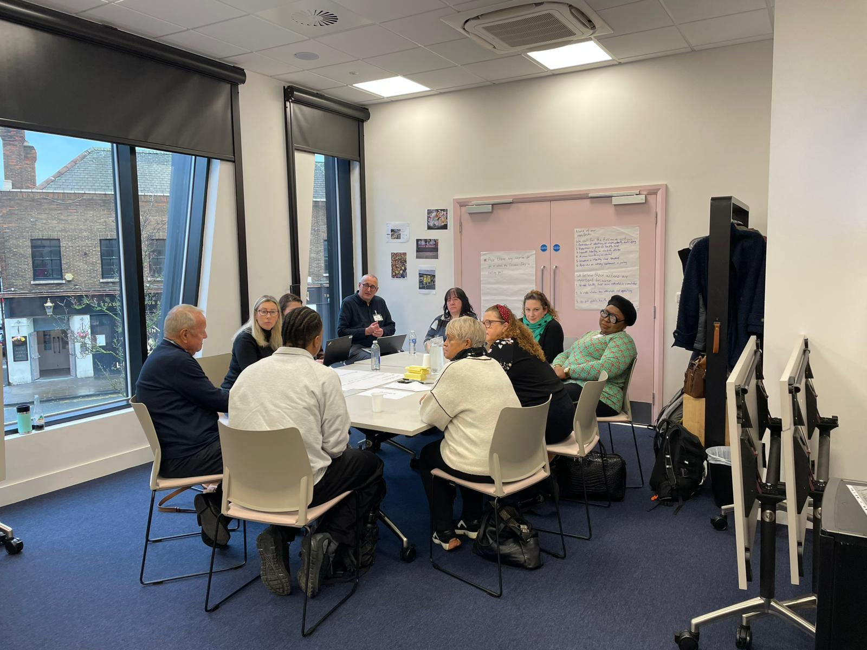
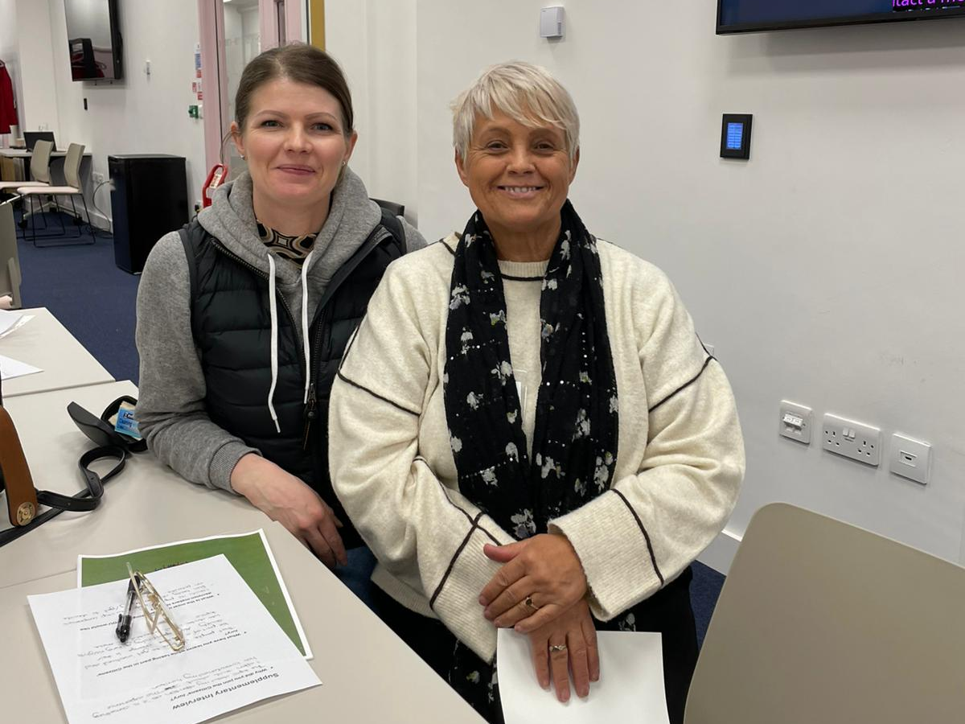
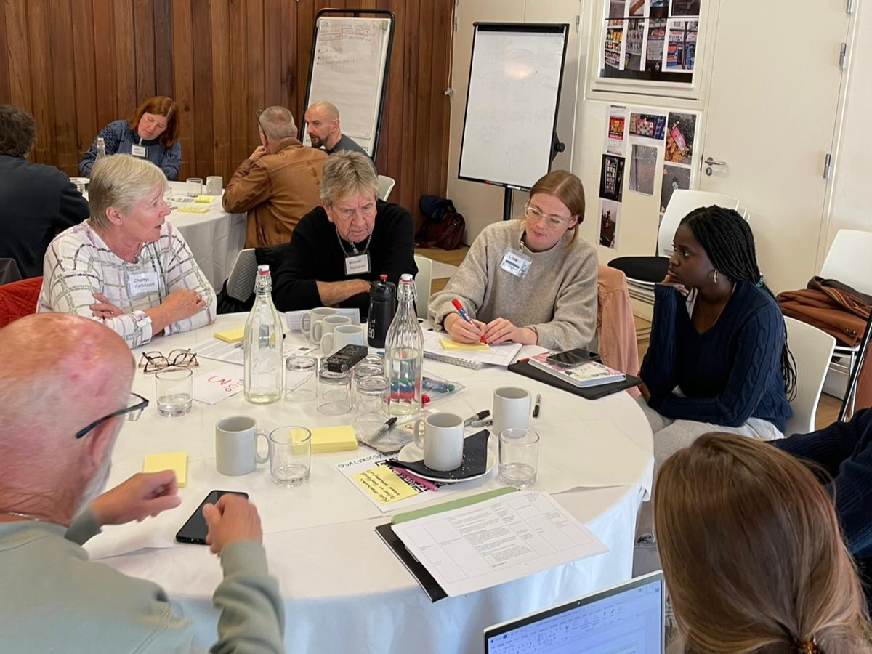
Questionnaire
Before and after questionnaire, asking about views on:
  Impacts on health and the alcohol, tobacco and unhealthy food industries
  Broad policy options for reducing their health impacts (marketing, availability, and price)
  Industry involvement in policymaking

Slide 7
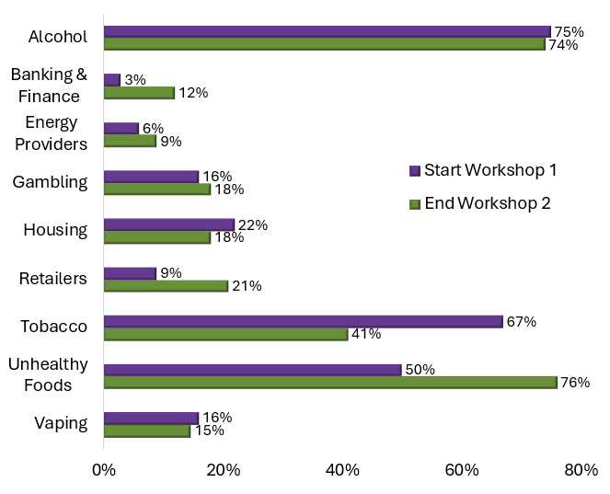
What has the biggest impact on health?
Large increase in the number of jurors selecting unhealthy food industries, but a decrease in those choosing tobacco
Increasing concern about the impact of social issues on health, with the influence of friends and family and of their local physical environment overtaking genetics and biology (separate to question shown here).
Individual questionnaire responses to:
“Select three industries that have the biggest impacts on health and well-being of people in their neighbourhoods”

Slide 8
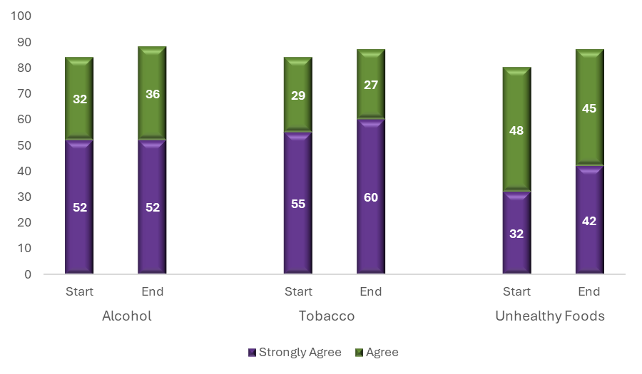
Support for marketing restrictions
A clear and increasing majority (87-88%) agreed that limits should be placed on advertising, promotion and sponsorship for all three industries (alcohol, tobacco and unhealthy food)
Percentage
Individual questionnaire responses to:
“Measures should be introduced to limit advertising, promotion and sponsorship”

Slide 9
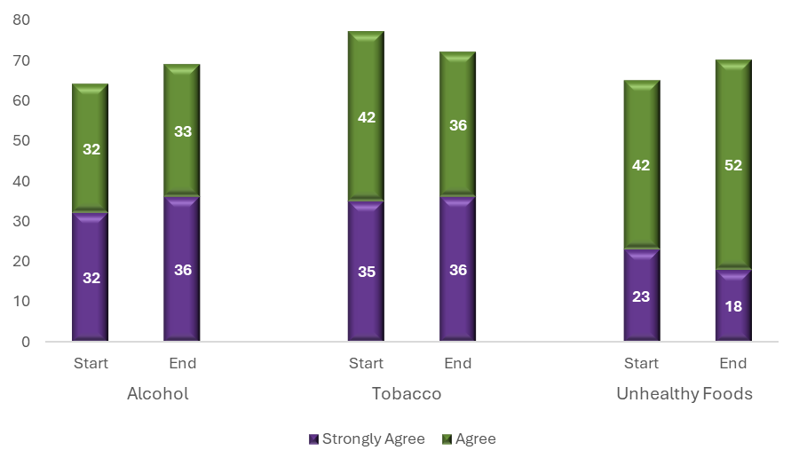
Support for reducing availability
Broad support (70-73%) for actions to reduce availability by reducing the number of outlets selling alcohol, tobacco and unhealthy food, with modest changes across the two workshops
Percentage
Individual questionnaire responses to:
“Policies should be adopted to reduce the number of outlets selling these products in my neighbourhood”

Slide 10
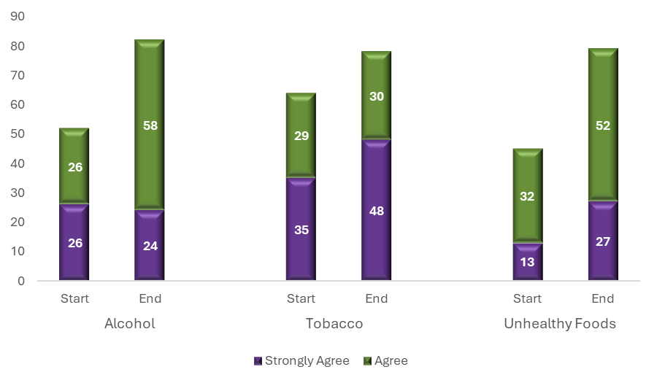
Support for price-based interventions
Strong support for price-based interventions for all three products.
By the end of the second workshop, 82% supported price increases for alcohol, and 79% for both tobacco and for unhealthy foods.
Percentage
Individual questionnaire responses to:
“Policies to increase prices should be adopted to reduce their health and social impacts”

Slide 11
Protecting policy from industry
Strong and increasing support for the idea that government health policy should be protected from the influence of each of the three industries
Nobody disagreed by the end of the second workshop
Individual questionnaire responses to:
“All government health policy should be protected from the influence of this industry.”

Slide 12
Partnering with industry
Significant drop in the number of jurors who believed that government should partner with any of the three industries to reduce health and social harms
Individual questionnaire responses to:
“Government should partner with this industry to develop collaborative approaches to reducing health and social impacts.”

Slide 13
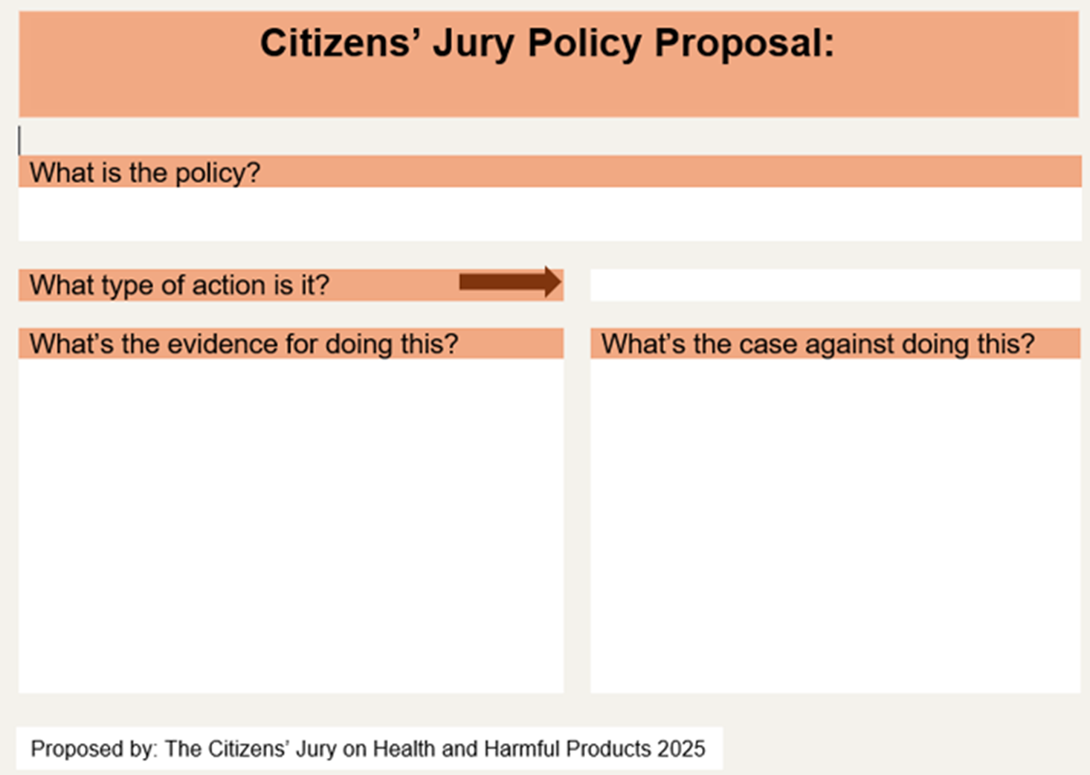
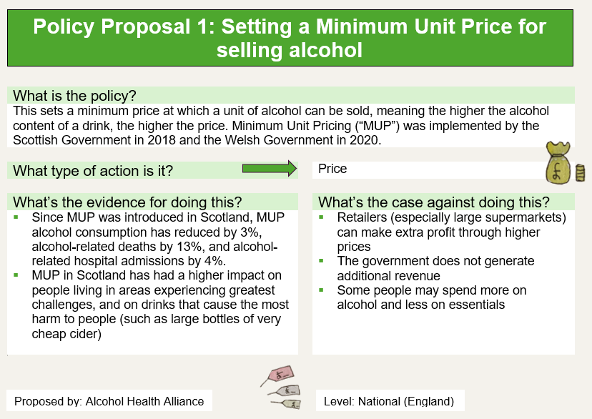
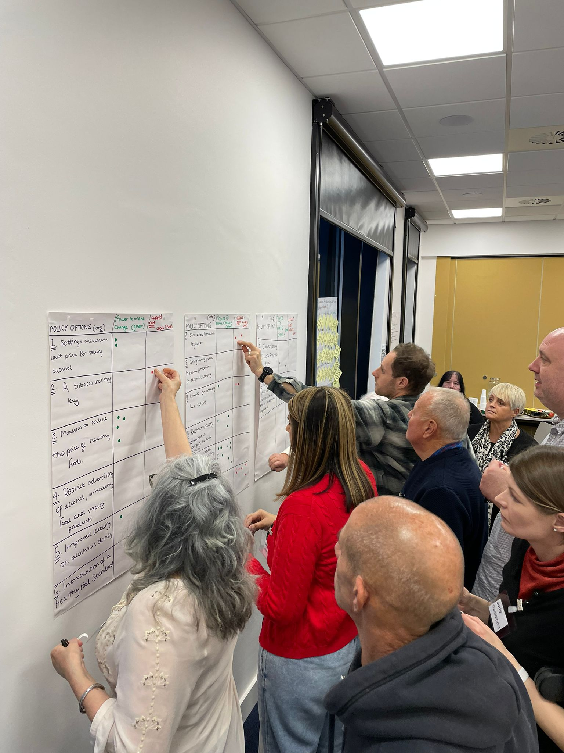
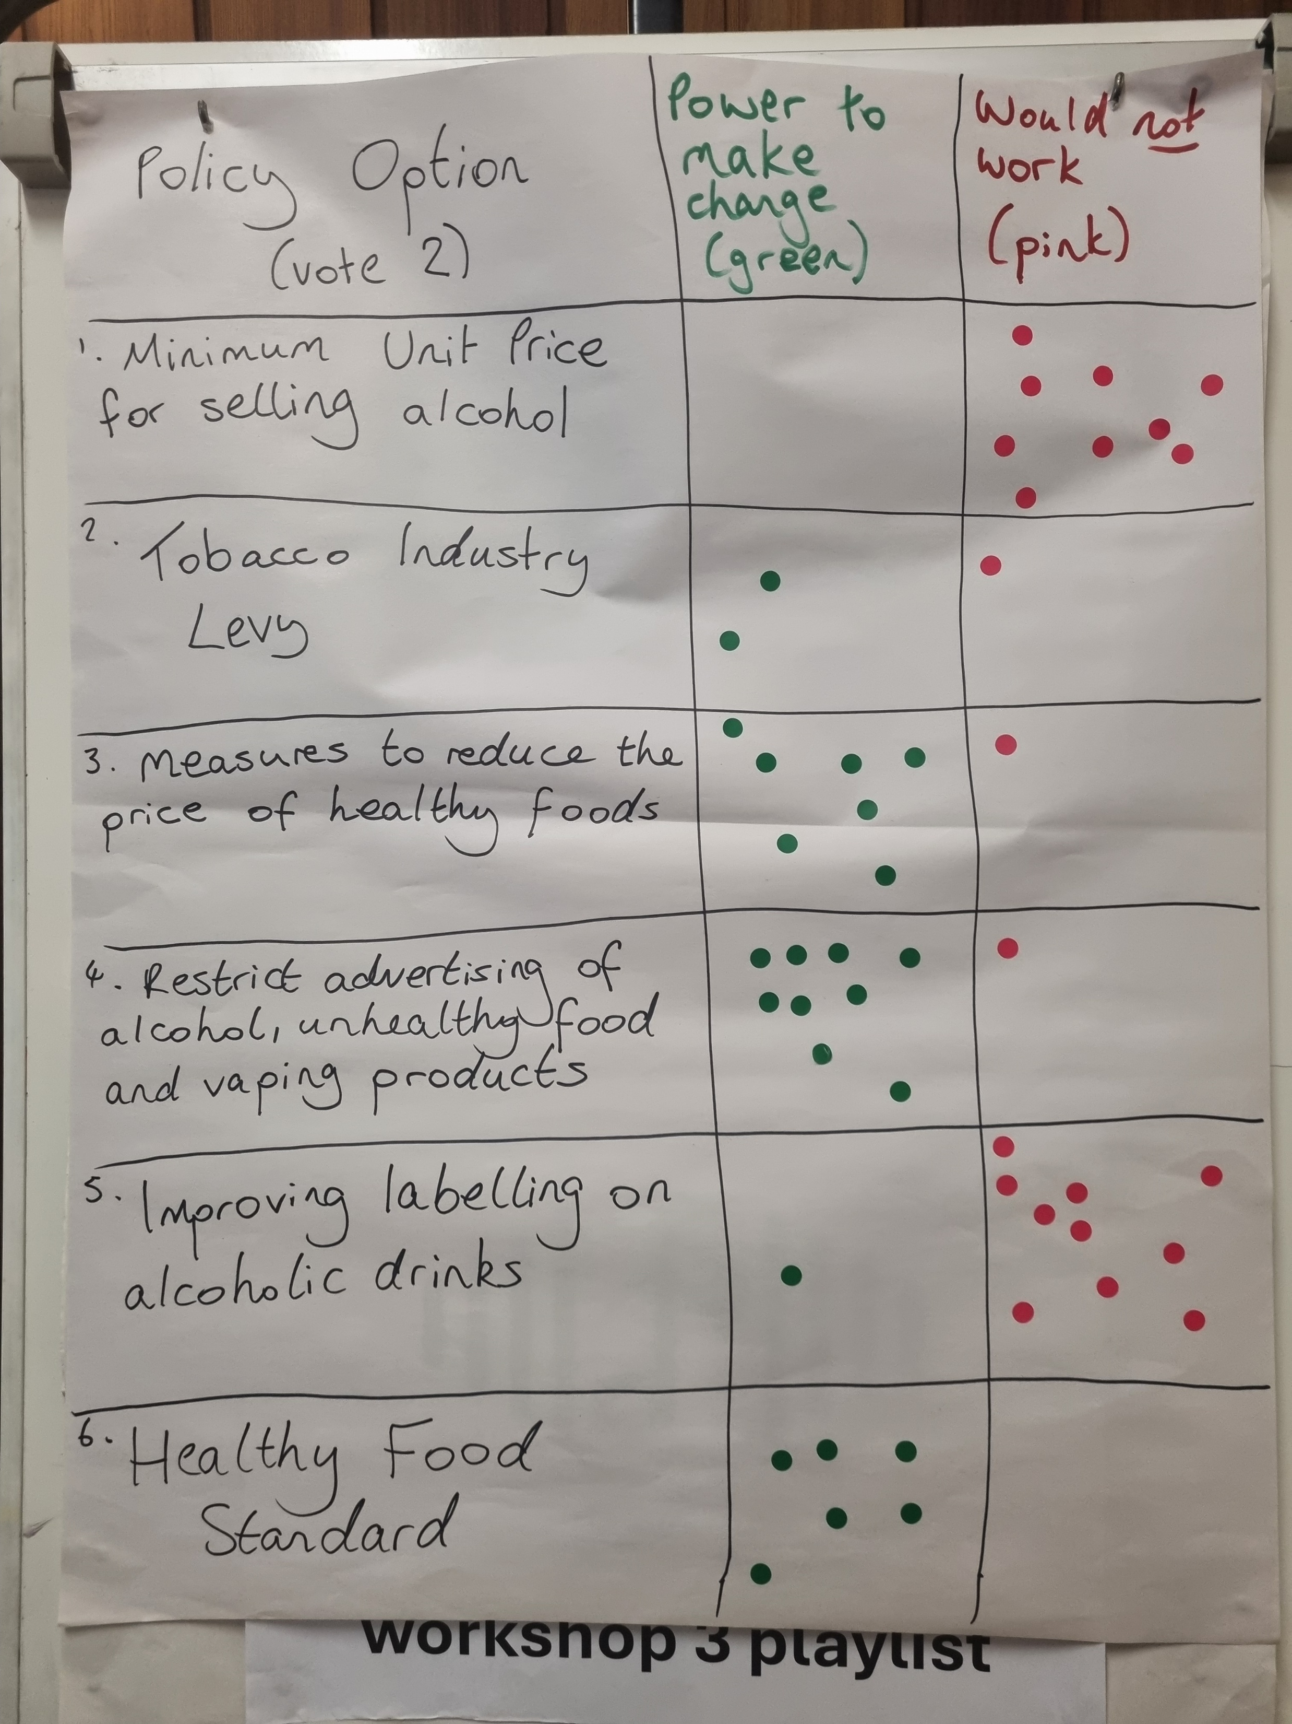
Votes on policy actions
In workshop 2, Jurors were given 10 policy actions cards, with a proposal and the cases for and against them.
Decisions on what to include were informed by proposals from advocacy organisations, and by what the jurors themselves wished to focus on. They were themed around price, marketing, availability and policy making.
Jurors were also given blank cards on which they could write their own policy proposals based on their small group deliberations.
There were two rounds of voting. The following results are from the second round; see the Summary Report for first round votes.
In each round, jurors could allocate 3 votes to policies which they believed had the “power to make change”, and 3 votes to policies which they felt “would not work”.

Slide 14
Votes on policy actions: “power to make change”
“Restricting industry involvement in health policy” and “reducing the price of healthy food” had good to high support in both juries
In Doncaster there was high support for “restricting advertising”, whereas in Wakefield there was strong support for education about healthy eating.
A “Healthy Food Standard” received some support from jurors in both places; however other jurors in Wakefield voted that “it would not work”.
Some changes were evident between the first and second round of voting: see the Summary Report for more details.
Results from the second round of voting | Combined | Wakefield | Doncaster
Restrict industry involvement in developing health policy | 19 votes | 6 votes | 13 votes
Measures to reduce the price of healthy foods | 17 votes | 10 votes | 7 votes
Introduction of a Healthy Food Standard | 10 votes | 4 votes | 6 votes
Restrict advertising of alcohol, unhealthy food and vaping products | 9 votes | 0 votes | 9 votes
Setting a minimum unit price for alcohol | 3 votes | 3 votes | 0 votes
Smokefree generation legislation | 3 votes | - | 3 votes
More education about healthy eating, food system, grow your own options in schools (change the curriculum)* | - | 15 votes | -
Stronger local planning to reduce availability# | - | - | 6 votes
* Policy action generated by jurors: Wakefield, Workshop 2
# Policy action generated by jurors: Doncaster, Workshop 2

Slide 15
Votes on policy actions: “would not work”
Both juries felt strongly that the smokefree generation legislation “would not work”
In Doncaster, jurors’ other votes were concentrated on policies relating to alcohol.
In Wakefield, jurors’ other votes were spread between 3 food policies and another tobacco policy (industry levy)
Some changes were evident between the first and second round of voting: see the Summary Report for more details.
Results from the second round of voting | Combined | Wakefield | Doncaster
Smokefree generation legislation | 23 votes | 12 votes | 11 votes
Improved labelling of alcoholic drinks | 13 votes | 3 votes | 10 votes
Setting a minimum unit price for selling alcohol | 10 votes | 1 vote | 9 votes
Limits on unhealthy food outlets | 9 votes | 6 votes | 3 votes
Introduction of a Healthy food standard | 6 votes | 5 votes | 0 votes
Tobacco industry levy | 6 votes | 5 votes | 1 vote
Ban under 16s from special offers and loyalty schemes from fast food retailers * | - | 8 votes | -
Limiting in-store display / separation# | - | - | 7 votes
* Policy action generated by jurors: Wakefield, Workshop 2
# Policy action generated by jurors: Doncaster, Workshop 2

Slide 16
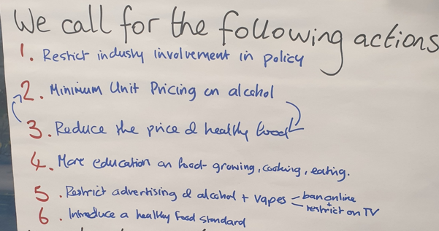
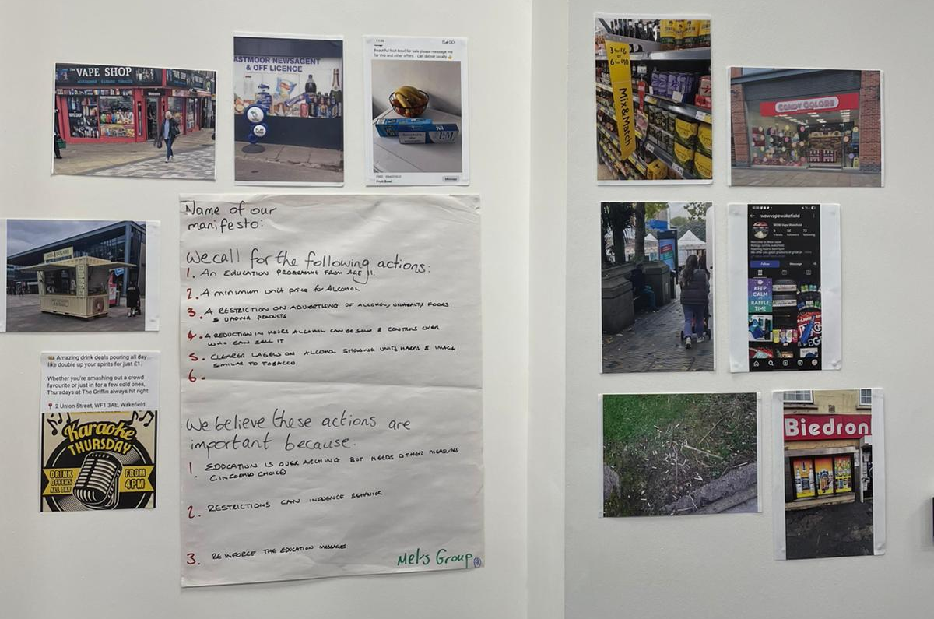
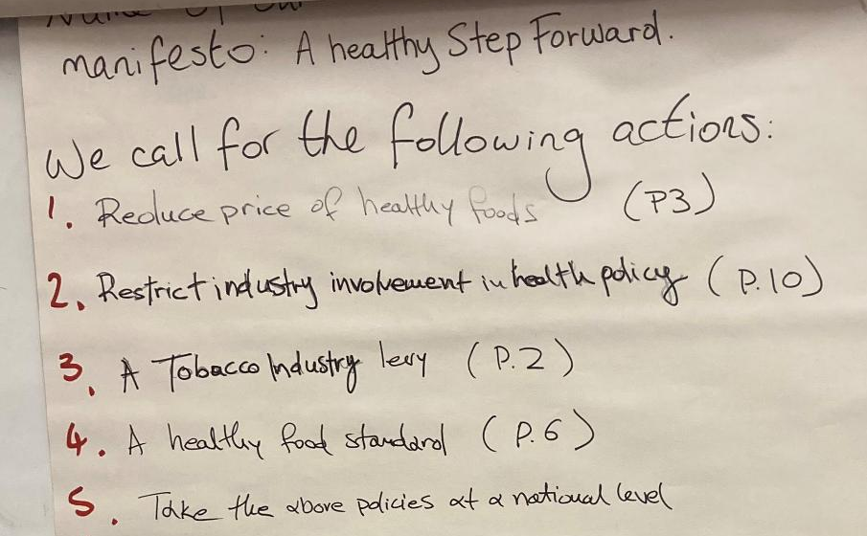
Policy manifestos
At the end of workshop two, jurors worked in small groups to develop their ‘Manifestos for change’
These manifestos included up to six policy actions which jurors felt most strongly should be enacted to create change.
Three small group manifestos were developed in Wakefield, and three in Doncaster. These have been combined to produce two summary manifestos.

Slide 17
Wakefield
Price
  A minimum unit price for alcohol
  Reduce the price of healthy food
Marketing, labelling and commercial influence
  Clearer labels on alcohol showing units, harms and images (similar to tobacco)
  Introduce a healthy food standard
  Restrict industry involvement in policy
  Restrict advertising of alcohol, unhealthy food and vapes – consider banning advertising online and restrict on TV
Education
  An education programme from age 11 including more emphasis on growing, cooking and eating
Availability
  A reduction in hours alcohol can be sold and greater controls over who can sell it
Doncaster
Price
  Measures to reduce the price of healthy foods
  A Tobacco Industry Levy
Marketing
  Introduction of a Healthy Food Standard
  Restrict advertising of alcohol, unhealthy food and vaping products (local and national)
  Health promotion campaigns
Availability
  Smokefree Generation legislation
  Stronger local planning to reduce availability
Policy making
  Restrict industry involvement in developing health policy
  Take the above policies at a national level
Highlighted policies appear in both combined manifestos

Slide 18


Overall support for policy proposals
Policy proposals where support was demonstrated in both individual votes and across the small group manifestos, with at least 2 out of 3 small groups in both Wakefield and Doncaster including the policy:
Restrict advertising of alcohol, unhealthy food and vaping products
Measures to reduce the price of healthy foods
Restrict industry involvement in developing health policy
Introduction of a Healthy Food Standard*
* While there was support from jurors individually and collectively in both places, some individual jurors in Wakefield voted that “it would not work”.

Slide 19


Overall support for policy proposals
Other policies which received strong support in one of the two Juries:
More education about healthy eating, food system, grow your own options in schools (change the curriculum) #
Improved labelling of alcoholic drinks*
Setting a minimum unit price for selling alcohol*
*Included in multiple small group manifestos in one location, but received multiple individual votes from jurors in the other location that the policy would not work.
# Juror generated policy in one location

Slide 20
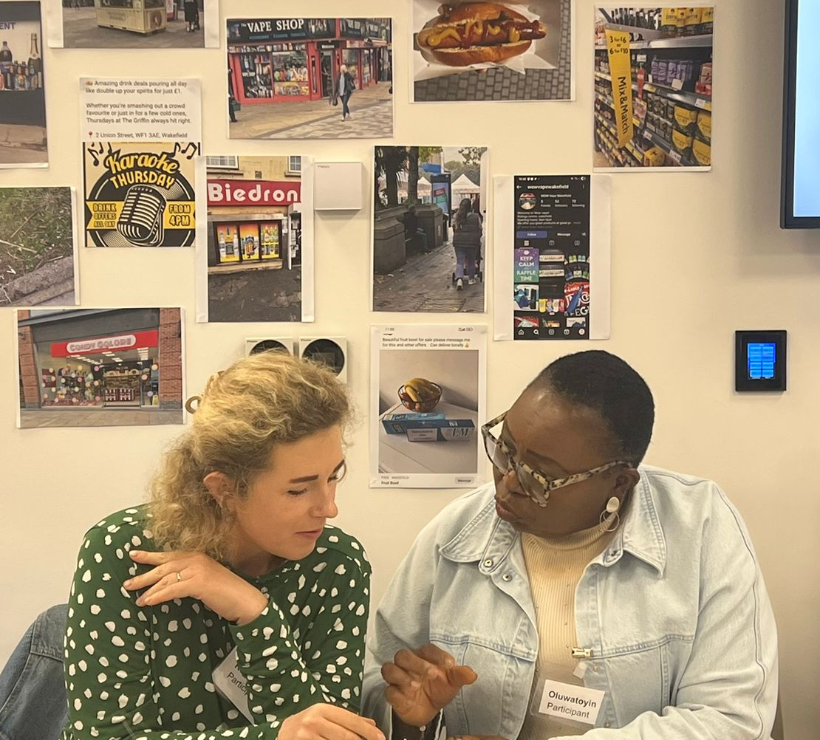
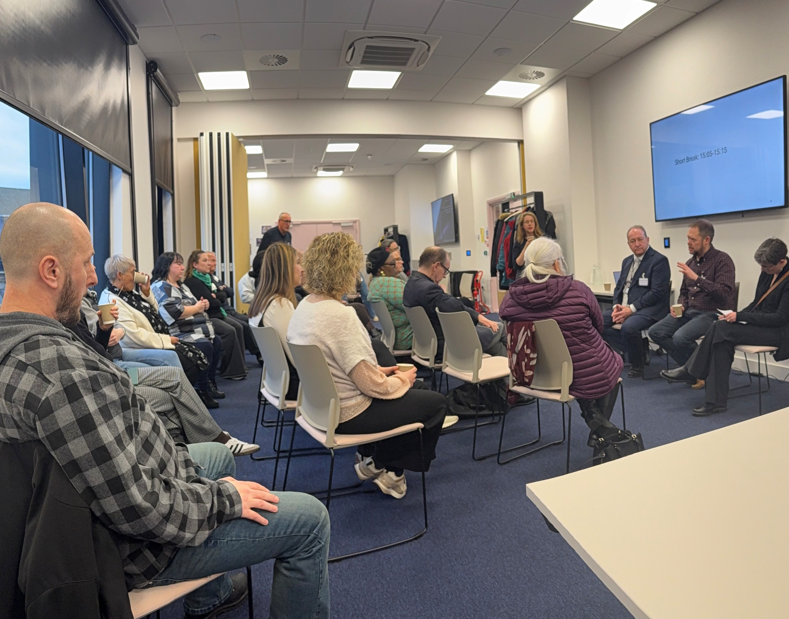
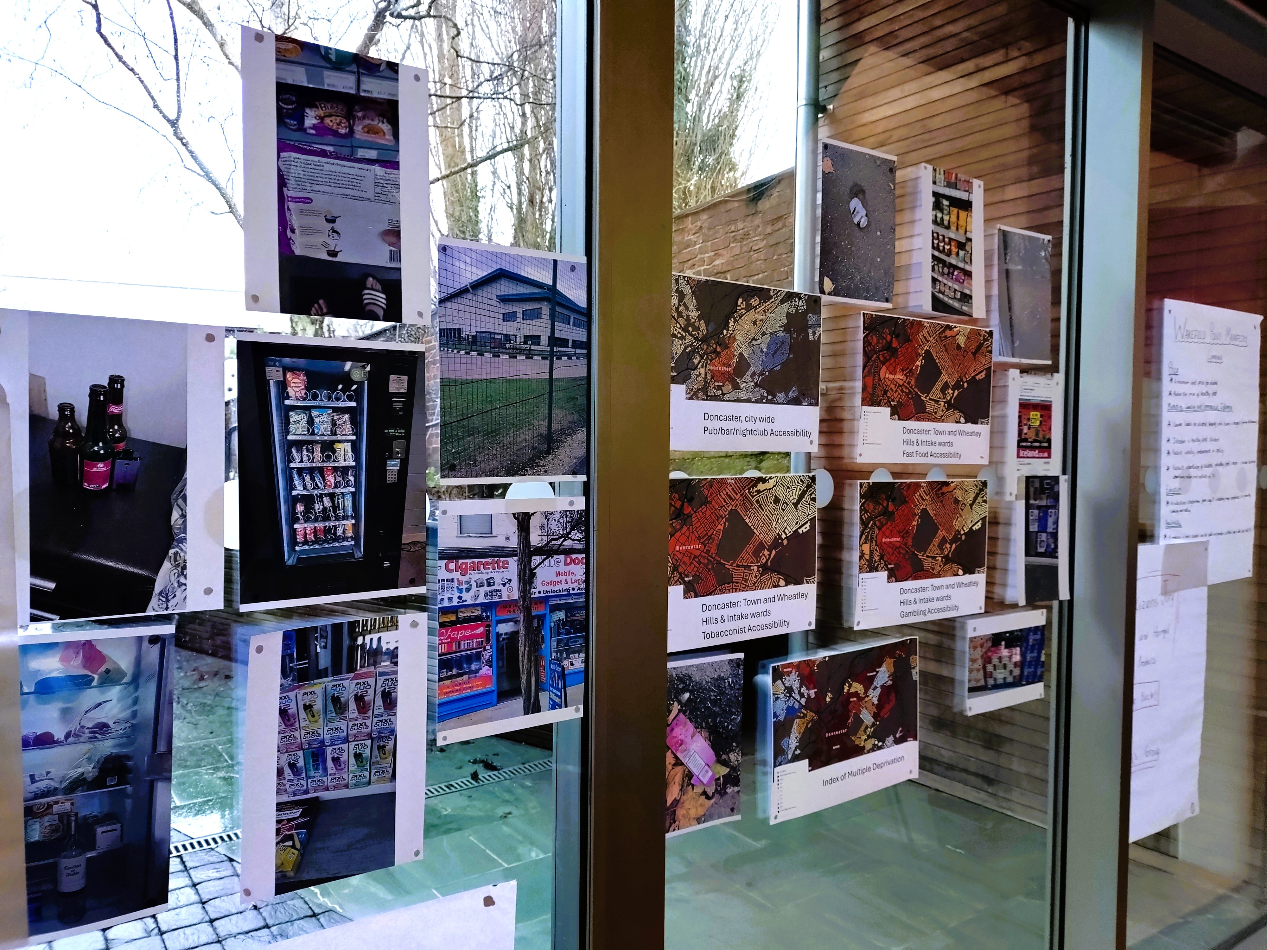
Initial themes and reflections
Alcohol and unhealthy food were the most frequently highlighted industries of concern; concerns about unhealthy food increased over time (“we all need to eat”)
Clear support for measures to restrict industry interference in policy (prioritise health over profit narrative), place limits on advertising and reduce the price of healthy food.
Some shifts across the workshops demonstrating the significance of the deliberative process
Other key themes from the discussions will emerge following analysis of the transcripts

Slide 21


Why do jurors want these changes?
When developing their policy manifestos, jurors were asked to explain why it is important to implement the changes they have called for.
In jurors’ own words:
“It will empower local communities to take control of their health”
“Empower the people rather than the industry”
“People will have the opportunity to ‘start from the same place’, access healthy food regardless of where they are”
“It will make our local communities healthier, now and in the future”
“Prevent (future) strain and burden on the NHS”
“Keep financial interests out of policy – health above profit”
Notes:
These reasons can be group under the following areas:
Create choices and give people control
Improve health locally and nationally
Reduce pressure on the NHS
Prioritise health over profit
Education and reinforcement of messages to influence change

Slide 22
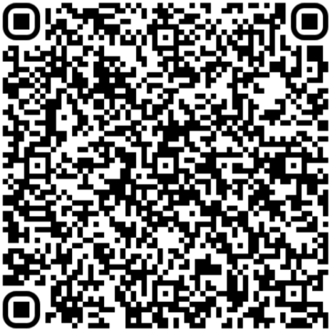
Find out more…
https://yhadph.short.gy/CJ
Juror stories and video clips
Communicating for impact - framing toolkit
The Citizens’ Jury process
Slidesets, quotes and images
Executive summary and full report

