Slide 1


The Citizens’ Jury process:
What did we do?
Yorkshire and Humber Citizens’ Juries on Health and Harmful Products

Slide 2














Commissioned and funded by: Yorkshire and Humber Association of Directors of Public Health (Y&H ADPH)
Acknowledgements
Juror recruitment and support:
With support from:

Slide 3

What are Citizens’ Juries?
Several important features:
Jury members or ‘jurors’: the membership is designed to be representative of the wider population, in this case the population of Yorkshire and Humber, using stratified random sampling.
The deliberative process: jurors go through a three-stage process of learning, discussion, and decision-making.
Evidence and information: jurors are presented with balanced, accurate and comprehensive evidence during the learning phase.
Independent facilitation: to ensure that the deliberations are not influenced by those who have a vested interest in the topic and that the Jury is properly supported to do their work.
Notes:
The process was developed by what is now the Center for New Democratic Processes in the USA in the 1970s and has been used widely as a form of democratic public involvement.
https://cndp.us/about-us/how-we-work
Jury members or ‘jurors’: the membership is designed to be representative of the wider population, in this case the population of Yorkshire and Humber, drawn from the two cities of Wakefield and Doncaster.
The deliberative process: jurors go through a three-stage process of learning, discussion, and decision-making.
Evidence and information: jurors are presented with balanced, accurate and comprehensive evidence during the learning phase.
Independent facilitation: to ensure that the deliberations are not influenced by those who have a vested interest in the topic and that the Jury is properly supported to do their work.

Slide 4

Why are they useful?
Robust and trusted method for exploring complex, controversial and value-laden policy issues that matter to society, understanding different perspectives and finding common ground.
Jurors are given time and resources to learn about, reflect on, and discuss a topic in-depth. It gives insight into what people think once they better understand an issue: it is not just a snapshot opinion poll.
Stratified random sampling ensures diversity and involvement of people who may not usually engage in the political process.
Notes:
Citizens’ Juries are a robust and trusted method for exploring issues that matter to society, finding common ground and understanding different attitudes.
Citizens’ Juries are particularly effective in exploring value-laden and controversial questions, where knowledge is contested and there are important ethical and social repercussions.
Jurors are given time and resources to learn about, reflect on, and discuss a topic in-depth. Tells us what citizens think once they better understand a policy question. Not just a snapshot opinion poll
stratified random sampling increases credibility because it leads to a representative assembly with diverse membership and has the benefit of involving people who may not usually engage in political processes

Slide 5

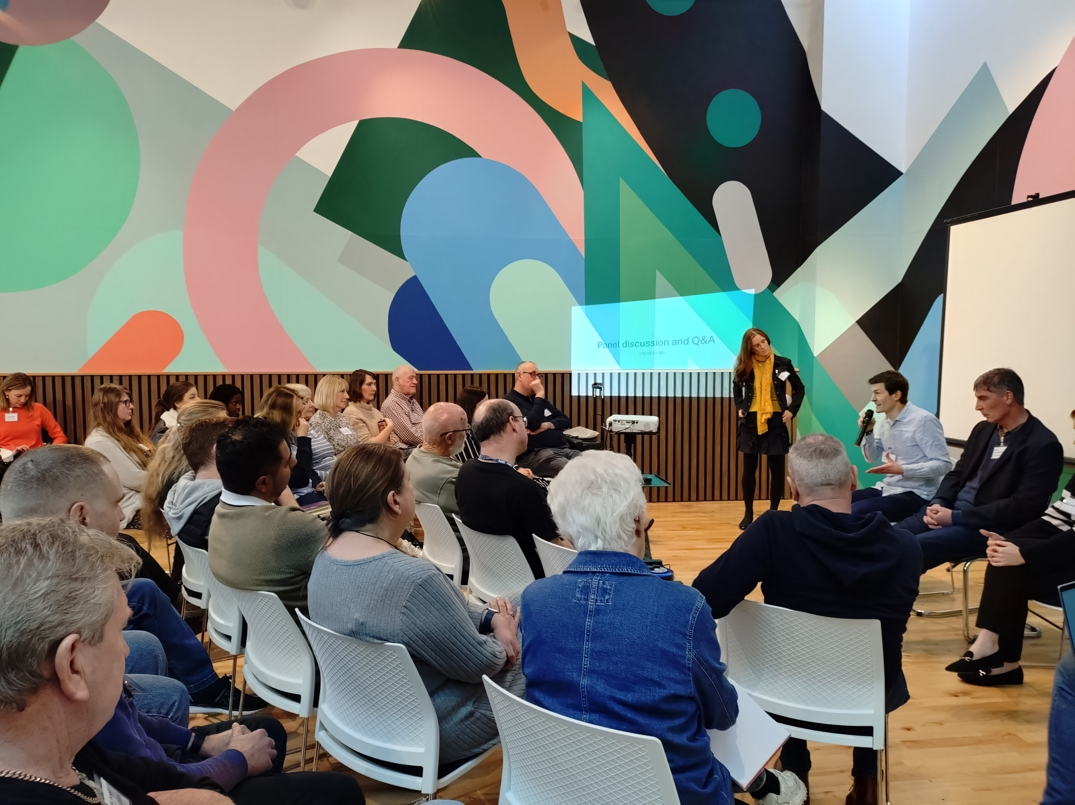
Why did we commission these juries?
Preventing harms caused by the tobacco, alcohol and unhealthy food industries is an important part of protecting and improving the health of people in Yorkshire and Humber.
We wanted to connect evidence with the voices and experiences of real people - understanding what they think and feel, how these trends in society affect their lives and health.
And to understand what solutions and ideas they have for us to take forwards in local government, and advocate for on their behalf to national powers.
In our 2024 position statement we committed to: “finding opportunities for funding and capacity for proper work with the public to shape this agenda […] through deliberative democracy approaches”

Slide 6
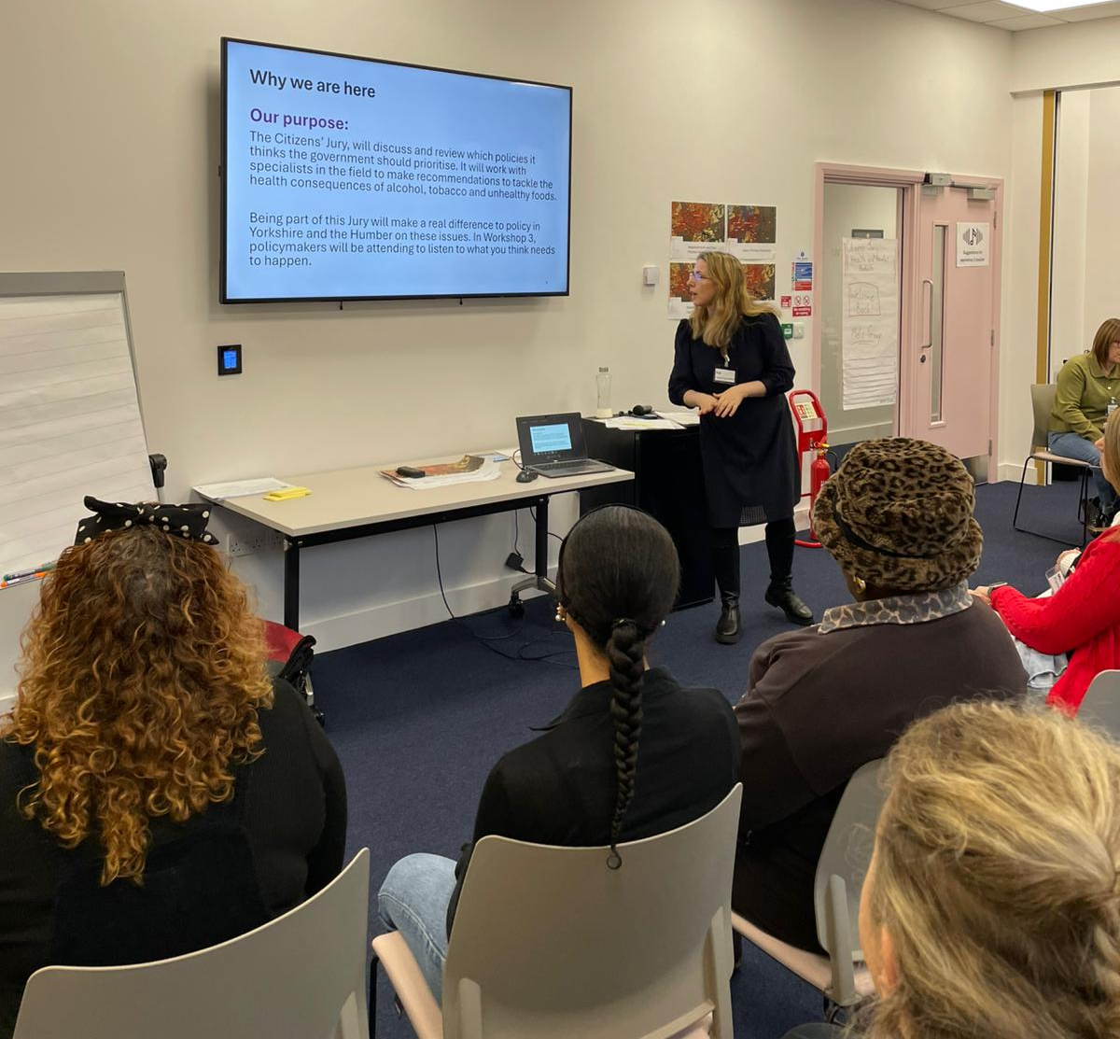
Project aim
To explore public views about the health and social impacts of commercial activities relating to tobacco, alcohol, and unhealthy food and to consider how governments should respond.
Notes:
To consider how governments (local, regional and national) should respond

Slide 7
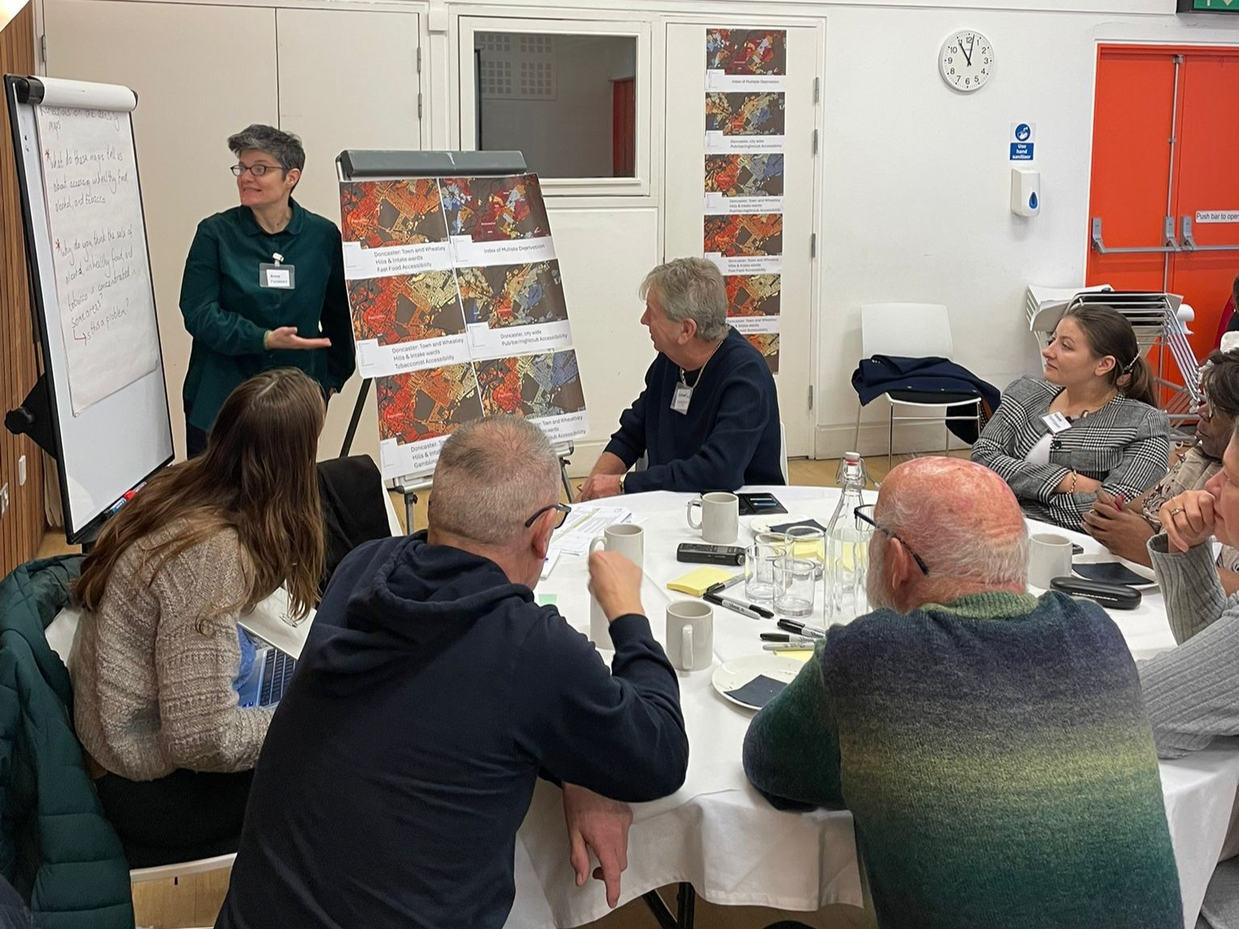
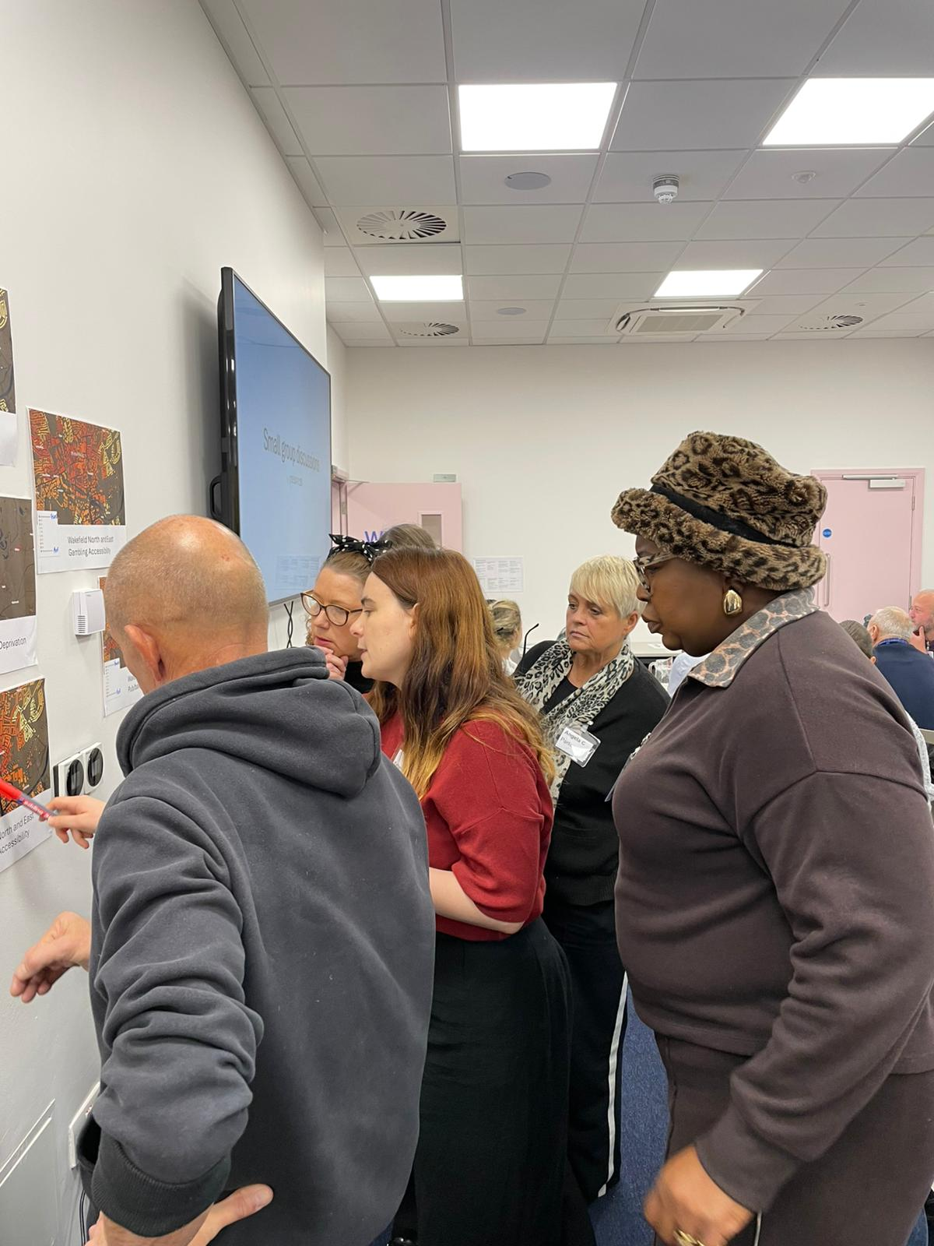
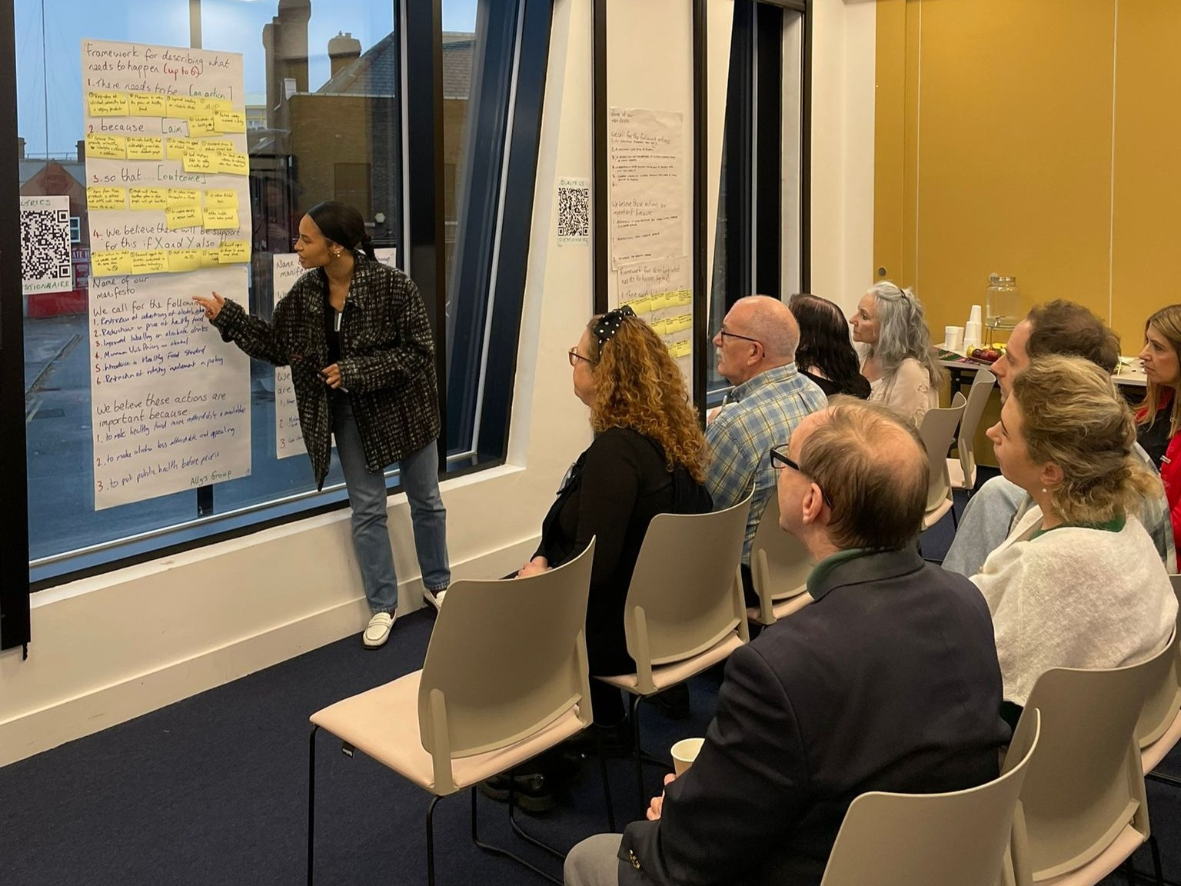
Timeline
Feb 2025: Proposal for Y&H CDOH Citizens’ Juries approved, based on a model developed by SPECTRUM for a Citizens’ Jury in Glasgow in 2024.
Jul 2025: Procurement and contracting. Project team mobilised.
Aug 2025: Project kick-off. Subcontracting and sortition begins: 12,500 invites posted to residents of Wakefield and Doncaster. 512 expressed an interest.
Jul-Oct 2025: Workshop planning, materials designed, ethics granted, training delivered. OnBoarding of 42 Jurors, representative of Y&H population.
Oct 2025: First of six citizens’ jury workshops!
Nov 2025: Decision makers and policy colleagues invited to the final workshops
Dec 2025: Summary report collaboratively written.
Feb 2026: Final workshop!

Slide 8
Juror recruitment
Members of the Citizens’ Juries were recruited using a stratified sampling method which creates a mini-public broadly representative of the regional population of Yorkshire and Humber.
This is a civic lottery method called sortition. The process was delivered by the Sortition Foundation working to a recruitment specification co-designed by SPECTRUM.
To ensure place-based reflections on the issues, the sortition process focused on two neighbouring wards within each of Wakefield and Doncaster, and issued invitations to addresses in particular parts of those wards

Slide 9
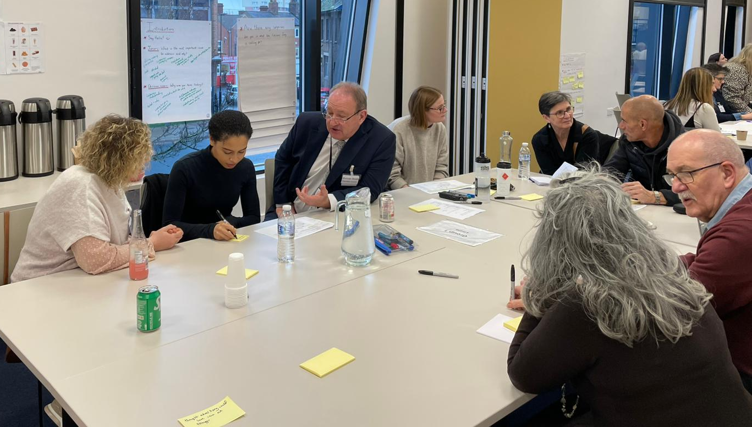
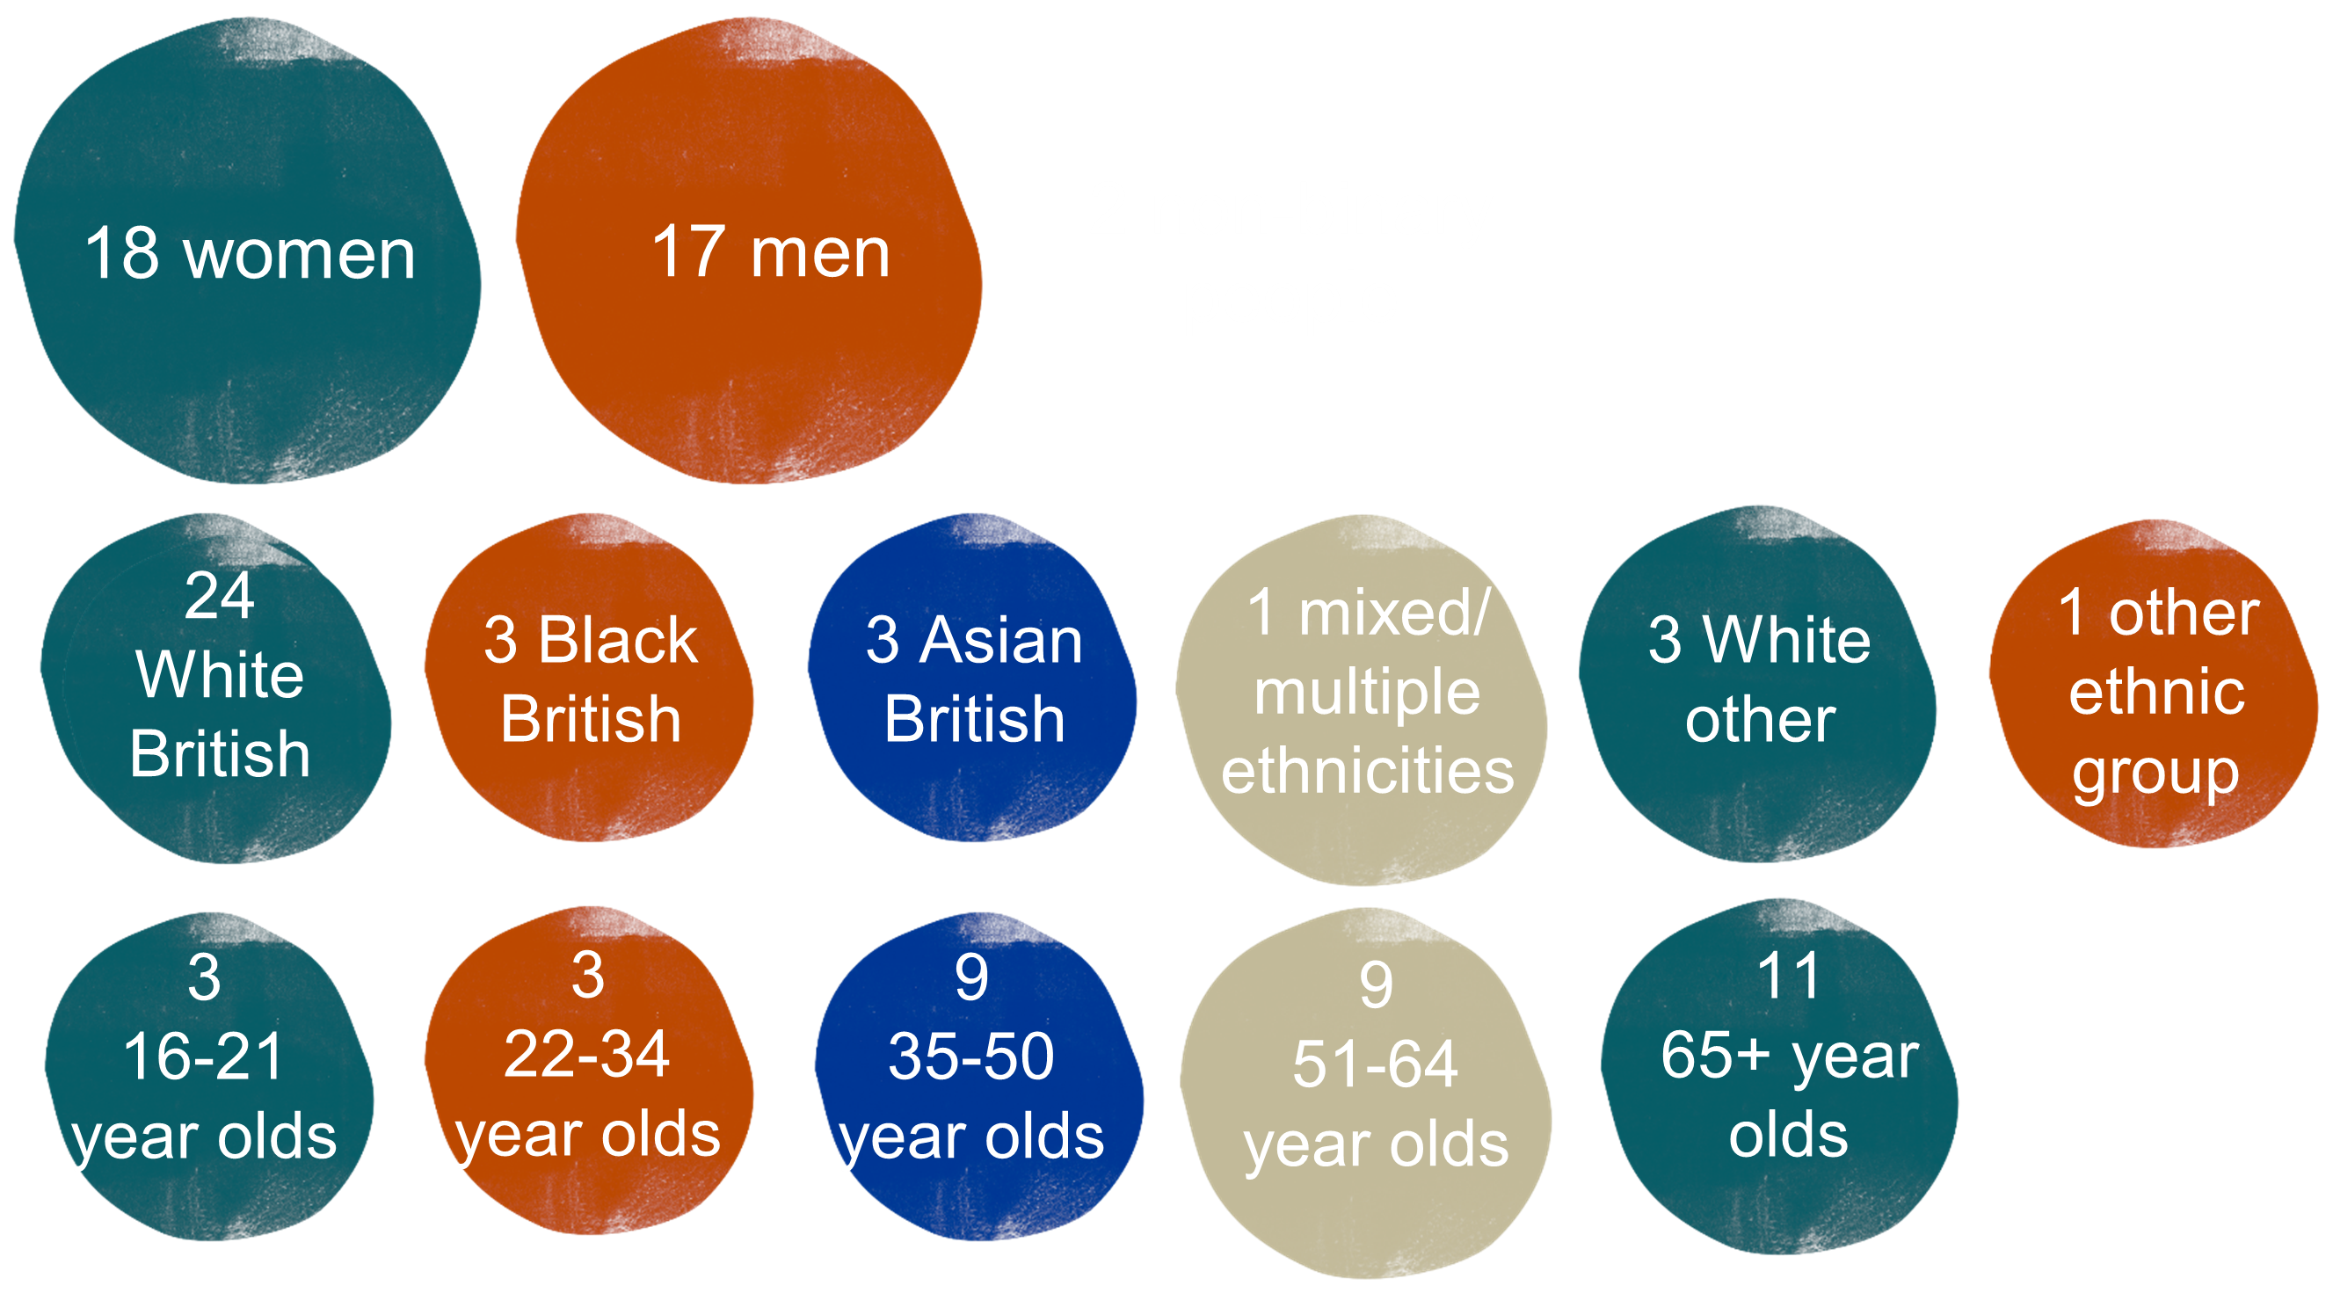
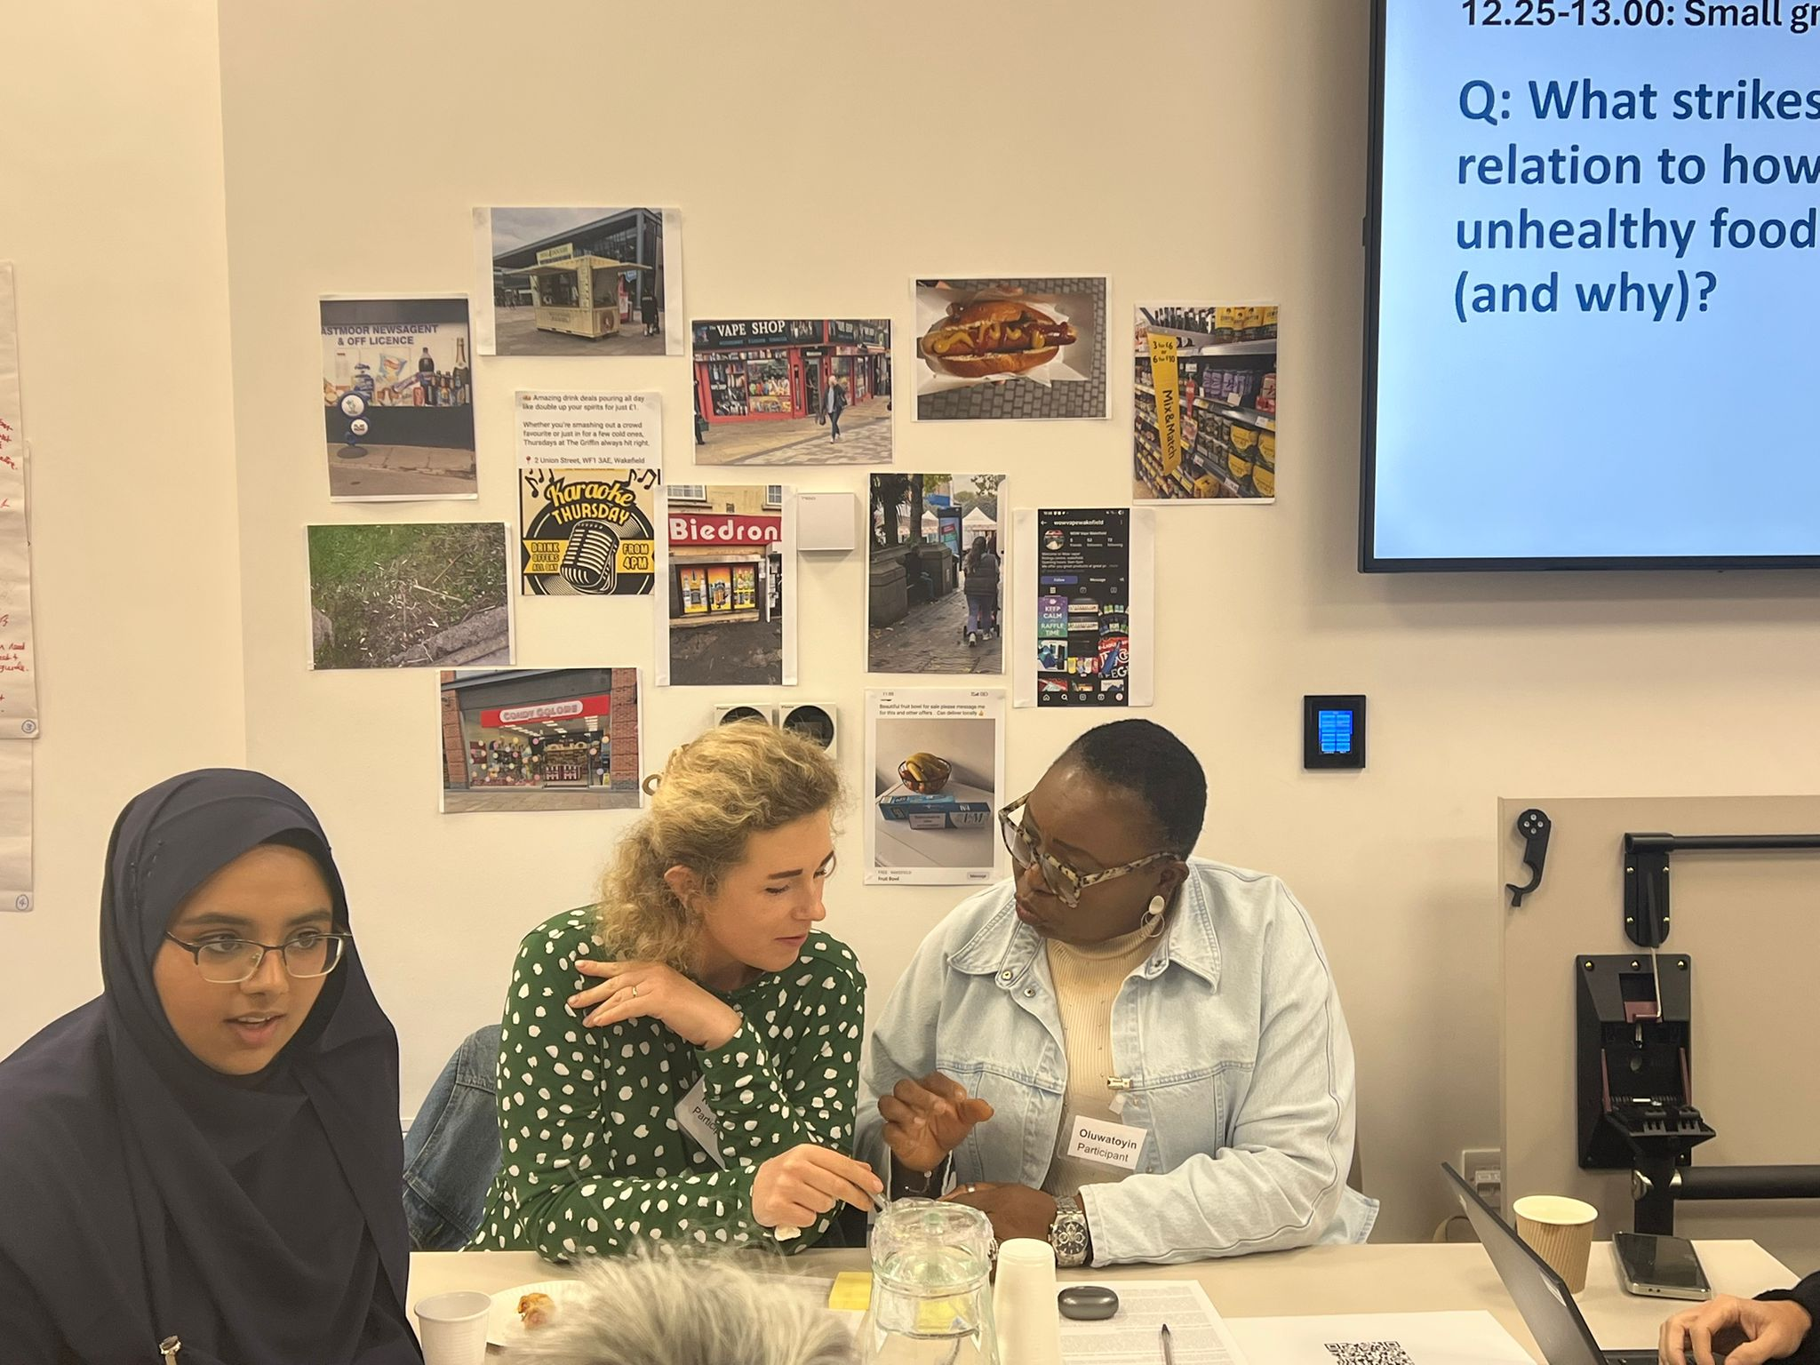
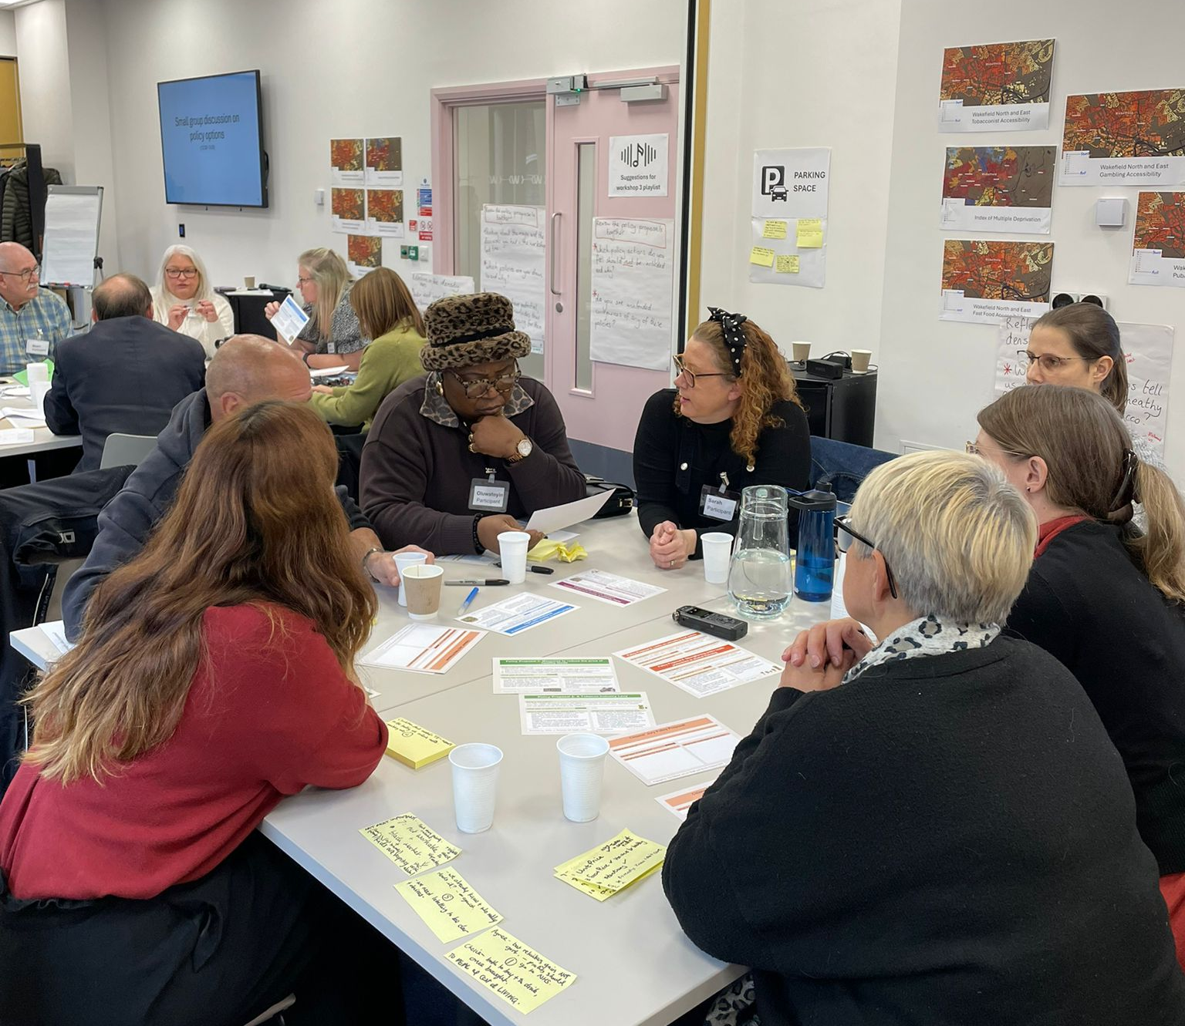
Jurors
The Juries included a diversity of jurors based on key demographics such as gender, ethnicity and age.

Slide 10
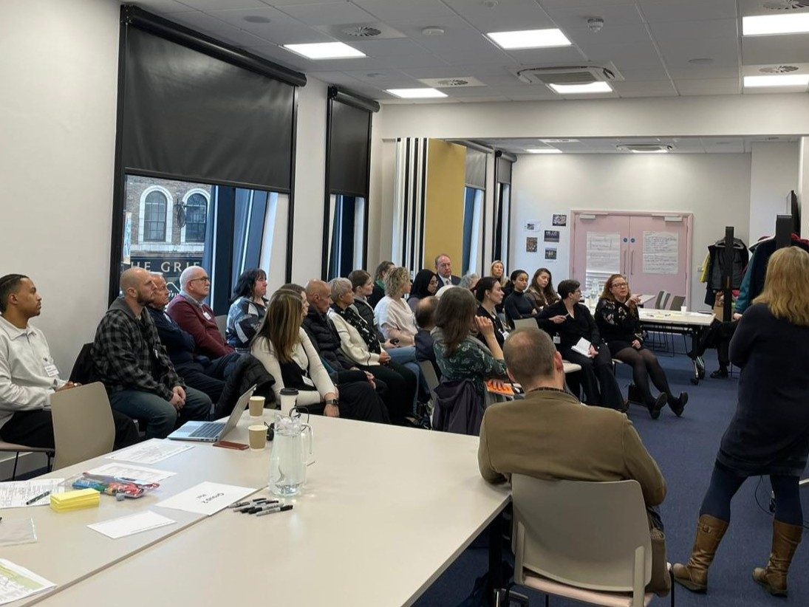
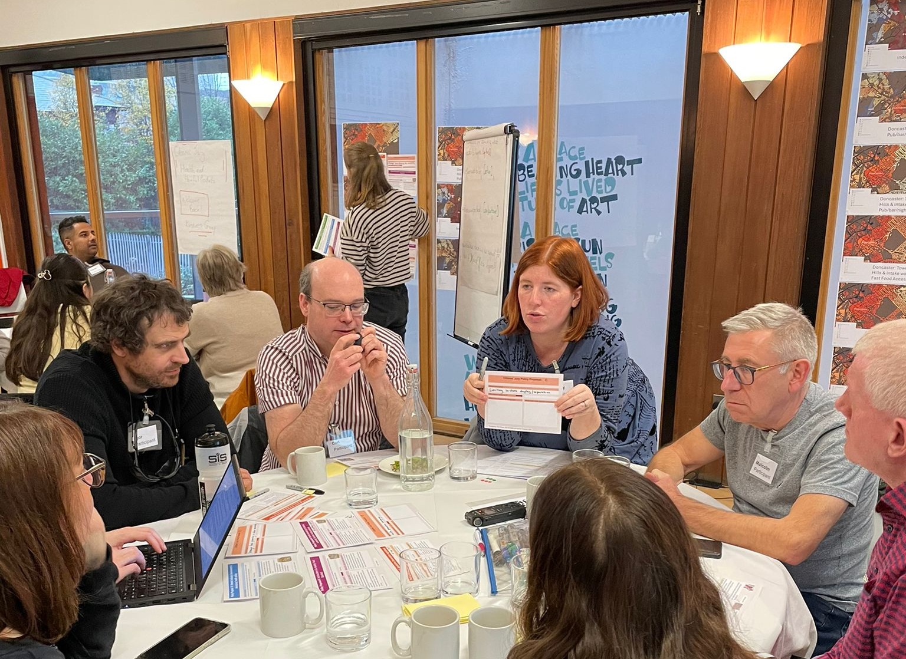
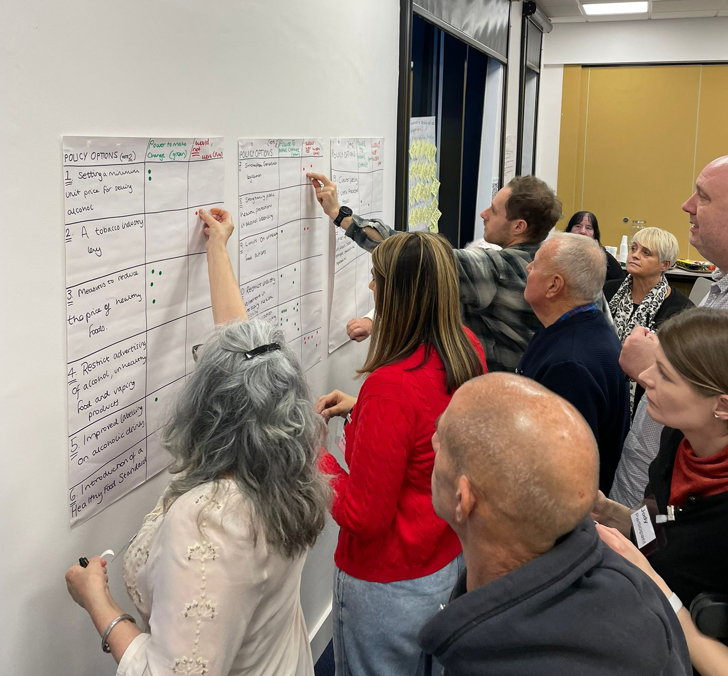
Workshop content
Workshops were designed around the three stages of the deliberative process: learning, discussion, and decision-making.
Learning: jurors were presented with evidence from speakers, films, maps of outlets, and policy action proposals.
Discussion: jurors deliberated in small facilitated groups, and as a whole group, with support from two Jury Friends to interrogate the evidence and to ask questions.
Decision-making: jurors agreed findings as small groups, which they reflected on as a whole group. Jurors also voted individually on key priorities and shared their views via a questionnaire.

Slide 11
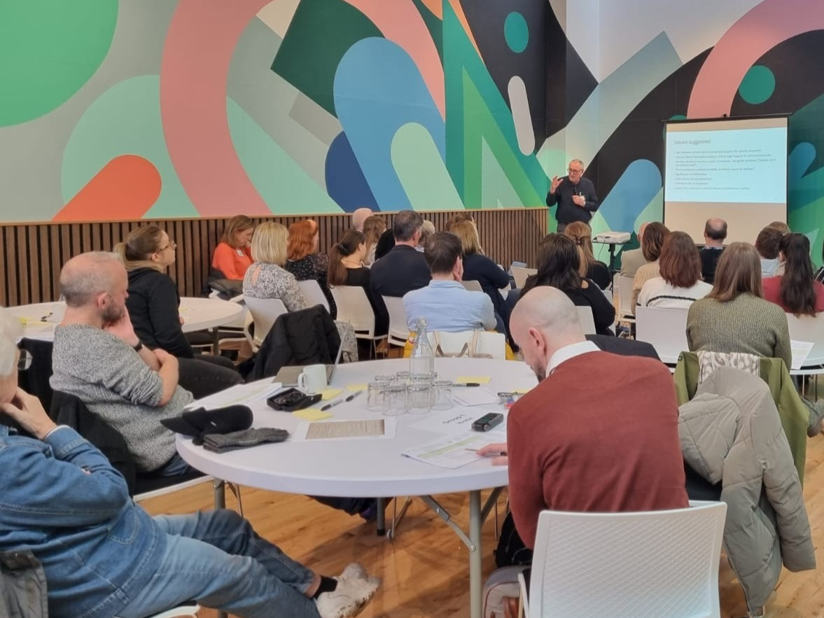
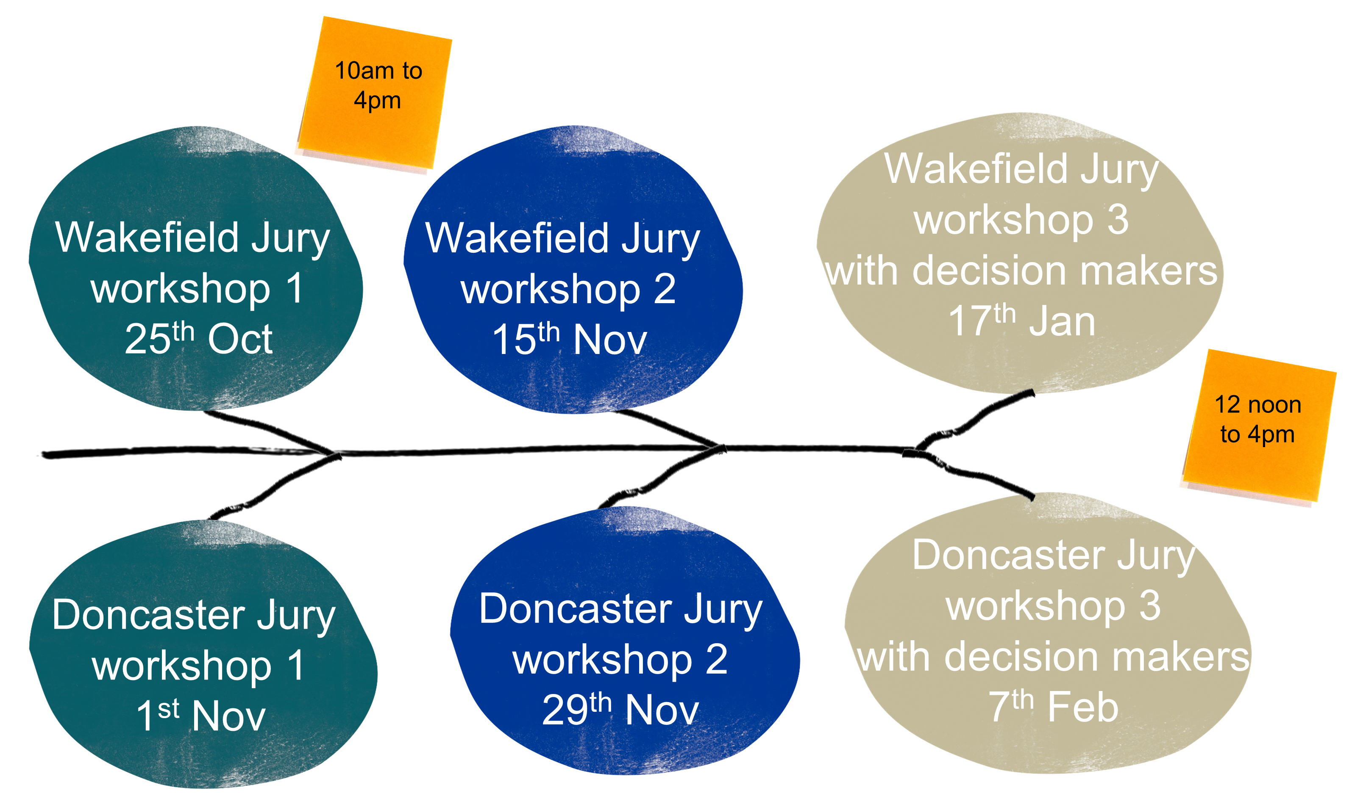
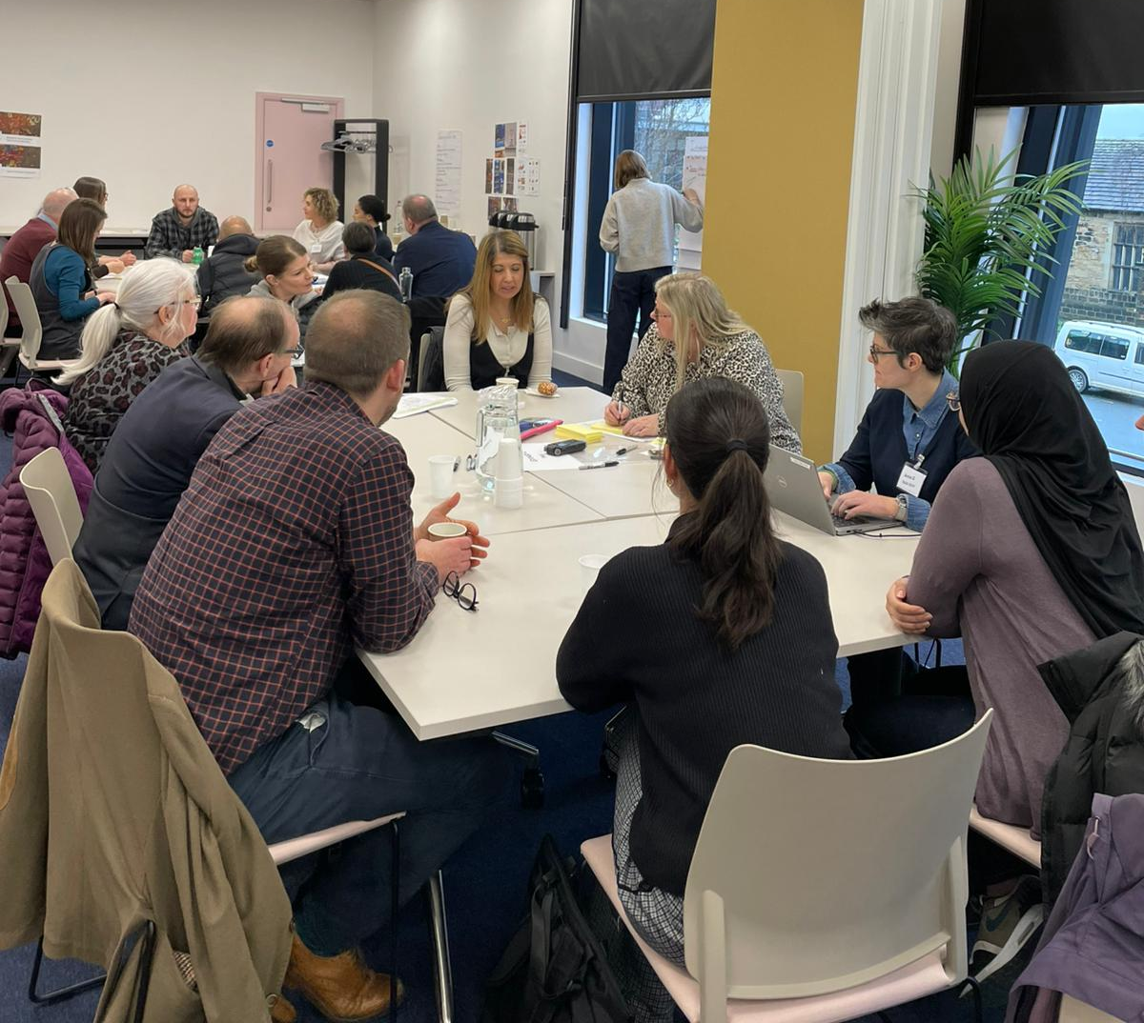
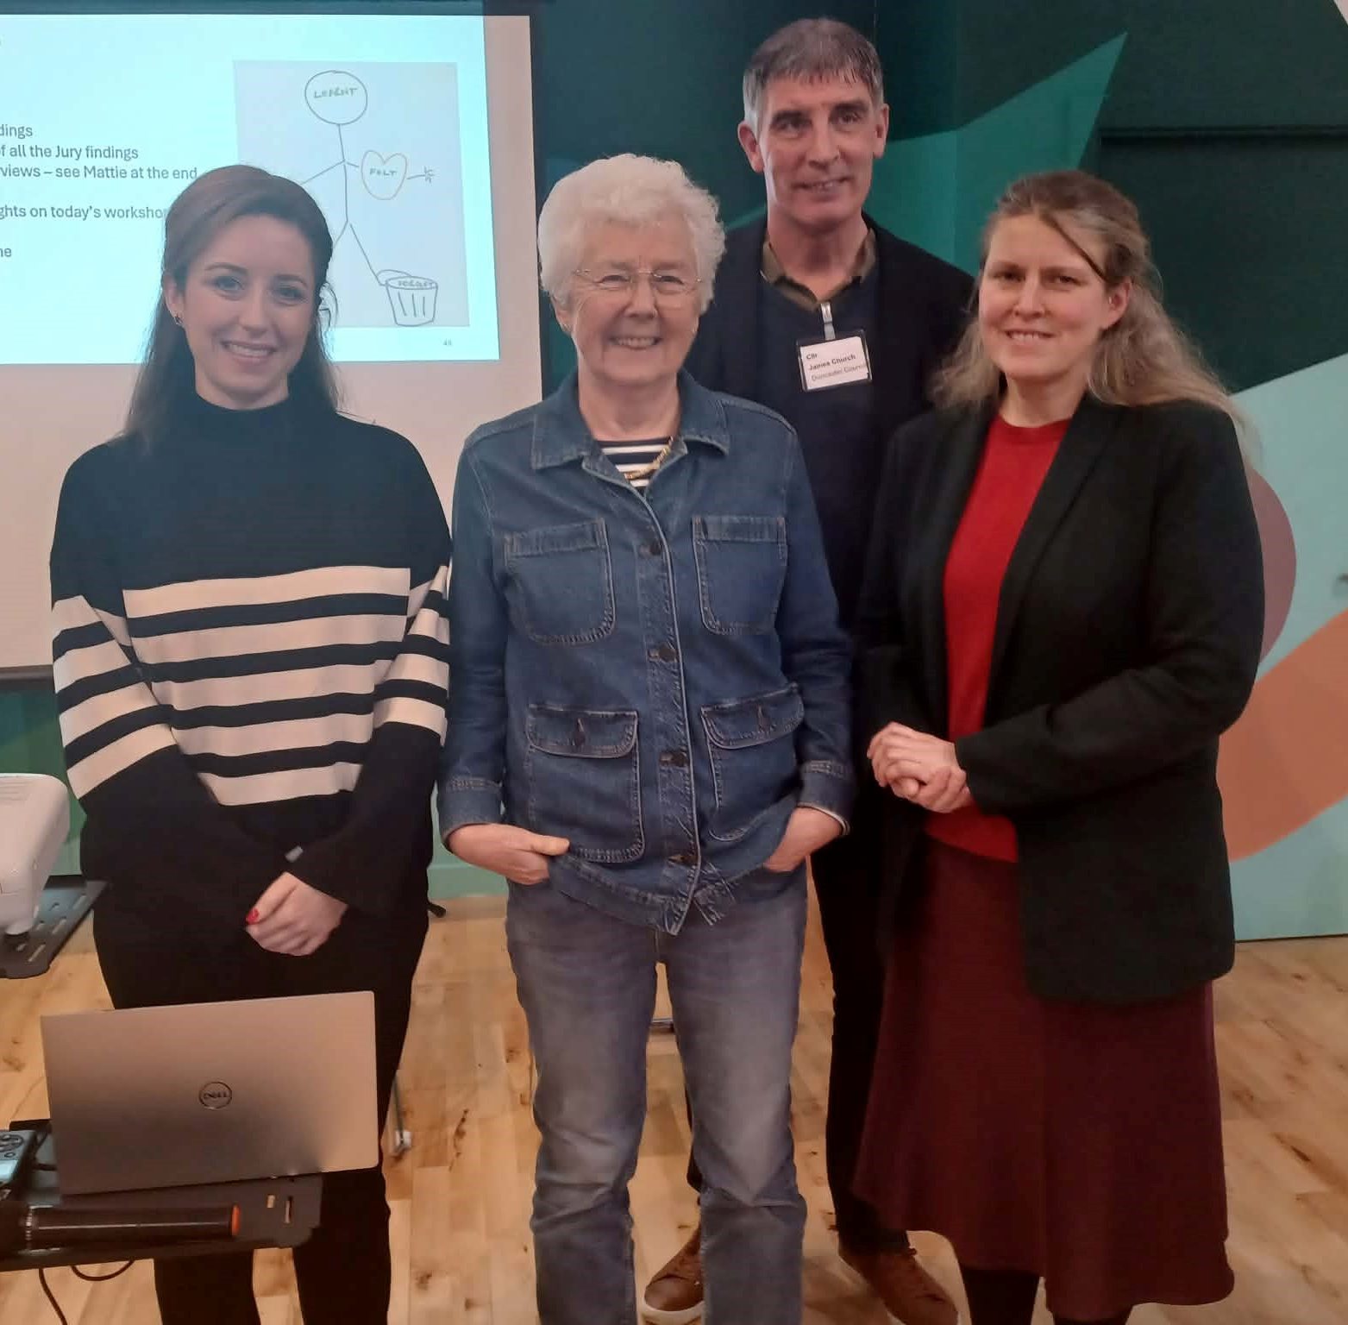
Workshops

Slide 12



Workshop outlines
Baseline questionnaire. Learning about the issues, reflecting on what jurors find important and establishing what other questions they have.
Sharing views with decision makers
In Workshop 3, jurors had the opportunity to share their manifestos with:
Local councillors and a Mayor
Local MPs
Local Directors of Public Health
Policy colleagues from national and regional government and local authority public health teams
Colleagues from national advocacy organisations and think tanks
Workshop 1
Further evidence, tailored to juror questions and priorities from the first workshop, voting on policy actions, developing small group policy manifestos. Repeated questionnaire.
Workshop 2
Sharing and discussing manifestos with decision makers and policy colleagues, with opportunities to question decision makers.
Workshop 3

Slide 13
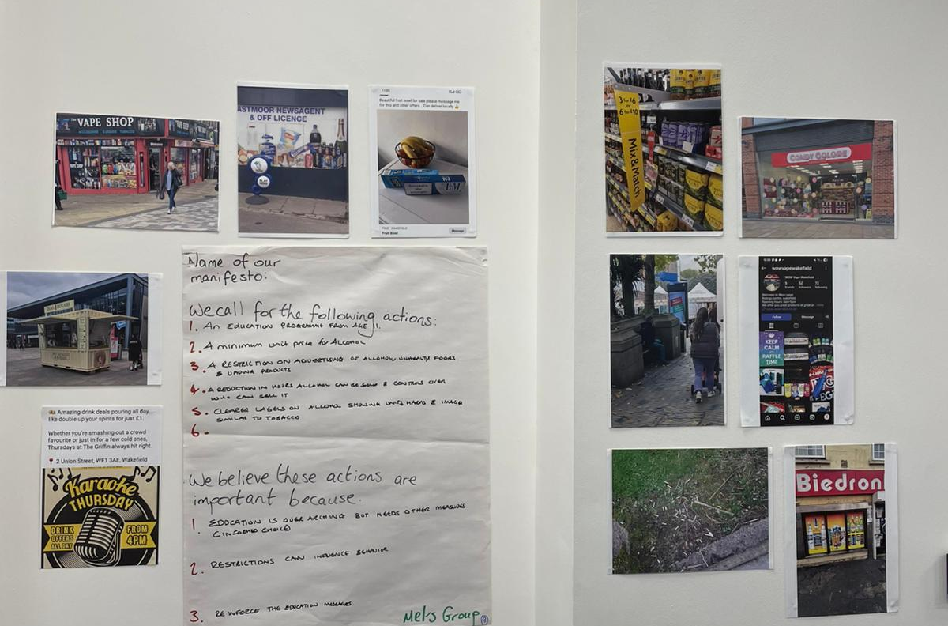
Data generated from the workshops
Images shared by Jury members
Questionnaire (at the start of W1 and repeated at the end of W2)
Polling using Wooclap.com during workshops
Jury voting of key issues and different policy actions
‘Manifestos for change’ developed by Jury members
Transcripts of discussions
Ethnographic notes

Slide 14
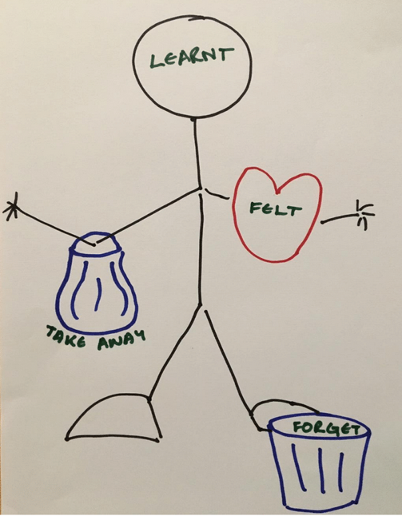
Jurors’ reflections on the process
After each workshop, jurors were invited to reflect on the process:
Jurors described how participation in the Citizens’ Jury made them feel:
They valued meeting new people, working as a group and taking part in something important
The opportunity to hear other people’s views
Coming away feeling enthusiastic and encouraged
Jurors felt they learnt:
A lot of helpful information, including health statistics and about public health policies and policy making
That unhealthy eating is a major issue
About the importance and power of advertising to influence people and that there is too much advertising
That change is slow but change is possible
That people think differently
About the limitations of education as a policy intervention

Slide 15
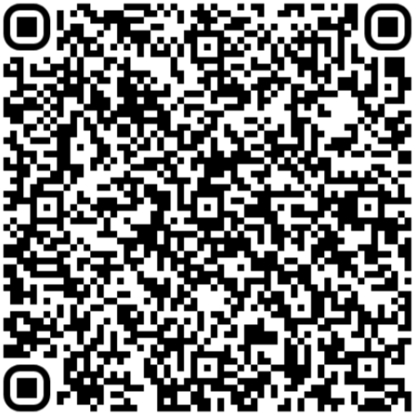
Find out more…
https://yhadph.short.gy/CJ
Findings from the juries
Juror stories and video clips
Sidesets, quotes and images
Communicating for impact toolkit
Executive summary and full report

Slide 16
Supplementary slides:

Slide 17


Workshop 1: learning about the issues, reflecting on what jurors find important and establishing what other questions they have
Q&A & whole group discussion
Presentation
Welcome and introduction to the workshop and Citizens’ Jury process
Presentations
Dr Anna Brook, Public Health Consultant and University of Bath
Health Inequalities and health challenges in Yorkshire & the Humber
Prof. Jeff Collin, University of Edinburgh,
The role and significance of commercial determinants in poor health and inequalities in Scotland
Filmed presentations from SPECTRUM
How does alcohol affect public health
What is the relationship between poor diet and health inequalities
What is the relationship between tobacco consumption and health inequalities
Small group discussions
Reflections on what the Jury understand the:
key issues
Actions to be taken
Priorities for action
at the end of day one
Workshop 1
Context for the
issues
WooClap questions
To help jurors settle in and understand more about each other
Questionnaire
Baseline: views on health, industries that impact on health and wellbeing and policies to reduce harm.
WooClap questions
To understand what is important for Jurors and to identify potential focus areas for Workshop 2
Small group discussions
Sharing/discussing participant images
Small group discussions
Reflections on what is important to Jury members
Q&A with speakers
Jury vote
On the issues they find urgent and important
Notes:
Blue = sharing evidence and learning, with opportunities for engagement with speakers (red circles)
Beige = discussion and deliberation, in pairs, small groups and whole group
Green = opportunities to share opinions and preferences as individuals
Workshop 1: learning about the issues, reflecting on what they find important and what other questions they have

Slide 18

Workshop 2: further evidence, tailored to juror questions and priorities from the first workshop, voting on policy actions, developing small group policy manifestos
Presentations
Presentation to get people back into the space, remind them what they have discussed previously and how it has shaped the workshop discussions.
A short film on the commercial determinants of health
Small group discussions
Reflections on the density maps and what they say about health and harmful products.
Presentation
What’s in the party political manifestos?
Policy proposals for reflection
Small group discussions
Creation of manifestos for change based on all the Jury deliberations
Workshop 2
Policy actions &
manifestos
Small group discussions
Deliberation on potential policy actions
Final Jury vote
To prioritise potential policy actions
Filmed presentations
Caroline Cerny, Deputy Chief Executive, Action on Smoking and Health
Ewan MacDonald-Russell, Deputy Head, Scottish Retail Consortium
WooClap questions
To help jurors settle in and understand more about each other
Questionnaire
Repeat: views on health, industries that impact on health and wellbeing and policies to reduce harm.
Jury vote
To prioritise potential policy actions
Presentation
Prof. Niamh Shortt, University of Edinburgh – an introduction to the outlet density maps.
Whole group discussion
Deliberation on potential policy actions
Q&A & whole group discussion
Q&A & whole group discussion
Notes:
Workshop 2: further evidence, tailored to juror questions/priorities from Workshop 1, voting on policy actions, developing small group policy manifestos

Slide 19
Workshop 3: sharing and discussing findings with decision makers and policy colleagues, with opportunities to question decision makers.
Q&A & whole group discussion
Presentation
Presentation to welcome back jurors, welcome and introduce decision makers and policy colleagues, and explain the purpose of today.
Small group discussions
Giving jurors and decision makers and policy colleagues the chance to understand more about each others’ priorities and discuss and reflect on the policy manifestos.
Small group discussions
Individual jurors each have an opportunity to speak directly to a decision maker, and for the group to reflect on their hopes for the future.
Panel discussion
Decision makers are given an opportunity to reflect back to jurors what they have heard today
Jurors have an opportunity to question decision makers directly
Workshop 3
Sharing findings with decision makers
Presentation
Prof. Jeff Collin, University of Edinburgh.
Reflections on the previous workshops, sharing Jury findings so far to inform discussions.
WooClap questions
To establish connection and common ground
Closing presentation
Wrap-up, thank you and next steps
Q&A & whole group discussion
Small group discussions
Opportunity for jurors and decision makers to move around the room, engage with the manifestos and each other.
Notes:
Workshop 3: sharing and discussing findings with decision makers and policy colleagues
Local councillors, mayors, directors of public health,
Policy colleagues from national civil service, regional government and local authority public health teams
Colleagues from national advocacy organisations
MPs

