Slide 1


Yorkshire and Humber
Citizens’ Juries on Health and Harmful Products
Summary slideset

Slide 2















Commissioned and funded by: Yorkshire and Humber Association of Directors of Public Health (Y&H ADPH)
Acknowledgements
Juror recruitment and support:
With support from:
Notes:
These Citizens’ Juries were commissioned and funded by Yorkshire and the Humber Association of Directors of Public Health (Y&H ADPH).
The project was delivered by Y&H ADPH alongside researchers from the Shaping Public hEalth poliCies To Reduce ineqUalities and harM (SPECTRUM) research consortium, and two National Institute for Health and Care Research (NIHR) Health Determinants Research Collaborations (HDRCs) hosted within Wakefield and Doncaster Councils. Hopkins Van Mil and Sortition Foundation also provided support for the project.

Slide 3
Juror stories
Options to add in:
3 minute video
Written quotes and photographs
Available here:
https://yhadph.short.gy/CJ

Slide 4

What are Citizens’ Juries?
Several important features:
Jury members are representative
The deliberative process
Evidence and information
Independent facilitation
Notes:
The process was developed by what is now the Center for New Democratic Processes in the USA in the 1970s and has been used widely as a form of democratic public involvement.
https://cndp.us/about-us/how-we-work
Jury members or ‘jurors’: the membership is designed to be representative of the wider population, in this case the population of Yorkshire and Humber, drawn from the two cities of Wakefield and Doncaster.
The deliberative process: jurors go through a three-stage process of learning, discussion, and decision-making.
Evidence and information: jurors are presented with balanced, accurate and comprehensive evidence during the learning phase.
Independent facilitation: to ensure that the deliberations are not influenced by those who have a vested interest in the topic and that the Jury is properly supported to do their work.

Slide 5

Why are they useful?
Exploring complex and controversial policy issues
Understanding different perspectives and finding common ground
Insight into what people think once they better understand an issue
Diversity and involvement of people who may not usually engage in the political process
Notes:
Citizens’ Juries are a robust and trusted method for exploring issues that matter to society, finding common ground and understanding different attitudes.
Citizens’ Juries are particularly effective in exploring value-laden and controversial questions, where knowledge is contested and there are important ethical and social repercussions.
Jurors are given time and resources to learn about, reflect on, and discuss a topic in-depth. Tells us what citizens think once they better understand a policy question. Not just a snapshot opinion poll
stratified random sampling increases credibility because it leads to a representative assembly with diverse membership and has the benefit of involving people who may not usually engage in political processes
Why Health and Harmful products?
Good health needs the right building blocks in place: stable jobs, good pay, quality housing, clean air, decent food, and good education.
We know the actions of businesses play a key role in society. They create jobs, generate income, give people purpose, as well as create health improving goods such as medicines and healthy food.
However, the products that businesses manufacture and promote, how they treat and pay their workers, and their lobbying activities all shape our health and wellbeing.
Certain industries lie at the root of most preventable health harm: tobacco, alcohol and unhealthy food. The tactics they use to promote sales of their products are also increasingly recognised as unfair and unethical.
Preventing harms caused by the tobacco, alcohol and unhealthy food industries is an important part of protecting and improving the health of people in Yorkshire and Humber.
The citizens’ juries give us in Yorkshire & Humber the opportunity for proper work with the public. Connecting evidence with the voices and experiences of real people - understanding what they think and feel, how these trends in society affect their lives and health, and to understand what solutions and ideas they have for us to take forwards in local government, and advocate for on their behalf to national powers.

Slide 6
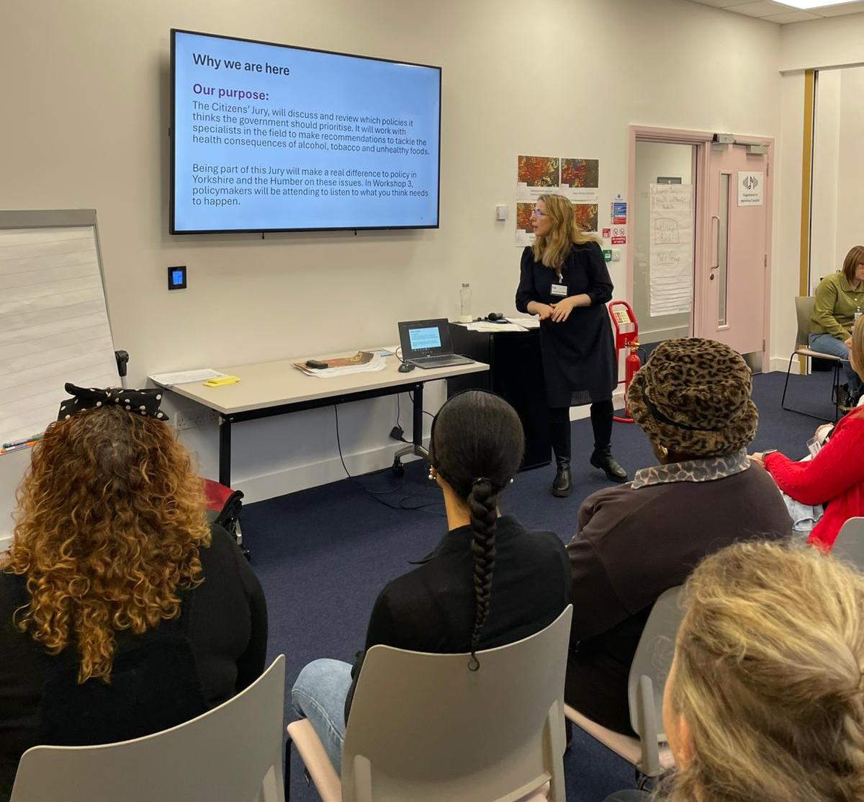
Project aim
To explore public views about the health and social impacts of commercial activities relating to tobacco, alcohol, and unhealthy food and to consider how governments should respond.
Notes:
To consider how governments (local, regional and national) should respond

Slide 7
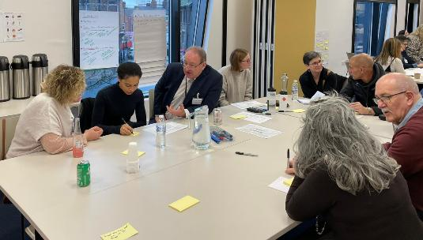

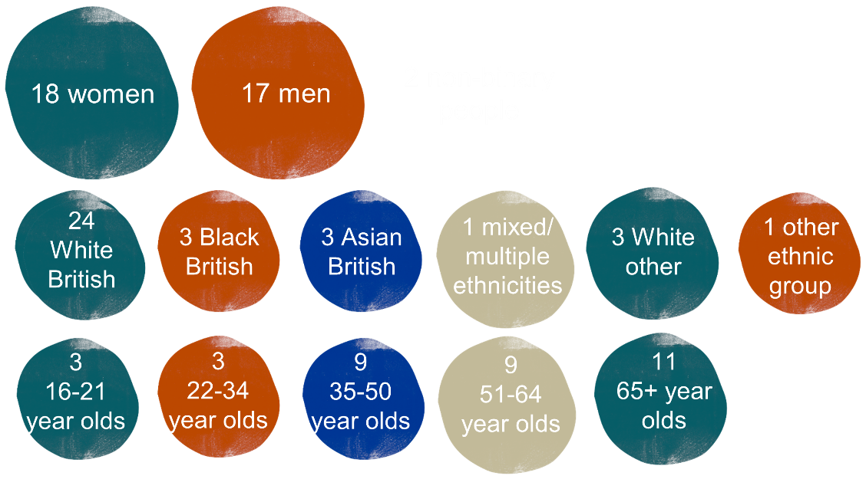
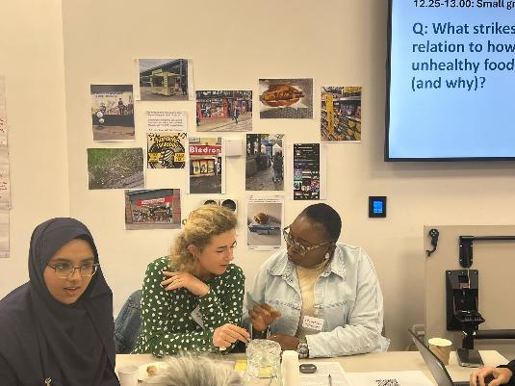
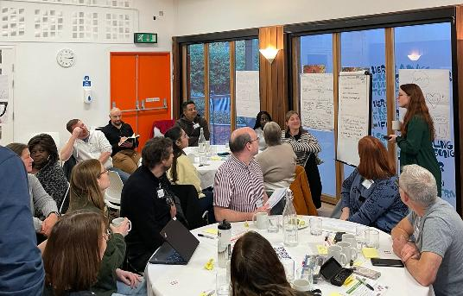
Juror recruitment
Notes:
Members of the Citizens’ Juries were recruited using a stratified sampling method which creates a mini-public broadly representative of the regional population of Yorkshire and Humber.
This is a civic lottery method called sortition. The process was delivered by the Sortition Foundation working to a recruitment specification co-designed by SPECTRUM.
To ensure place-based reflections on the issues, the sortition process focused on two neighbouring wards within each of Wakefield and Doncaster, and issued invitations to addresses in particular parts of those wards
Each of the mini-publics included a diversity of Jury members based on key demographics such as gender, ethnicity and age.

Slide 8
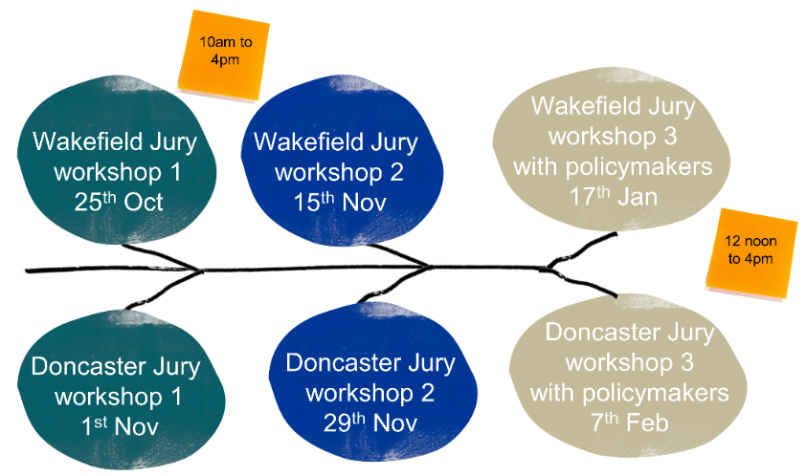
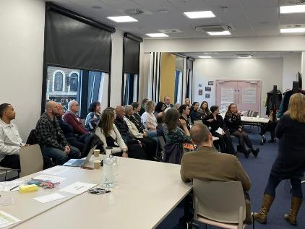
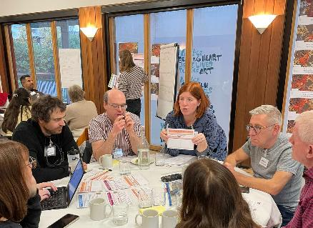
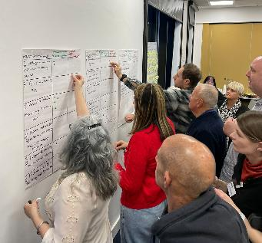
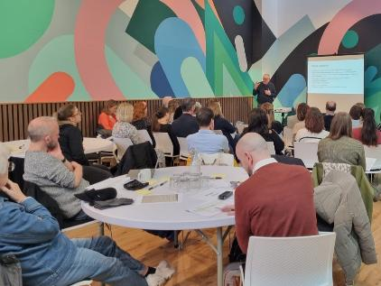
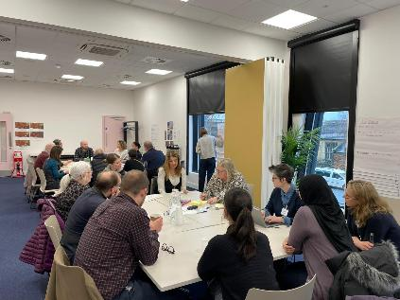
Workshop content
Learning: jurors were presented with evidence.
Discussion: jurors were supported by facilitators to deliberate in small groups and as a whole group.
Decision-making: jurors agreed findings as small groups and voted individually on key priorities
Notes:
Evidence from speakers, filmed presentations from academics and advocacy organisations, maps of density outlets, and policy action proposals, with opportunities for engagement with speakers
Jurors deliberated in small facilitated groups, and as a whole group, supported by a lead facilitator, with support from two Jury Friends to interrogate the evidence and get their questions answered
Jurors agreed findings as small groups, which they presented back and reflected on as a whole group. Opportunities to share opinions and preferences as individuals through votes, a questionnaire, and an interactive engagement platform (like Menti)
In Workshop 3, jurors had the opportunity to share and discuss their findings with decision makers (local councillors, MPs, Mayor), Local Directors of Public Health, Policy colleagues from national and regional government and local authority public health teams, Colleagues from national advocacy organisations and think tanks

Slide 9
Findings
The findings shared here are preliminary. Full findings will be shared once academic analysis of the workshop discussions has been completed. Any results should be understood alongside the full mix of data generated in the workshops.
Data generated from the workshops
Images shared by Jury members
Questionnaire (start of W1 and repeated at the end of W2)
Polling using Wooclap.com during workshops
Jury voting of key issues and different policy actions
‘Manifestos for change’ developed by Jury members
Transcripts of discussions
Ethnographic notes
Initial, high-level findings
Researchers undertaking qualitative analysis; published academic outputs and updated summary of findings to follow.

Slide 10
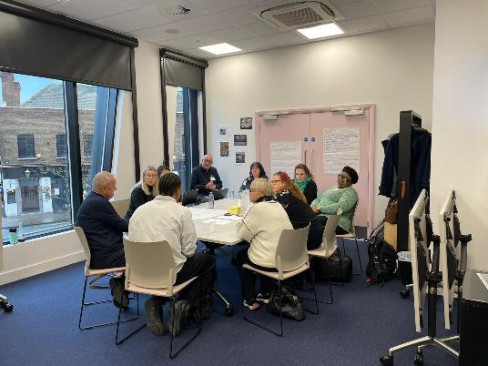
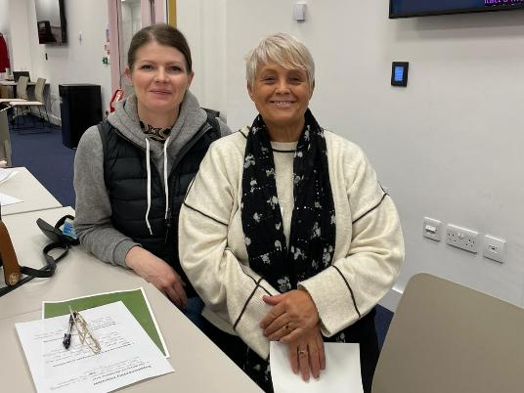
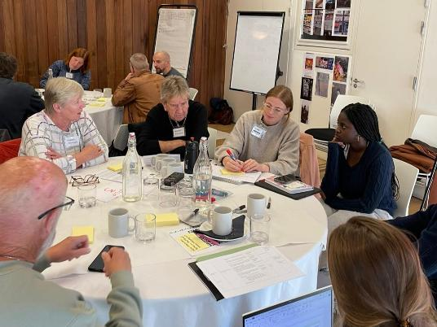
Questionnaire – key findings
Increasing concern about the impact of social factors on health.
Increasing concern about unhealthy food.
Limits should be placed on advertising, promotion and sponsorship for all three industries
We should reduce availability by reducing the number of outlets selling these products
Price-based interventions should be used to increase prices for all three products
Government health policy should be protected from industry influence, and government shouldn’t partner with industry to reduce health and social harms.
Notes:
Jurors were asked to complete a short survey with six questions to provide an overview of their understandings
Jurors were asked to complete this at the beginning of workshop one, to provide initial views, and again at the end of workshop two, to show any changes in people’s views across the workshops.
Increasing concern about the impact of social issues on health, with the influence of friends and family and of their local physical environment overtaking genetics and biology
Large increase in those highlighting unhealthy food as an industry which has the biggest impact on health.
A clear majority (87-88%) agreed that limits should be placed on advertising, promotion and sponsorship for all three industries
Broad support (70-73%) for actions to reduce availability by reducing the number of outlets selling alcohol, tobacco and unhealthy food.
Strong support for price-based interventions for all three products: 82% for alcohol, and 79% for both tobacco and for unhealthy foods.
Strong support for the idea that government health policy should be protected from industry influence, with nobody disagreeing in Workshop 2.
Significant drop in the number of jurors who believed that government should partner with industry to reduce health and social harms.

Slide 11
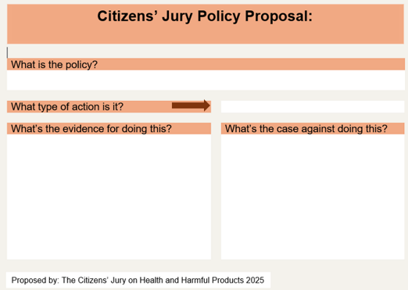
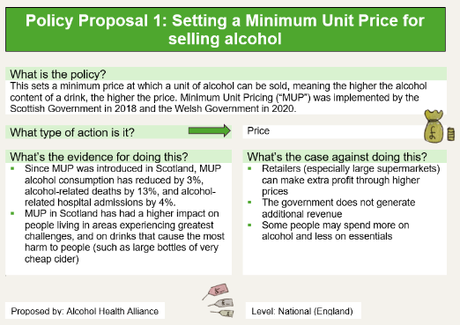
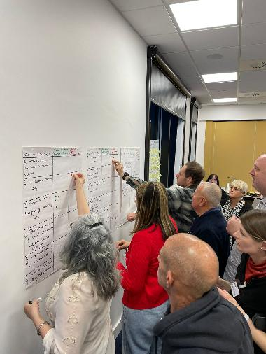
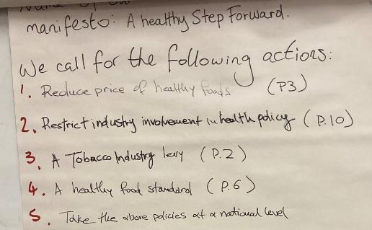
Policy proposals
Jurors were given 10 policy proposals and could write their own
Jurors could allocate 3 votes to policies which they believed had the “power to make change”, and 3 votes to policies which they felt “would not work”
Jurors also worked in small groups to develop their ‘Manifestos for change’. These included up to six policies which jurors felt most strongly should be enacted to create change.
Notes:
In workshop 2, Jurors were given 10 policy actions cards, with a proposal and the cases for and against them.
Decisions on what to include were informed by proposals from advocacy organisations, and by what the jurors themselves wished to focus on. They were themed around price, marketing, availability and policy making.
Jurors were also given blank cards on which they could write their own policy proposals based on their small group deliberations.
There were two rounds of voting. The following results are from the second round; see the Summary Report for first round votes.
In each round, jurors could allocate 3 votes to policies which they believed had the “power to make change”, and 3 votes to policies which they felt “would not work”.
Three small group manifestos were developed in Wakefield, and three in Doncaster.

Slide 12


Support for policy proposals
Policy proposals where support was demonstrated in both individual votes and across the small group manifestos, with at least 2 out of 3 small groups in both Wakefield and Doncaster including the policy.
Restrict advertising of alcohol, unhealthy food and vaping products
Measures to reduce the price of healthy foods
Restrict industry involvement in developing health policy
Introduction of a Healthy Food Standard*
* While there was support from jurors individually and collectively in both places, some individual jurors in Wakefield voted that “it would not work”.

Slide 13


Support for policy proposals
Other policies which received strong support in one of the two Juries:
More education about healthy eating, food system, grow your own options in schools (change the curriculum) #
Improved labelling of alcoholic drinks*
Setting a minimum unit price for selling alcohol*
*Included in multiple small group manifestos in one location, but received multiple individual votes from jurors in the other location that the policy would not work.
# Juror generated policy in one location

Slide 14
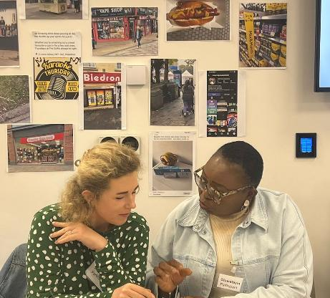
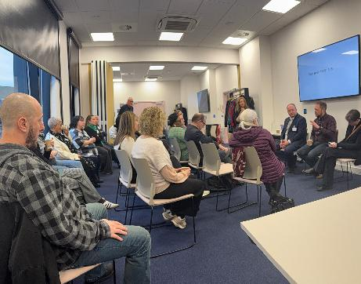
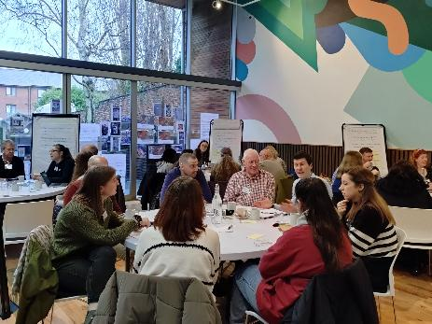
Initial themes and reflections
Alcohol and unhealthy food were the most frequently highlighted industries of concern; concerns about unhealthy food increased over time (“we all need to eat”)
Clear support for measures to restrict industry interference in policy (prioritise health over profit narrative), place limits on advertising and reduce the price of healthy food.
Some shifts across the workshops demonstrating the significance of the deliberative process
Other key themes from the discussions will emerge following analysis of the transcripts
Notes:
Industry specific
Tobacco was generally seen as less of a concern – a feeling that the government had already done lots in this space, and the problem now is vaping, with lack of understanding of relative harms.
Support in principle for broad policy options to reduce outlets and increase prices of unhealthy products. Some gaps between levels of concern around alcohol and food systems and specific policies to address this.
Significance of the deliberative process
Shifts across the workshops (support for price-based interventions; concerns about unhealthy food; support for protecting health policy from industry involvement).
Themes which we might expect to emerge from analysis of the discussion transcripts:
Concerns about the impact on young people and the role of education
The role of advertising (including social media)
The availability, pricing and marketing of, and accessibility of clear information about, food (healthy and unhealthy) is significant because “we all need to eat”

Slide 15


Why do jurors want these changes?
When developing their policy manifestos, jurors were asked to explain why it is important to implement the changes they have called for.
In jurors’ own words:
“It will empower local communities to take control of their health”
“Empower the people rather than the industry”
“People will have the opportunity to ‘start from the same place’, access healthy food regardless of where they are”
“It will make our local communities healthier, now and in the future”
“Prevent (future) strain and burden on the NHS”
“Keep financial interests out of policy – health above profit”
Notes:
These reasons can be group under the following areas:
Create choices and give people control
Improve health locally and nationally
Reduce pressure on the NHS
Prioritise health over profit
Education and reinforcement of messages to influence change

Slide 16
Suggested questions/discussion points
How are we going to take forward the Juries’ call for change?
What else can we do specific to each product (tobacco, alcohol, unhealthy food)?
What else can we do to prevent harms across all three products using cross-cutting policy action (marketing, availability, price)?
How can we improve governance of healthy harming industry interactions, relationships and influence in X to maximise benefits and minimise risk for the health of our population?

