Slide 1

Inclusion health and work:
North East and Yorkshire
Prepared by:
North East and Yorkshire Office for Health Improvement and Disparities (OHID)
Department for Health and Social Care (DHSC) and Department for Work and Pensions (DWP) Joint Work and Health Directorate
October 2025
Updated: Jan 2026, May 2026

Slide 2
Work as a wider determinant of health
Work and inclusion health
Work and health
Policy Context
DWP Structures
Practice examples
How to use this interactive document
This interactive document has features to help you access the information you need quickly and easily.
Use the tabs at the top of this page to go straight to the start of a different section (or just scroll through page by page).
Throughout the document there are hyperlinks to web addresses for additional information and resources.
Purpose of this pack
This slide set has been developed by North East & Yorkshire (NEY) OHID team and DHSC/ DWP Joint Work and Health Directorate Regional Programme Advisor to support work around work and inclusion health across the NEY region.
It can be used/adapted to suit a range of audiences to be delivered by and for:
Local Authority Public Health Work and Health leads, and Employment and Skills leads
Job Centre Plus District Partnership Managers and their teams
Local Authority and Integrated Care Board (ICB) Inclusion Health leads
Caveat: this slide deck represents the most recent data from a number of sources to provide an overview- care needs to be taken with interpretation.

Slide 3
Work as a wider determinant of health
Work and inclusion health
Work and health
Policy Context
DWP Structures
Case Studies
Work as a wider determinant of health

Slide 4
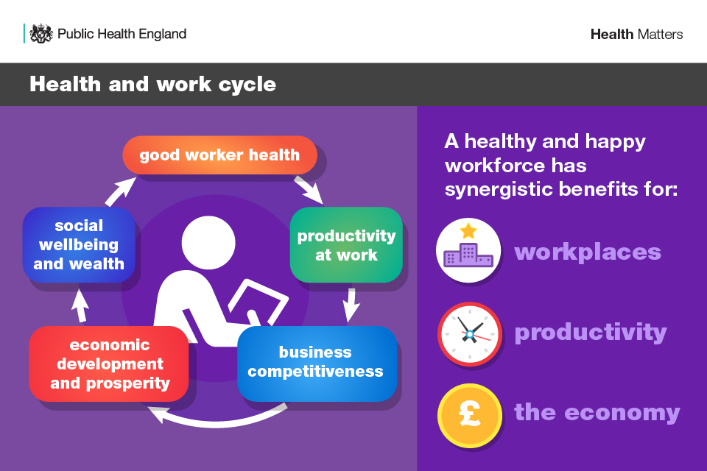
Notes:
Source: WHO Health Workplace Framework and Model

Slide 5
Wider determinants of work and health
Being in good work is better for your health than being out of work.
‘Good work’ is defined as having a safe and secure job with good working hours and conditions, supportive management and opportunities for training and development.
There is clear evidence that good work improves health and wellbeing across people’s lives, not only from an economic standpoint but also in terms of quality of life.
There is also evidence that shows that good quality work protects against social exclusion through the provision of:
income
social interaction
a core role
identity and purpose
Notes:
Source PHE Health Matters Health and Work 2019

Slide 6
Health and work
Work and Health - eLearning for healthcare
2025 Healthcare Professionals' Consensus Statement for action on health and work - AOMRC
An NHS workforce, fit for the future
Promoting work as a health outcome: guidance for AHP leaders - GOV.UK

Slide 7
Work as a wider determinant of health
Work and inclusion health
Work and health
Policy Context
DWP Structures
Case Studies
Work and inclusion health

Slide 8
Why focus on inclusion health and work?
Work is an evidenced wider determinant of health
Opportunities - Government growth agenda focus on reducing economic inactivity
Increased cross sector working at scale on this agenda leads us to build better relationships and understand each other's role
Across NEY, we wanted to focus attention on supporting those who can be furthest away from the labour market and therefore reducing inequalities and preventing the widening of the inequality gap
Work underway between JWHD, DWP, NHSE and NEY OHID (DHSC) at a regional level to address this

Slide 9

What do we mean by inclusion health and why is intersectionality important?
Inclusion health describes an approach to prevent and address extreme health inequities.
Populations are diverse but can share common experiences such as social exclusion, extremely poor health, and barriers in accessing services.
They are largely absent in electronic systems meaning their needs can be overlooked.
Impact of wider determinants such as education, income, employment and housing
Socio-economic
Area you live: Population composition, built and natural environment, levels of social connectedness, and features of specific geographies such as access to green spaces and transport
Inclusion health
Geography
Includes
People experiencing homelessness
Gypsy, Roma and Traveller communities
Sex workers
Migrants in vulnerable circumstances
People subject to modern slavery
People in contact with the justice system
People experiencing drug and/or alcohol dependence
Among others e.g. people with experience of the care system
Personal attributes: Age, disability, gender reassignment, marriage and civil partnership, pregnancy and maternity, race, religion or belief, sex, sexual orientation
Protected characteristics
The health inequalities experienced by belonging to one or more inclusion health group can be further exacerbated if individuals also experience other domains of inequality as described above

Slide 10
So, inclusion health is about more than health inequalities, these groups can have significantly worse health, quality of life and die earlier than the general population ^{(1, 2, 3)} inc. those living in the most deprived areas (⁴) . They are populations that experience multiple overlapping risk factors for poor health and whilst diverse, studies have shown these common characteristics can result in them experiencing the most extreme health inequities.
We know factors that influence health relate to multiple conditions suggesting importance of whole systems approach
A job, safe place to live, social network and community links
Access to healthcare is important but also the upstream work / wider determinants (like work!)
Wider than NHS - role of LA, CA, VCSEs, JCP, police, communities is key
Biggest impact – have everyone looking at the needs of these populations within existing work but to do this we need to be proportionate to need and develop bespoke approaches

Slide 11
Inclusion health data
Data on health needs and outcomes for inclusion health populations are not routinely available.
Spotlight provides data on public health outcomes for inclusion health groups, but this is mainly available at national level.
To note, the use of national datasets is limited and should be used in conjunction with local which can provide a much richer source of information and can describe populations and their needs more effectively.

Slide 12
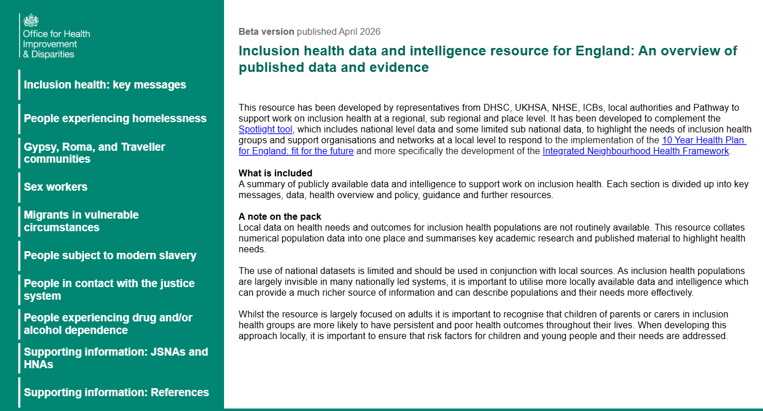
The Inclusion health data and intelligence resource for England provides a summary of publicly available data and intelligence to support work on inclusion health at a local level.
It includes population level data which can be filtered by local authority to help you to consider some of the communities to focus on where there may be higher levels of economic inactivity.

Slide 13
So, what do we need to consider in our approach?
Understand the concepts of inclusion health and social exclusion. These populations face structural discrimination, are more likely to have had past experiences of being turned away from services or being badly treated and be afraid of punitive action after accessing services.
People in inclusion health groups may have experienced significant trauma in their lives so it's important that staff are trained to work in a trauma informed way and understand the importance of cultural humility.
People may not speak English or be able to read or write - is a translator offered routinely and are materials accessible?
To support access, do you need to consider bespoke approaches such as peer support and providing outreach to bring the services you provide closer to communities?

Slide 14
5. Work collaboratively: The needs of inclusion health groups are often complex and intersect across different domains. Consider the networks and services available in your area that can help. There are inclusion health leads in all local authority public health teams who can signpost you to information and local contacts.
6. Encourage local businesses to get involved: Raise awareness about the benefits of inclusive hiring practices and the support available to employers.
7. Sometimes, people are keen volunteer/work within organisations that focus on topics they have lived experience of, e.g. in a drug and alcohol service, for a local refugee VCSE etc. This isn’t right for everyone but providing options like this could be considered.
See also Qualitative research with disadvantaged groups on Universal Credit covering: care experience, ex-offenders, homelessness and substance dependency - GOV.UK which includes some key principles for providing support to some inclusion health groups (DWP, 2026).

Slide 15
Further information
For some inclusion health populations there are more established national government led programs to support people to work such as the Probation Employment Pathway and more recently the New Employment Councils to bring probation, prisons and local businesses together to help people in the justice system into work. There is also the Individual placement and support work for adults in drug and alcohol treatment.
There are also examples of work to support other inclusion health groups which are often led through the VCSE sector such as:
Access to Employment in NHS Health Care Support Worker Roles for People with Lived Experience of Homelessness: Programme Evaluation Final Report – Pathway
Refugee Action delivers the Pathways to Work project, focusing on helping refugees build skills and find employment aligned with their aspirations.
Organisations like National Ugly Mugs offer vocational support workshops designed by and for sex workers and services such as Basis in Leeds offer support to those wanting to transition into alternative employment, volunteering and training
To support Gypsy, Roma and Traveller communities with employment and education, VCSE work includes The Traveller Movement, Leeds GRT outreach and inclusion team and London Gypsies and Travellers runs the Bright Futures program for young people aged 16-25, offering one-on-one mentoring, career guidance, and well-being support.
Migration Yorkshire provide information to support professionals working with migrants, and more specifically regarding with work and education and advice for employers.
Locally, your VCSEs supporting inclusion health groups may offer volunteering and work experience for the communities they serve.
Other useful information
Health Equity Assessment Tool (HEAT) - GOV.UK to support systematic action on health inequalities and equalities
Safety and Survival: How the Work Ban Fuels Violence Against Women Seeking Asylum, Women for Refugee Women, 2024

Slide 16
Work as a wider determinant of health
Work and inclusion health
Work and health
Policy Context
DWP Structures
Case Studies
Work and health

Slide 17
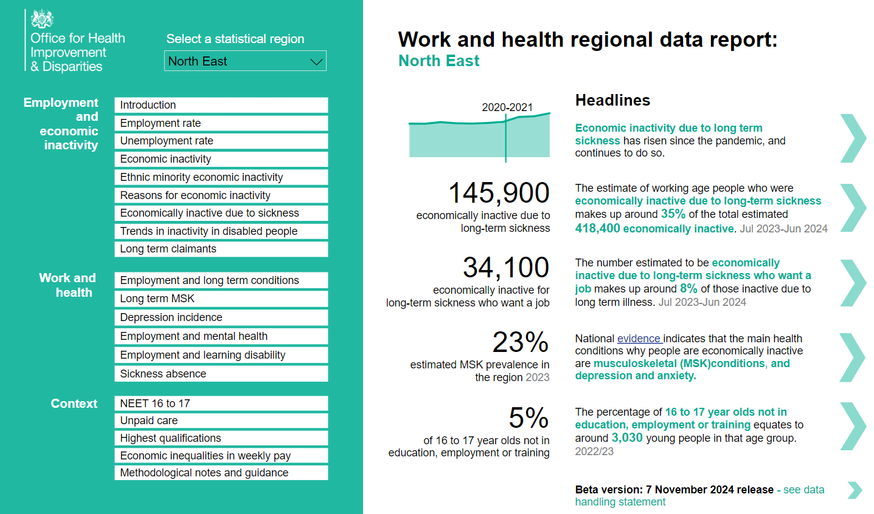
Key work and health data headlines – NEY
Work & Health Regional Data Report

Slide 18
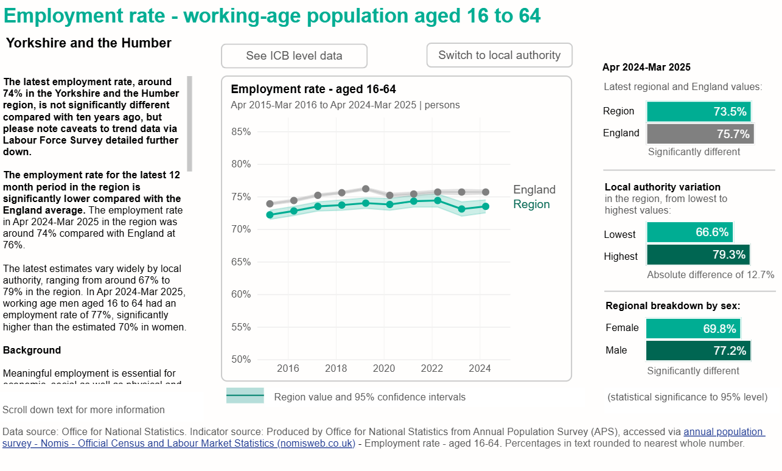

Slide 19
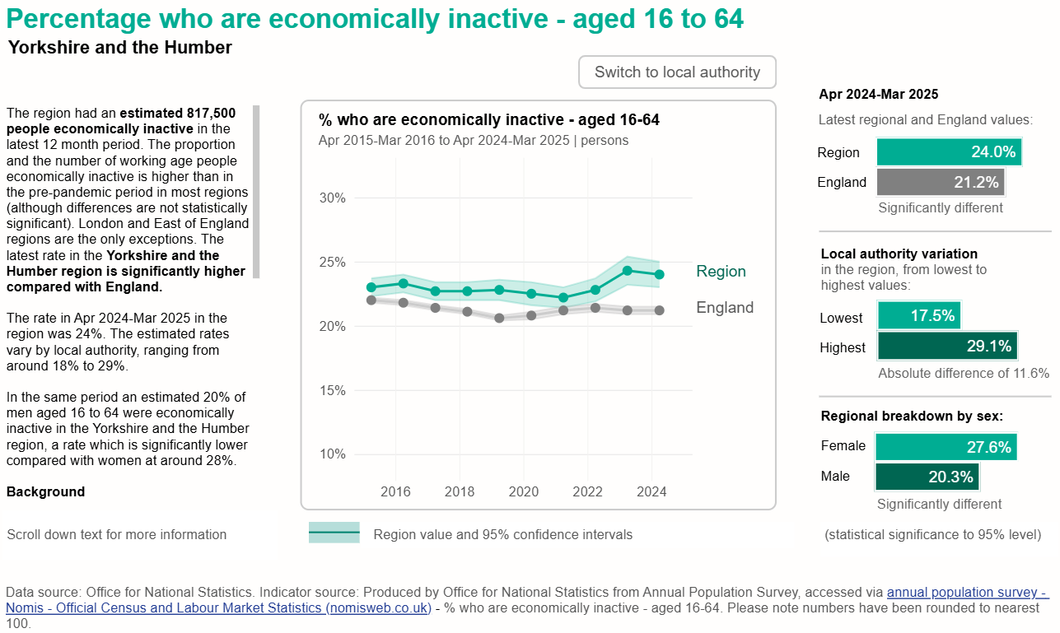

Slide 20
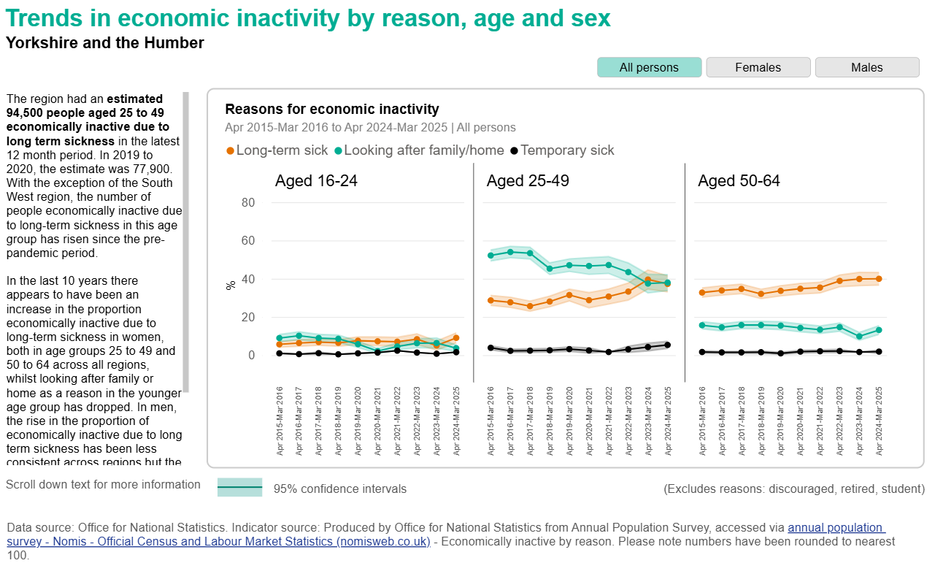

Slide 21
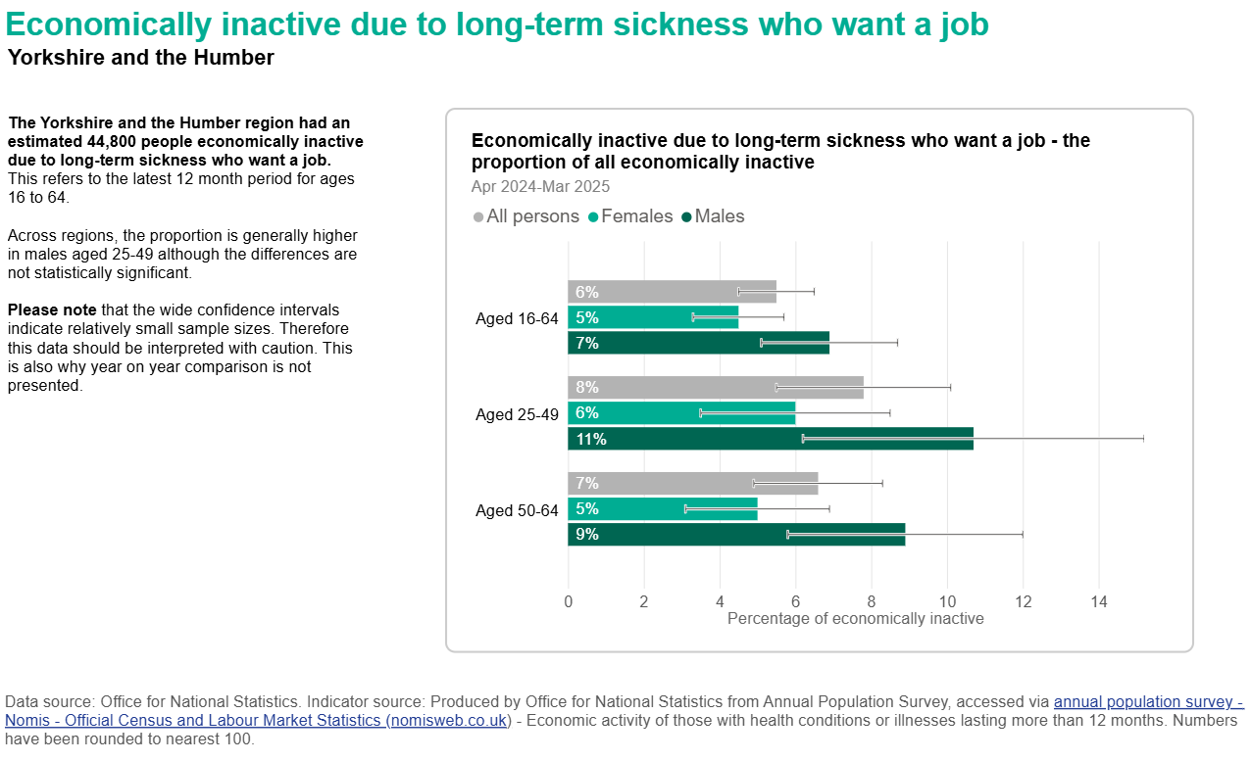

Slide 22
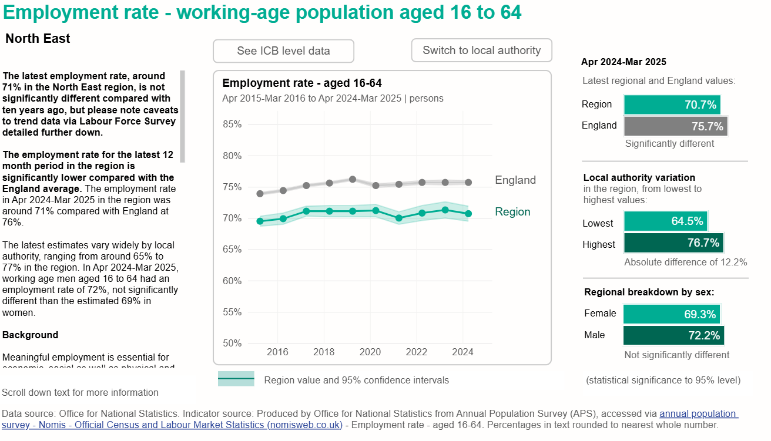

Slide 23
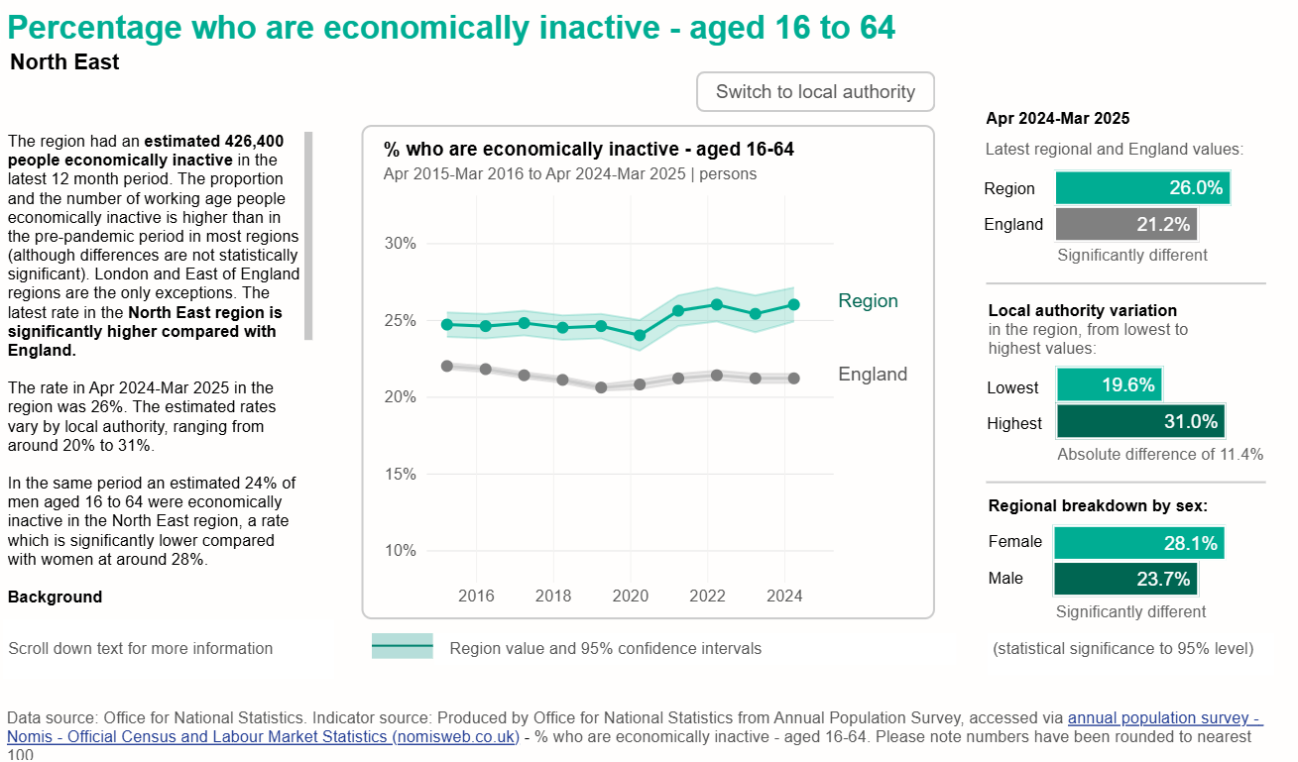

Slide 24
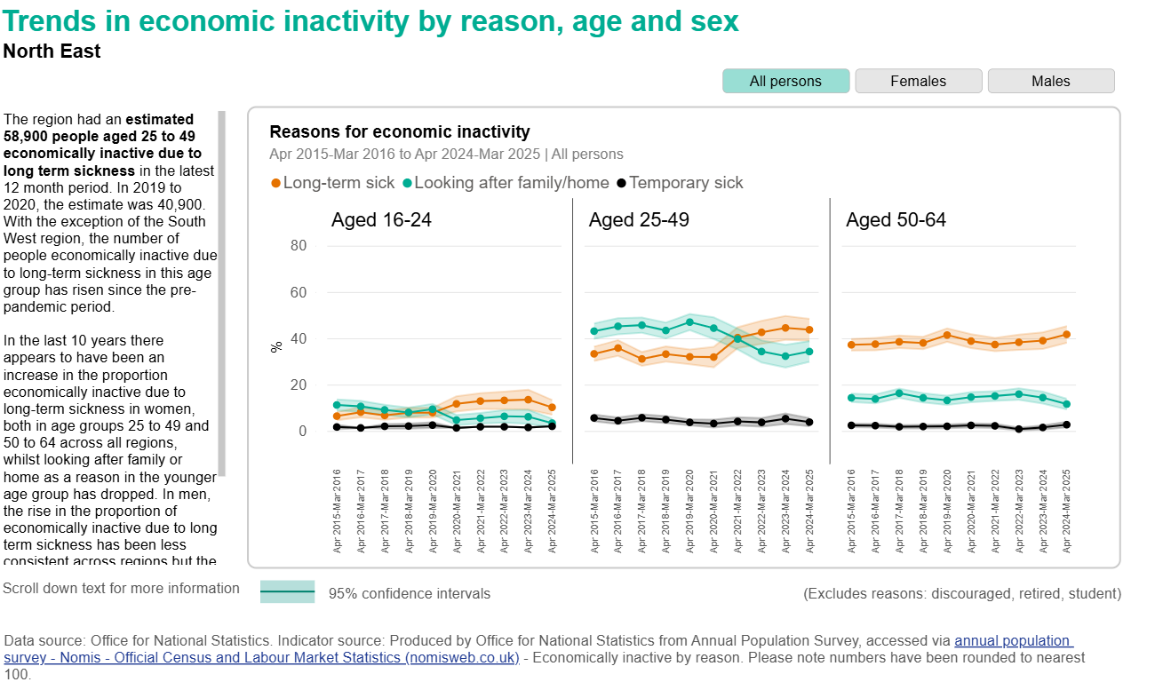

Slide 25
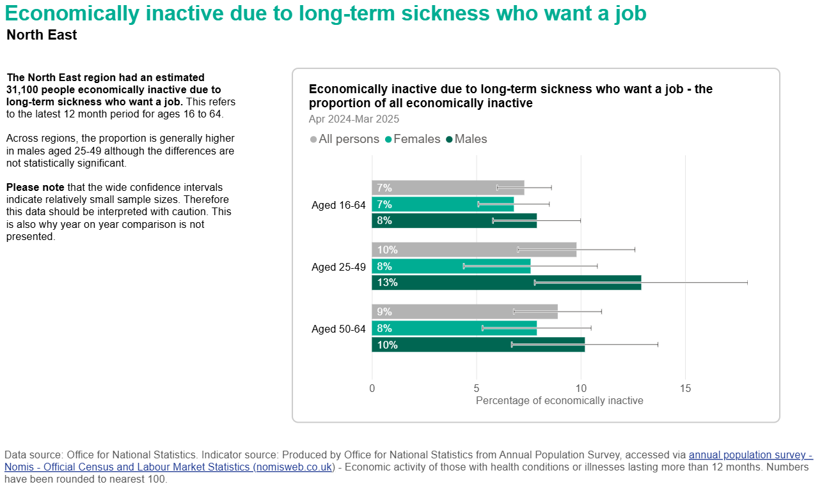

Slide 26
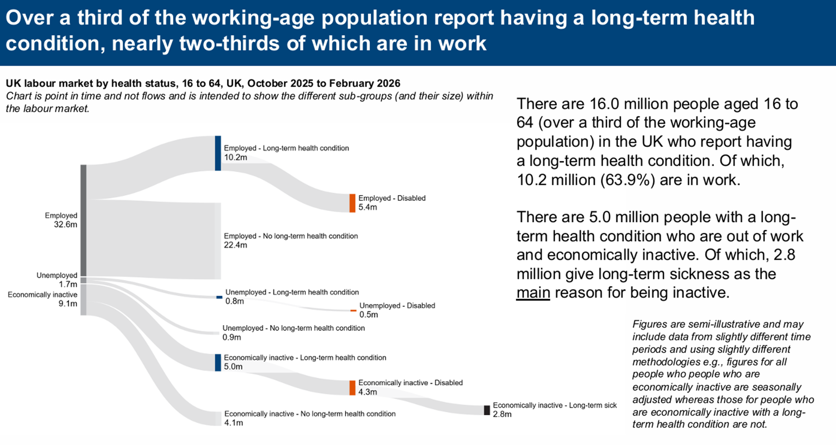

Slide 27
Work as a wider determinant of health
Work and inclusion health
Work and health
Policy Context
DWP Structures
Case Studies
Policy Context
10 Year Health Plan for England: fit for the future
Get Britain Working
Keep Britain Working: Final report - GOV.UK

Slide 28
Policy: 10 Year Health Plan for England: fit for the future
Recruitment
  Reorientate the focus of NHS recruitment away from its dependency on international recruitment and towards its own communities; supporting those unemployed or economically inactive into appropriate roles.
  Expand apprenticeships and accessible training so that people can earn while they learn.
  Allocate £5 million across ten integrated care systems (ICSs) to support 1000 young people and those from deprived backgrounds into pre-employment training, entry level roles or training posts.
  Continue to actively support care leavers, building on action the NHS has already taken as a signatory to the care leaver covenant.
Professional development
  By 2035, every single member of NHS staff will have their own personalised career coaching and development plan, to help them acquire new skills and practice at the top of their professional capability.
  Embed a culture of lifelong learning with a focus on skills and competencies. Introducing ‘skills escalators’ to give staff a trajectory for clear career progression.
  Create 2,000 more nursing apprenticeships over the next three years, prioritising areas with the greatest need.
  Development of advanced practice models for nurses, midwives, and allied health professionals, particularly in neighbourhood settings. And including increasing the number of nurse consultants.
Notes:
Expansion of Health and Growth Accelerators to join up support from across work, health and skills systems to help people find and stay in work. We will work with all ICBs to establish Health and Growth Accelerators models
In addition to these ambitions there are plans to support improvements in terms and conditions; training for senior line managers and flexible appraisals which include rewarding excellence/ acting decisively where under performance occurs, and increased numbers of specialty training posts in areas of increasing need

Slide 29
Get Britain Working White Paper
The Get Britain Working White Paper sets out the government's ambition to build a thriving labour market. This would place the UK among the highest performing countries in the world, with the equivalent of over two million more people in work.
The Government is going to tackle this challenge, in four priority areas:
Improving the health of the population so that more people can stay in and thrive at work.
Mobilising local leadership to tackle economic inactivity by better connecting work, health and skills support and increasing engagement with that support.
Supporting employers to promote healthy workplaces, and to recruit and retain workers with a health condition or disability.
Reforming the system of health and disability benefits to promote and enable employment.
Notes:
The UK is facing a significant labour market inactivity challenge, which is impeding economic growth. The UK is the only major economy that has seen its employment rate fall over the last five years, reversing the previous long-run trend of declining rates of economic inactivity.
The biggest driver of economic inactivity is ill health. Increases in inactivity rates since 2020 have been primarily driven by long-term health conditions. Evidence also indicates that the long-term health conditions which are the main drivers of health-related economic inactivity are depression and anxiety, musculoskeletal disease (MSK), cardiovascular disease and obesity. Long term sickness inactivity is at a near record high.
A quarter of all people aged 16 to 64 have a long-term health condition that limits their day-to-day activities (therefore classing them as disabled), with disabled people nearly 3 times more likely (than non-disabled people) to be economically inactive. This leads to significant adverse impacts for people, for the economy and for the public finances.
The OBR now forecasts that welfare spending on incapacity and disability benefits alone will rise from £64.7bn in 2023-24 to £100bnin 2029-30, increasing from 2.4 per cent to 3 per cent of GDP. This means that if no action is taken, the government will need to allocate almost £40bn more to health and disability benefits alone by 2029-30.
Disability prevalence is also increasing, with 2.6 million (38%) more people in the working-age population classed as disabled compared to a decade ago. The employment rate of disabled people (53%) is nearly 29 percentage points lower than that of non-disabled people, and this employment ‘gap’ has stopped narrowing over the last 5 years
There has also been a decline in the health of those who are working. 4.1 million people are currently in work with a health condition that is work-limiting – an increase of 300,000 over the past year
Work is one of the key social determinants of health. Being in work is associated with improved mental and physical health, provided this is ‘good work’ – i.e. good working conditions and supportive management. Good work can therefore be considered a health outcome itself
Building a thriving and inclusive labour market and increasing the number of people in work is central to achieving the government’s number one mission to grow the economy, as well as delivering missions to spread opportunity and improve the health of the nation.

Slide 30
Measures and Target Groups
Measure | Location | Target Group
Work Well - ICBs | 15 ICBs in England. Birmingham and Solihull, Black Country, Bristol, North Somerset and South Gloucestershire, Cambridgeshire and Peterborough, Cornwall and the Isles of Scilly, Coventry and Warwickshire, Frimley, Herefordshire and Worcestershire, Greater Manchester, Lancashire and South Cumbria, Leicester, Leicestershire and Rutland, North Central London, Northwest London, South Yorkshire and Surrey Heartlands Plans for national rollout 2026/27 | Early low intensity intervention for people in-work and at risk of falling out, or recently out-of-work; and where health is a barrier to work
Inactivity Trailblazers/Youth Guarantee - MCAs | Youth Guarantee – Liverpool City Region, West Midlands, Tees Valley, East Midlands, London 1, London 2, Cambridge and Peterborough, West of England. Economic Inactivity – West Yorkshire , North East , South Yorkshire , Greater Manchester, Wales, London 3, London 4, York and North Yorkshire. | Employment and skills intervention for the economically inactive and young people between 18 and 21 with tailored support for those who are not in education, employment or training (NEET) or at risk of becoming NEET.
Connect to Work - funding to LAs and administered through MCA | Covers all of England and Wales | Primarily economically inactive people with a disability or complex barriers (disadvantaged groups),

Slide 31
Measures and Target Groups
Measure | Location | Target Group
NHS Health and Growth Accelerators - ICBs | South Yorkshire, West Yorkshire and North East North Cumbria ICB | Higher intensity health led intervention for people in-work and at risk of falling out, or recently out-of-work focussing on health conditions most likely to impact economic inactivity
Employment Advisers in NHS Talking Therapies | All NHS Talking Therapy Services in England | Adults (16+) with anxiety disorders and/or depression accessing NHS Talking Therapies. Combined employment support and therapy for individuals who request it available to both in-work and out-of-work individuals, with tailored support depending on employment status
Employment Advisers in Musculoskeletal Services | TBC | Individuals with Musculoskeletal (MSK) conditions
MSK Community Delivery Programme (GIRFT) - ICBs | 17 ICBs across the East of England, London, Midlands, North East, North West, South East and the South West | Individuals with Musculoskeletal (MSK) conditions

Slide 32
Keep Britain Working Review
Keep Britain Working: Final report - GOV.UK
The review identified three persistent problems:
Culture of fear on both sides blocks early, safe conversations and support
Lack of effective support for employers/line managers; fit notes often default to ‘not fit for work’ (93%; and often extended without further consultation)
Structural exclusion leaves disabled people disproportionately out of work
(employment rate ~53%; persistent 12.7% pay gap)

Slide 33
Keep Britain Working summary
The Review represents an opportunity to reshape how we support people to stay healthy, stay in work, and build better futures for themselves and their families.
It sets out a fundamental shift from a model where health at work is largely left to the individual and the NHS, to one where it becomes a shared responsibility between employers, employees and health services.
Government is taking immediate action through employer-led Vanguards and developing a Healthy Workplace Standard. Central to this will be the Workplace Health Intelligence Unit.
The Vanguard Phase is launching with forward thinking employers across different sizes and sectors to build evidence and data, and to test new approaches and learn about what works across different places and conditions.
The Vanguard taskforce will bring together representatives from business, disabled people, workers' representatives, and health experts to shape and deliver this work collaboratively.

Slide 34
Three Recommendations
Launch a three-year scaling of the Vanguard
Create the pathway for employer-led solutions to develop a Healthy Working Standard and Workplace Health Provision by 2029 – a framework of evidence-based practices that deliver:
better retention of people with physical or mental health conditions, and those who are neurodivergent
longer, healthier working lives for older workers
stronger support for disabled people
Establish the Workplace Health Intelligence Unit
Quickly stand up and provide initial funding for the unit as an independent ‘movement HQ’ to support vanguards, build the evidence base and drive innovation. By 2029, it will deliver:
outcome measures and data to underpin the Healthy Working Standard
development of sustainable Workplace Health Provision with innovation and accessibility at its core
recommendations to drive general adoption in the next Spending Review
Rewire the incentive system in time for the next Spending Review
The Secretaries of State for DWP, DBT and DHSC to act as joint sponsors, aligning levers across government to remove barriers and accelerate change, including:
Employer incentives, grounded in evidence, to accelerate adoption
Adjacent reforms – for example, welfare, fit note, Access to Work, dispute resolution – that amplify impact
NHS and OH partnerships, including regional and pooled-risk models, to make provision more affordable
Integration of workplace health into neighbourhood health strategies, making sustained employment a core health outcome
Notes:
1. Reset Workplace Health as a Shared Responsibility
Move away from a model where workplace health is left to individuals and the NHS.
Enable and incentivise employers and employees to act, making workplace health and inclusion a proactive, shared responsibility between the state, employers, and employees.
2. Launch and Scale the Vanguard Phase
Immediately launch a three-year ‘vanguard phase’ to develop and test the Healthy Working Lifecycle and Workplace Health Provision (WHP) with willing employers and providers.
Use this phase to build momentum, consensus, and robust evidence for what works before embedding and extending reforms across the wider economy.
3. Establish the Workplace Health Intelligence Unit (WHIU)
Quickly set up and provide initial funding for the WHIU as an independent “movement HQ” to support vanguards, build the evidence base, and drive innovation.
The WHIU should aggregate and analyse data, guide continuous improvement, and provide leadership across the new system.
4. Rewire Incentives and Policy Levers
Use procurement, tax, welfare, and regulatory levers to embed shared responsibility and sustain change.
Develop targeted incentives for employers (e.g., procurement scoring, tax relief, sick pay rebates, pooled funding models) to encourage adoption of certified standards and positive behaviours.
Align adjacent reforms (e.g., welfare, fit note, Access to Work, dispute resolution) to amplify impact.
5. Support Affordable and Accessible WHP for All Employers
Ensure that Workplace Health Provision is affordable and accessible, especially for SMEs and the self-employed, by supporting pooled funding models and market development.
Oversee the development of certified standards for WHP and the Healthy Working Lifecycle.
6. Integrate Workplace Health with Broader Strategies
Align workplace health reforms with the NHS Long Term Plan, neighbourhood health strategies, and industrial strategy.
Make sustained employment a core health outcome in local and national health policy.
7. Provide National Leadership and Governance
Ensure senior political sponsorship and cross-departmental coordination (DWP, DBT, DHSC).
Oversee governance and accountability for both day-to-day direction and long-term strategic decision-making.
8. Monitor, Evaluate, and Scale Up
Use robust data and evidence from the WHIU and vanguard phase to inform scaling, continuous improvement, and the introduction of further incentives.
Target interventions in sectors or regions with low adoption and drive continuous improvement through legal, financial, and cultural levers.
OH – occupational health
Affordable for SMEs

Slide 35
Work as a wider determinant of health
Work and inclusion health
Work and health
Policy context
DWP structures
Case Studies
DWP structures

Slide 36
Jobcentre Plus organisation chart
Jobcentre Plus Area
Area Director – SCS2
E.g. Scotland, North or South-East
Service leaders are responsible for relationships with external organisations
JCP Group
Group Director – SCS1
E.g. Northern England, Yorks & Humber
JCP District
Service Leader – G6
E.g. West Yorkshire
Senior Operations Leaders
G7
E.g. Bradford, Calderdale, Wakefield
Advanced Customer Support Senior Leaders
District Partnership Manager
Customer Service Leaders
Youth Lead
Coach and mentor DWP colleagues, providing an additional layer of support for vulnerable customers, supplying specialist help and joining up with external agencies.
See following slide
Work Coach Team Leaders
Helps individuals find employment by providing support for job applications, training, and job searching. They develop a plan to find work, and offer assistance with job applications, interviews, and accessing local training opportunities. Also help manage benefit claims and provide support as a person transitions from benefits to work.
Work Coaches

Slide 37
Jobcentre Plus organisation chart
District Partnership Manager
Health Partnerships
Senior Partnership Managers
Employer engagement
Estates, Operational Support, Resources
NB: In some areas the Health Partnerships role may not be badged separately to the SPM role
Employer Adviser Leaders
Disability Employment Advisor Leaders
Partnership Managers, Prisons WC, Community WC, Schools Advisor, Third Party Provision, Supporting Families Employment Advisers
Employer Advisers
Disability Employment Advisors
Supports Work Coaches by providing specialised support to help people with disabilities or health conditions find and stay in work. They offer personalized advice on job searching, skills training, and government schemes like Access to Work. DEAs also help with practical aspects like work preparation, interview coaching, and identifying Disability Confident employers.
Prison WC - work with prisoners to build skills, support their Universal Credit claims, and can contact employers to help retain a job. Assist in managing the transition back into society, aiming to reduce reoffending by creating a path to stable employment.
Community WC – Embedded within, and often co-located with, services that work with Inclusion Health groups: e.g. Drug & Alcohol services, Probation, Homelessness, Gypsy, Roma, Traveller groups.
Schools Advisors - support schools in providing high-quality, impartial careers advice, assist students with the transition from education to work, and connect students with opportunities like traineeships, apprenticeships, and work experience.

Slide 38
Opportunities to support IH populations example
This diagram illustrates what the Jobcentre’s relationships with local services typically look like, using the example of Calderdale in West Yorkshire. In addition to the services offered in the local Jobcentres they also have people working in these community settings. What happens locally around the region will vary but local Partnerships teams in Jobcentre Plus will be open to exploring opportunities where they can work with other services to support people.
A charity for mainly homeless but pretty much all Inclusion Health groups. There is wound clinic, crash pads, temp accommodation, food and other support services under 1 roof. JCP and multiple other areas of service are linked in as well.
For people that are going through and completed treatment for drugs/Alcohol. This does not just do treatment, but also housing, work, moving on support and JCP work there to support this
The LA homeless reduction team work here. A Community Work Coach works with them, as does a Family coach who also works alongside the Social work and Family intervention team as well as the housing staff
The Gathering Place / Happy Days
The Basement Project
Customer First
Coming soon - Project Colt & Elland Hub
Calderdale Jobcentre Plus
Newground
Probation
Youth Employment Coaches are based here and work with Care Leavers, youth workers and youth clubs.
GP Surgeries
Weekly Multi-Agency MDT

Slide 39
Opportunities to support IH populations – Joint Work and Health Directorate
The Joint Work and Health Directorate have programmes in trial and pilot stages. These initiatives join up health and employment systems, both at national and local level, and are key to providing effective support.
WorkWell sites went live from October last year in 15 areas across England and provide a low intensity holistic support for health-related barriers to employment, and a single joined up gateway to existing local work and health service provision. Locally designed services will support disabled people and people with health conditions through building a personalised action plan that will guide core support to address a person’s health related barriers to work. The pilot has been funded to deliver until Spring 2026.
We also have established programmes and areas of work:
Employment Advisors in NHS Talking Therapies combines the expertise of therapists and employment advisers to give those with mental health conditions the support they need to find work tailored to them. This voluntary service enables Talking Therapies clients to access therapeutic treatment and employment support through a single service to help them to remain in, return to or find work and improve their mental health. Employment Advisers support patients in NHS Talking Therapies irrespective of their employment or benefit status.
In the UK, over 20 million people live with a musculoskeletal (MSK) condition. MSK is a leading cause of sickness absence , comorbidity and of Years Lived with Disability in the UK. Waiting lists for MSK Community Services are high at 340,000 people. Key modifiable risk factors include physical inactivity, being overweight or obese, alcohol, drugs and smoking.
The fit note is the primary form of medical evidence used for Statutory Sick Pay and some welfare benefits. They can be issued by doctors, nurses, physiotherapists, pharmacists and occupational therapists. There is an opportunity to improve the fit note process to support effective health and work conversations and enable people to access the right support at the right time to help prevent a move toward economic inactivity.
Additionally, the JWHD is working to support NHS England on the Health and Growth Accelerators which are developing a new approach to how the health system operates with local partners to join up services and deliver on shared outcomes. In 2025/26, three Health & Growth Accelerators ICBs (North-East and North Cumbria, West and South Yorkshire ICBs) will receive a share of £45million to meet a target for reducing economic inactivity by 1.2% through working with local partners.

Slide 40
Opportunities to support IH populations – Joint Work and Health Directorate
JWHD works with employers to support individuals and workplaces with the tools needed to promote inclusive work environments recognising that employers play an important role in addressing health and disability
The Disability Confident scheme provides employers with the knowledge, skills, and confidence they need to attract, recruit, retain and develop disabled people in the workplace. It is a voluntary scheme, developed by disabled people, employers and disability organisations representing disabled people. As of 31 January 2025, there are over 19,000 Disability Confident members and they estimate over 12 million paid employees working in their organisations.
We have worked with employers from SME businesses, disability organisations, and other parts of government, to build the digital service Support with employee health and disability. This service provides a first port of call from which employers are guided through ‘must-dos’ in common health and disability scenarios. The service signposts to related services, and to sources of more detailed advice and expert help. Employers tell us they trust government the most in this area and want guidance on how to manage situations in a way that fulfils their multiple legal obligations.
Statutory Sick Pay (SSP) is the minimum level of income that employers must pay to eligible employees when they are sick or incapable of work. The costs of paying sick pay are met in full by the employer. SSP can play a key role in supporting people to return to and stay in work.
Occupational health (OH) is expert (clinically-led) advisory support which helps to maintain and promote employee health and wellbeing and an important enabler to retain and support earlier employee returns to work from sickness absence and prevent job loss. Most UK OH provision is delivered privately and voluntarily purchased by employers, with only 45% of GB workers having access. Previous focus of OH reforms have involved increasing private market coverage of employer-led OH to help businesses support disabled people and those with health conditions to remain in work.
JWHD is facilitating “Keep Britain Working”, an independent review of the role of UK employers in reducing health-related inactivity and to promote healthy and inclusive workplaces. The lead reviewer, Sir Charlie Mayfield, is expected to bring forward recommendations in Autumn 2025

Slide 41
Work as a wider determinant of health
Work and inclusion health
Work and health
Policy Context
DWP Structures
Practice examples
Practice examples

Slide 42
PRACTICE EXAMPLE: ReSTORE – Refugee Support Training Orientation Recruitment and Education
CONTACT: ReSTORE, blerta.ilazi@nhs.net -
Context
The offer
Learning
Established in 2023, ReSTORE is provided by South Yorkshire Primary Care Workforce and Training Hub.
The Programme is a cross-sector collaborative initiative designed to support healthcare professionals from inclusion health groups, particularly refugee nurses, midwives, and allied healthcare professionals in South Yorkshire, in returning to their nursing careers and joining the NHS workforce through a structured program.
ReSTORE aligns with the principles of the IPS Model:
Prioritises competitive employment in standard NHS roles
Participation is voluntary and based on individual choice. offers trauma-informed, pastoral support
Tailored to each participant's clinical background, career aspirations, and personal circumstances
Participants begin NHS job applications alongside exam preparation, reducing delays between registration and employment
The programme works with five NHS Trusts in South Yorkshire, primary care providers, and academic institutions to develop employment pathways
Participants receive ongoing support beyond employment recognising that integration is a long-term process
ReSTORE addresses significant barriers that refugee healthcare professionals face in joining regulatory bodies and resuming their careers trained in their home countries. Our partners include the DWP (Lisa Dalby, copied into this email), five NHS Hospital Trusts across South Yorkshire, the Nursing and Midwifery Council, both Sheffield universities, and various voluntary and community sector organisations such as the Refugee Council, Hope English School, and SAVTE.
40 refugee nurses have been supported so far, 30 of them are now working in the NHS. Of these, 9 have fully qualified and are now working as Registered Nurses in the NHS and 21 participants are working as Clinical Support Workers, catering assistants and volunteers whilst they continue their Registration journey.
Find out more about ReSTORE Building ReSTORE - National Association of Primary Care

Slide 43
PRACTICE EXAMPLE: Sheffield Inclusive Recovery Cities Model
CONTACT: tracey.ford@sheffield.gov.uk, Joanna.yardley@likewisesheffield.org.uk
Context
The offer
Learning
Inclusive Recovery Cities (IRC) started out as a UK movement that aims to create communities where recovery from addiction is visible, celebrated, and supported. The IRC approach takes action to remove the shame and stigma surrounding substance dependence, increasing understanding, support and opportunities for recovery, and one of the core goals and essential metrics for success is reducing stigma and social exclusion.
There is a mutual benefit – not just for recovering people, but for the city, in that people in recovery, individually and as part of a vibrant and integrated recovery community, make the city a better place for everyone.
The movement is led by Lived Experience Recovery Organisation individuals in partnership with Sheffield City Council, Partnership Board and Recovery Community.
Visible Recovery: Making recovery achievements and events prominent to challenge negative perceptions and foster a sense of hope and possibility.
Challenging Stigma: Actively working to dismantle negative attitudes and stereotypes surrounding addiction and recovery through public awareness campaigns and community engagement.
Multiple Pathways: –Recognising that individuals recover in different ways and supporting diverse approaches to recovery, including peer support, professional treatment, and community-based initiatives.
Collaborative Approach: Encouraging partnerships between city councils, recovery organisations, healthcare providers, employers, and community members to create a supportive ecosystem for recovery.
Public Events: Hosting regular public-facing events to celebrate recovery, promote positive narratives, and foster a sense of community
Includes pre-employment pathways such as volunteering in services, ambassadors' scheme and Shelter’s Getting Real Opportunities of Work (GROW)
We know anecdotally that people experiencing issues with addiction, whether it be themselves or being an affected family member will shy away from disclosing to employers because of the stigma associated with addiction. – hence the inclusive recovery cities campaign, which aims to have more open conversations in the workplace and for employers HR departments to have policies that support individuals
We are currently doing some consultation work to back up what we know anecdotally. We also have plans for a recovery toolkit aimed at supporting conversations about addiction and recovery and are engaging the public in conversations about recovery.
Timeline so far:
Established a Steering Group in 2023 and co-created a mission statement. Set up subgroups in 2024 looking at Comms, BAMER communities, Business & Employment. These led to the Recovery Directory and a conference held in Sheffield Pakistan Muslim Centre.

Slide 44
PRACTICE EXAMPLE: Individual Placement and Support (IPS) in Drug & Alcohol Services
CONTACT: Various (see accompanying service directory)
Context
The offer
Learning
IPS is an employment programme funded by DHSC/OHID and DWP. It is currently available in every local authority area in the North East and Yorkshire. Participation is entirely voluntary.
Each local authority (or consortium where working in partnership) is responsible for appointing an IPS provider. Contact details of providers can be found in the accompanying service directory
The aim of IPS is to help people to secure paid employment
OHID-funded IPS can be accessed by anyone in structured treatment for drug and/or alcohol use regardless of (e.g.) perceived job-readiness, complexity, cooccurring needs, prognosis, offending history or housing circumstances. The eligibility requirements are:
Working age
Able to work legally in the UK
Keen to find paid work/retain their current job where that is at risk
IPS is a manualised, evidence-based model of employment support. As specified by OHID, IPS rests on 8 core principles:
Focus on open market employment (not ringfenced jobs)
Open to anyone, regardless of diagnosis, complexity etc (zero exclusion)
Aims to follow client employment preferences
Works quicky: job search within 4 weeks
Integrates employment support and clinical services
Employer engagement by all IPS staff
In-work support to clients and employers
Benefits/work incentives advice is included
For more information about IPS see here
There is an extensive and growing evidence base for the effectiveness of IPS, including evidence from the services that OHID and DWP fund around the country. The first report of employment outcomes of OHID-funded IPS teams working in community drug and alcohol treatment can be found here.
The most recent analysis of outcomes attained by over 6,000 IPS clients found that 52% of IPS clients find work (44% for opiate clients), with 77% of those sustaining work for 13 weeks or longer (80% for opiate clients)
OHID has commissioned a consortium led by RAND Europe to undertake an independent qualitative evaluation of the national expansion of IPS in community drug and alcohol treatment. Their report will be published in the summer of 2025. It will be accompanied by a practice manual, which draws on the experience of currently live IPS to create a “how to” guide for any future services.

Slide 45
PRACTICE EXAMPLE: Women’s Out of Court Pathways pilot
ORGANISATION: West Yorkshire Combined Authority adultskillsfund@westyorks-ca.gov.uk
Context
The Offer
Learning
Provide context:
Lead organisation /service: West Yorkshire Police (WYP) in partnership with West Yorkshire Combined Authority (WYCA) funded through devolved Adult Skills Fund / intervention programme delivered by Kirklees Council
Overall aim of service/team: To provide an intervention to divert women from the criminal justice system. The programme offers a bespoke, women-led curriculum delivered in trusted spaces. It includes employability support, confidence building, role models, job matching, and self-esteem development. The gender informed approach is in line with the Ministry of Justice Female Offender Strategy and the National Police Chiefs’ Council vision to reduce reoffending and enable women to thrive in society.
Population group(s) supported: Currently offered to women referred by WYP within the Kirklees region, due to be rolled out across Leeds within the next few months.
Detail the support / offer: Include more specifics - services, interventions, or actions:
Referrals to the pathway from WYP (via Conditional Cautions, Community Resolution, Outcome 22)
Course – 12 hr provision, 3 sessions :
Developing essential psychological tools, self-awareness, and resilience.
Build confidence, emotional strength, and coping strategies
Be better prepared to navigate difficult circumstances and make positive choices
Wrap Around Support:-
Travel & Childcare (For those who don’t have nursery/school age children)
Employment support via Employment Kirklees programme
CV’s/Job Applications
Barrier breaker (Interview clothes, safety equipment)
Interpreters
Actions
Any breaches will be reported back to WYP
Feedback to WYP on progression/next steps
What’s the learning/top tips for others: How do you know it works:
Delivery partner’s involvement with WYP Mandatory Police Training (MPT) briefings which raise awareness for the pathway:
Know it works – increase in referrals following briefing sessions.
Experienced tutor who understands the cohort and regularly evaluates delivery, revising the course where necessary:
Know it works – positive feedback from women who have been referred to the pathway (see ILP details).
Individual Learning Plan (ILP) – captures impact of the course from a women’s perspective.
Example of content captured on ILP:
Session 1 – ‘Your Personal Target / your reason for doing the course’ response – ‘being made to’
Session 3 – response: 'feel better after this course, overall, it opened my mind, feel like I understand how different things can affect your brain’. Along with increased confidence, reduced doubt in their abilities, gained new knowledge and skills.
Offering wrap around support breaks down the barriers that are used as reasons to not attend:
Know it works – attendance

Slide 46
PRACTICE EXAMPLE: Public Health Work Experience Placement
CONTACT: Stockton on Tees Borough Council, Grace.Wali@stockton.gov.uk
Context
The offer
Learning
In 2024, Stockton-on-Tees Borough Council developed a 14-week hybrid Public Health Shadowing Work Experience Placement for three individuals from ethnic minority and migrant communities. The programme was designed to support participants in gaining exposure to UK workplace cultures, systems, and professional expectations while developing employability skills and confidence.
Delivered in partnership with organisations including Refugee Futures, NHS North Tees & Hartlepool Foundation Trust, and a range of community partners, the placement offered structured opportunities for participants to shadow public health teams, engage with external services, and volunteer with community-based projects.
The overall aim was to increase adaptability, understanding the UK workplace culture and integration, and skills in health literacy, promotion, and community engagement, while also providing opportunities for lived experience to shape service delivery.
The placement provided participants with:
• Workplace exposure and shadowing opportunities across public health, environmental health, commissioned services, and wider council teams including Employment and Training Hub, Fairer Stockton-on-Tees.
• Volunteering opportunities with internal and external partners such as Fairer Stockton-on-Tees (Community Spaces), the Bread-and-Butter Service, and Stockton Food Power Network.
• Training and development, including ICT induction, CPD, reflective writing, and support with job applications and interviews.
• Knowledge of public health systems and priorities, including commissioning, procurement, and contracting processes.
• Links with NHS employment pathways through the North Tees & Hartlepool NHS Foundation Trust and the SBC Employment & Training Hub, supporting job readiness workshops, NHS volunteering, and career progression.
This comprehensive approach enabled participants to gain skills, experience, and connections, while supporting their employability and future involvement in local health initiatives.
The programme demonstrated that an asset-based approach to working with ethnic minority and migrant communities yields positive results for public health.
Key outcomes included:
• All participants were recruited as Lived Experience Community Wellbeing Champions/Advocates/Connectors, strengthening links between communities and public health services.
• Participants reported increased confidence, employability skills, and understanding of UK workplace culture.
• The placement led to improved community engagement, with participants supporting health promotion, screening uptake, and mental health discussions in their communities.
• Positive feedback highlighted that expectations were exceeded, staff guidance was excellent, and participants would recommend the placement to others.
• Importantly, all participants are now employed, showing the programme’s effectiveness in creating sustainable employment pathways.

Slide 47
PRACTICE EXAMPLE: UK Shared Prosperity Funded delivery
ORGANISATION: Employability Durham Employability@durham.gov.uk
Context
The offer
Learning
Provide context:
Employability Durham, Durham County Council
1:1 support to economically inactive adults and those in vulnerable employment to overcome their barriers and support with moving closer to or into employment
Population group(s) supported include:
  Those rurally isolated
  Parents of young children
  Those with caring responsibilities
  Those who have retired early
  Those managing health conditions
Our model brings employment & skills support to individuals in their local communities by providing a place-based, hyper local service to individuals in places where they feel comfortable and can easily access.
We use trusted local hubs and venues such as community centres, leisure centres, libraries, foodbanks as well as partner venues, using these community facilities helps nurture relationships and keeps us connected with VCSE organisations which enables individuals to gain priority access to services.
Many of our participants have become disillusioned with services, so it's crucial to build rapport and trust in environments where they feel safe and at ease
Structured one-to-one guidance, supported by diagnostic tools like Outcomes Star, enables participants to explore their options and set their own goals. This approach promotes participant-led action planning, giving individuals ownership and control over the support they receive.
Taking time to understand an individual’s circumstances, the challenges they face and offer a holistic, solution-based plan to connect them with other vital support services to help them to build the foundations that supports future successful employment.
This approach supports removal of barriers to employment and makes the individuals ready to engage with us and others as well as increase their confidence across many aspects of their life.
Knowing we don’t have all the answers and maintaining a network of other professionals who do is key to maintaining the trust of participants
Phase 1 delivery (Jan 2024-March 2025) saw us over-achieve our engagement target with 494 participants supported, of these;
75 people were supported to retain vulnerable employment
43 gained employment (against a target of zero)
29 gained a qualification (against a target of 20)

Slide 48
PRACTICE EXAMPLE: Working Well North Tyneside
CONTACT: Claire Dunn claire.dunn@northtyneside.gov.ukhttps://www.skillsnorthtyneside.org.uk/support/workingwell/
Context
The offer
Learning
North Tyneside Council, in partnership with the NHS, Department for Work and Pensions (DWP), and a wide range of voluntary and community sector (VCS) organisations.
Working Well North Tyneside (WWNT) was launched as part of North Tyneside’s Health and Wellbeing Inequalities Strategy: Equally Well. Its core aim is to reduce health-related inactivity by bringing together health, wellbeing, and employment support under one accessible, community-based model.
The service supports all residents through an inclusive, universal offer, with targeted provision for those facing additional barriers, including:
Individuals furthest from the labour market
People with health barriers, including substance dependency and neurodivergence
Refugees and asylum seekers
Social housing tenants
People experiencing financial hardship
Over 50s
Carers
Lone parents and young people
Working Well North Tyneside Hubs are high-street based centres that make work, health, and wellbeing support visible and accessible. They aim to reduce social isolation, build confidence, and connect employers with motivated local candidates, creating stronger, healthier, and more inclusive communities.
The Working Well Hubs operate as a one-stop shop for residents to access coordinated support across employment, health, housing, skills, and financial wellbeing. By co-locating multiple partners in one space, the model ensures residents receive joined-up, person-centred support.
Key Features and Services:
Triage and Navigation: Dedicated advisors ensure residents are quickly connected to the most appropriate service or intervention — reducing duplication and improving outcomes.
Employment Support: Access to employability advisors, job search support and direct links to local employers.
Health and Wellbeing Services: Access to community services, addiction recovery, and lifestyle support.
Financial and Welfare Advice: Regular sessions with Citizens Advice and partner organisations providing benefits, debt, and cost-of-living support.
Community Engagement: Informal drop-in space encouraging social connection and reducing isolation.
Employer Engagement: Events and workshops that promote inclusive employment and provide direct employer connections for residents.
Collaborative Working:
The co-location of services has significantly increased partnership working, improved coordination, and reduced siloed delivery. Residents can now access multiple types of support in a single visit — for example, receiving employment advice alongside mental health or welfare support.
Since opening, the Working Well North Tyneside Hubs have welcomed over 22,000 visitors, many of whom were previously disengaged from traditional services such as Jobcentre Plus.
Independent evaluation has shown that:
The Hubs successfully engage a diverse range of residents across age, ethnicity, economic participation, and qualification levels.
Integration and partnership are key strengths — the shared physical space promotes daily collaboration, coordination, and reduced duplication across partners.
Residents value the ability to address multiple issues in one visit, accessing employment, health, housing, and financial advice in a single, joined-up setting.
Neutral branding as part of the North Tyneside Employment Partnership (rather than solely a council service) has enhanced trust and accessibility, helping to change perceptions among residents who might otherwise hesitate to engage.
The Hubs’ informal, welcoming, and non-clinical atmosphere has proven vital in encouraging footfall and engagement, particularly among residents who are socially isolated or have previously had negative experiences with formal services.
The model has also strengthened relationships between the local authority, partners, and employers, creating a visible, trusted community asset that supports both individual and system-wide change.
Co-location drives collaboration. Housing multiple partners under one roof ensures that joint working happens organically and daily, not just through formal meetings.
Design matters. The physical layout and atmosphere of the hubs — bright, informal, and welcoming — directly influence engagement and retention.
Neutral, partnership-led branding increases community trust and reduces perceived stigma associated with statutory services.
Simplify access. A clear triage process ensures that people reach the right service first time, reducing frustration and drop-off rates.
Tell the story. Capturing and sharing success stories and case studies reinforces the value of the model and builds momentum with partners and funders.
Build employer relationships early. Employer-facing events not only promote inclusive hiring but also create tangible job opportunities for residents.
Embed continuous learning. Ongoing feedback loops between partners and residents help refine delivery and sustain innovation.

